Slide 1
Looking Back…
…as we Move Forward

Slide 2
You are into your final term of primary school (kind of!)
You made it!!
Have a think about your funniest or most memorable moments from Andrews
But how much can you remember?

Slide 3
WALT:
Look back at our time at Andrews and structure our memories into an engaging and entertaining piece of recount writing
Some of you only arrived at AMPS in later years. Don’t worry! Just write your recount of the year(s) you spent at AMPS - it’ll just be a little shorter!

Slide 4
Some of these pieces of writing will be presented at our
Leavers’ Assembly
(In whichever way/shape/virtual form that may take!)
so they must be extra fantastic!!
We are writing for an audience

Slide 5
Take a new paragraph for each school year
Be written in the past tense
Display accurate spelling & grammar
Use a wide vocabulary to retell fond memories
Be written in chronological order
A successful “Looking Back” piece will…

Slide 6
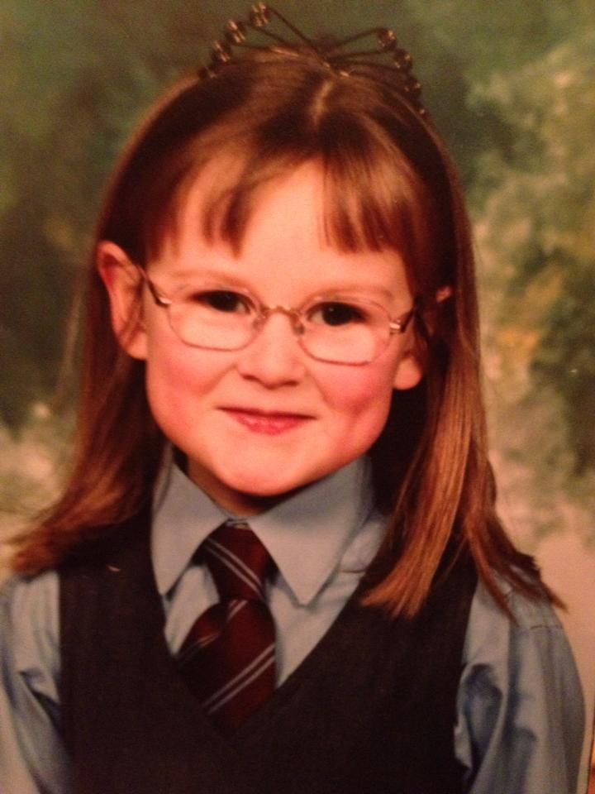
Let’s Go Back…
Who was your teacher?
Who/what do you remember playing with?
How did you react to starting school?
Whose P1 photo at AMPS could this be?
Memories of your first time meeting your classmates?
Any embarrassing moments?
P1
Who were your first friends?

Slide 7
P2
P3
P4
What were your favourite subjects or activities?
Who were your teachers?
Nativity play?
Did you have any funny moments?
Were there any exciting visitors to school?
Did you go on any school trips?

Slide 8
P5
P6
P7
Did your favourite subjects change?
Did you have any important roles, e.g. school council?
P6 Residential memories?
Any whole-school events?
Sports events?
Who were your teachers?
Did you join any after-school clubs?
Any embarrassing or funny moments?

Slide 9
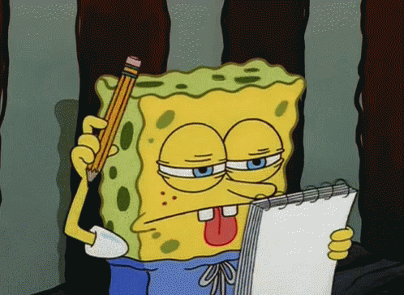
Let’s put some ideas on paper
Use bullet points to gather your memories from each school year in note form
WALT: Use bullet points to create clear, concise summaries of our ideas

Slide 10
Time to Write!
WALT: Look back at our time at Andrews and structure our memories into an engaging piece of recount writing that we can look back on
Introductory sentence or two
A short paragraph for each of your 7 years of primary school (2-4 sentences for each short paragraph)
Closing sentence or two
Past Tense
Chronological Order
New short paragraphs (2-4 sentences) for each school year
Take new sentences often
Use a thesaurus to find more expressive words

Slide 11
Take a new paragraph for each school year
Be written in the past tense
Display accurate spelling & grammar
Were you successful? Give yourself a WWW and an EBI!
Use a wide vocabulary to retell fond memories
Be written in chronological order
A successful “Looking Back” piece will…

Slide 12
Now for the Really Important part!
Now that you’ve written your “looking back as we move on” recount of your time at Andrews, share it with us!
Choose 3-4 memories you particularly like
Video yourself (preferably wearing your new AMPS Leavers hoodie!) telling us the memory (send separate video clip of each memory if possible!)
We will use 1-2 of each pupil’s memories to try to get an even spread of P1-P7 memories from everyone as part of our leavers’ yearbook video.
If you would like us to check over it before you video your memories, feel free to email us a copy and underline the memories you wish to read out on video!

Slide 13
Finally...
We would love you to send us a photograph of yourself at home so we can use it in a P7 montage. ALso, if you have any old, younger photos of you in your uniform, those would be really fun to include in our yearbook video too!
To SUmmarise, we need from you:
3-4 video clips of you reading out your AMPS memories
A photo of you recently at home
Any older photos of you at Andrews
(& Your “Looking Back as we Move On” recount writing if you’d like to share it with us or if you need anything checked over)

