Slide 1
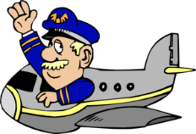
Captain Andrews’
Flight Experience…
…Lesson 5
DRAG

Slide 2
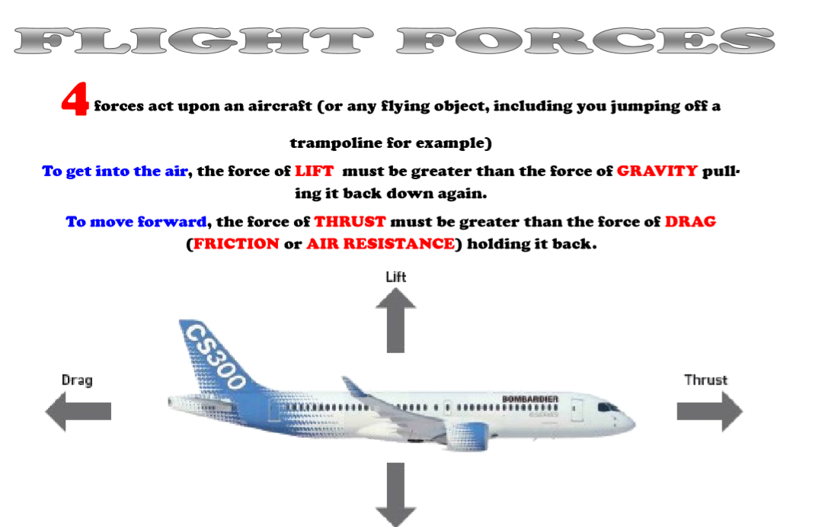

Slide 3
The forces of
FLIGHT
DRAG

Slide 4
The forces of
FLIGHT
WALT:
To know that a force called ‘drag’ acts against the free movement of an aircraft.

Slide 5
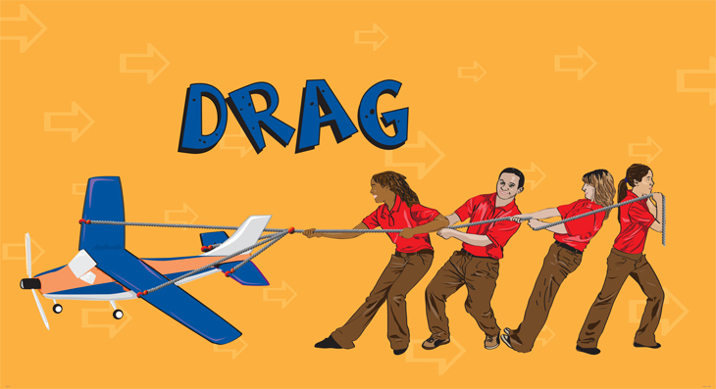
Drag is a type of force which always acts against the movement of an object.

Slide 6
It’s a type of friction and is also known as air resistance.
Changing the shape of the moving object can reduce air resistance / drag.
Acting against the forward movement of an object, means it slows it down.

Slide 7
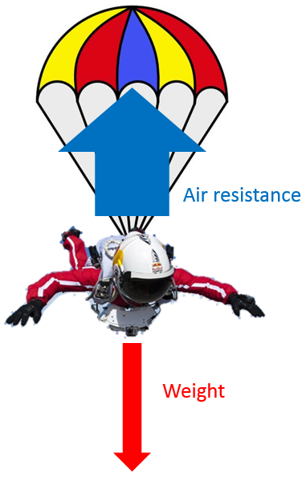
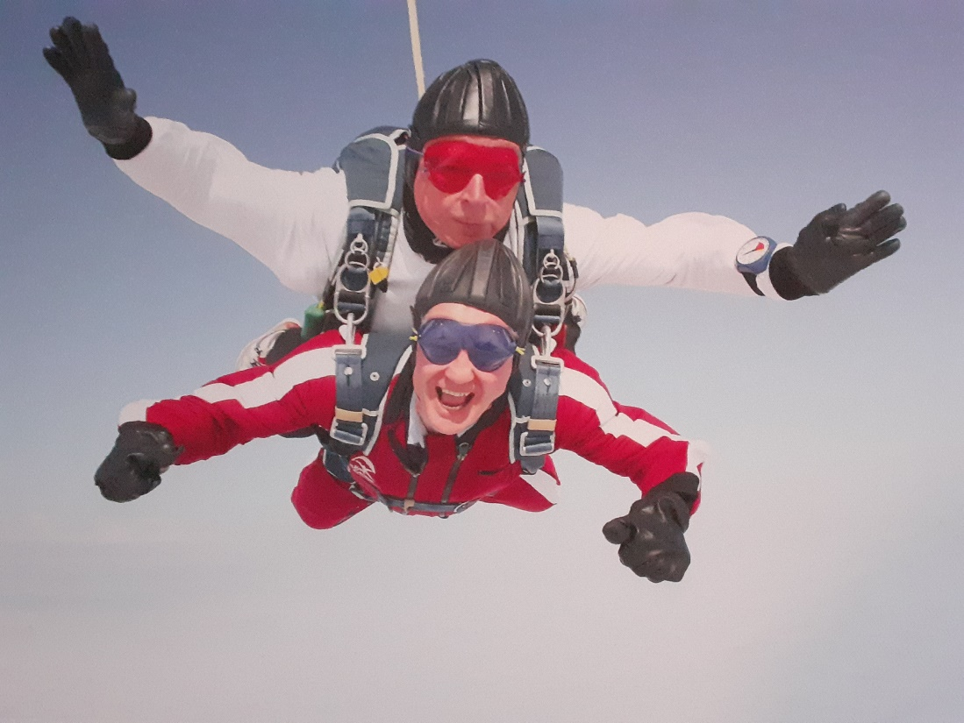
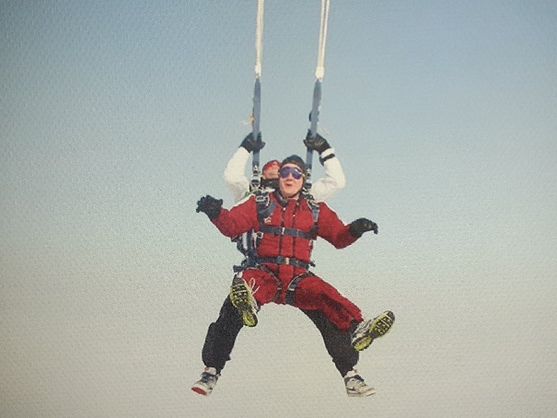
Sometimes, however, this can be very useful!

Slide 8
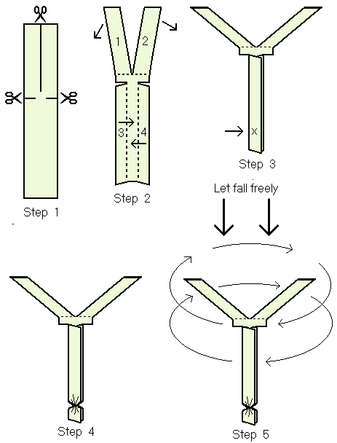
For today’s experiment you’ll need:
The ‘gyrocopter’ templates
A timing device (stopwatch, watch with a second hand, phone stopwatch)
Resource sheet for recording.

Slide 9
It is air resistance (drag) that will determine how quickly the spinner, or any object falls – not its size or how heavy it is.
No air (that’s called a vacuum) no drag.
BUT THAT’S FOR THE FINAL LESSON!

Slide 11
The forces of
FLIGHT
WALT:
To know that a force called ‘drag’ acts against the free movement of an aircraft.

Slide 12
Captain Andrews’
Flight Experience…
…Lesson 5
DRAG

