Slide 2
Teacher Notes
Play this game while playing some of the children's favourite songs.
Have all children standing up.
Select a child to pick a number on the dance move generator page.
It will randomly take them to a slide that shows a dance move.
Complete this move for 8 beats then the PowerPoint will return back to the dance move generator.
Select another number and then repeat to create a fun, random sequence of movements.

Slide 3
Pick a Number
1
2
3
4
5
6
7
8
9
10
11
12

Slide 4
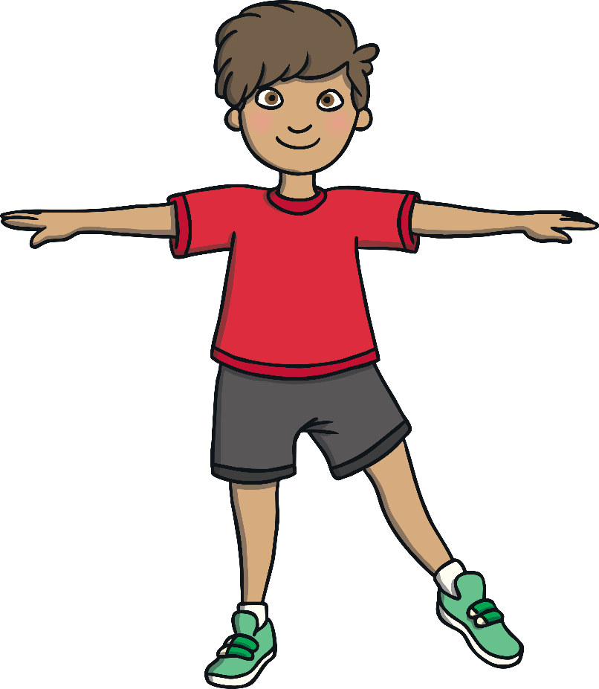
Home
Side Step
Take one step to the side and bring your other foot over to join it.
Step to the other side and bring your foot to join it.

Slide 5
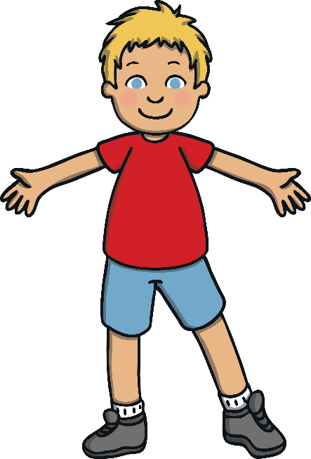
Home
Side Step With Claps
Keep side stepping.
Raise your arms and clap above your head when your feet come together at each side.
When you are stepping bring your hands back to your sides.
Step with arms down
Join feet together and clap
Step back to the other side and arms down
Join feet together and clap

Slide 6
Home
Jump
Feet together.
Jump forwards and backwards.
Punch high in the air while you jump, alternating the hand you punch with.

Slide 7
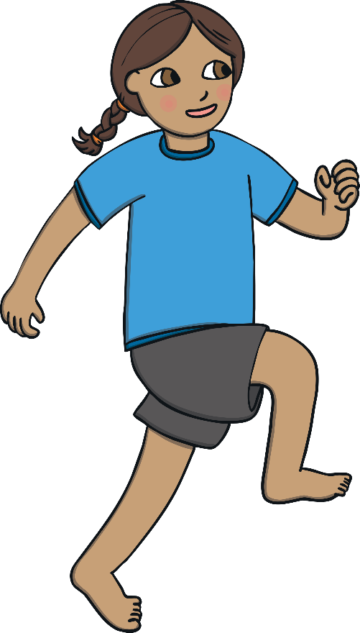
Home
High Knees
Run on the spot while trying to lift your knees as high as you can on each step.
With both hands, punch out in front of you then return your arms to your side. Keep repeating as you do high knees.

Slide 8
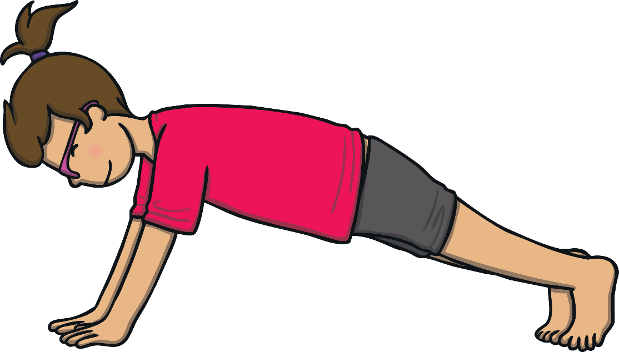
Home
Push Ups
Go onto all fours, with your body not touching the ground.
Have your hands under your shoulders.
Bend your arms to bring your body closer to the ground then straighten them again.
Continue going down and up.
For a simpler push up, put your knees on the ground and do the same movement.

Slide 9
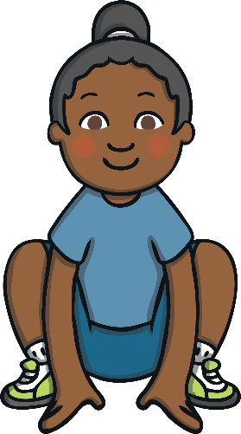
Home
Frog Jump
Crouch down with your hands touching the floor in-between your legs.
Jump straight up in a pencil jump.
Land and crouch back down.

Slide 10
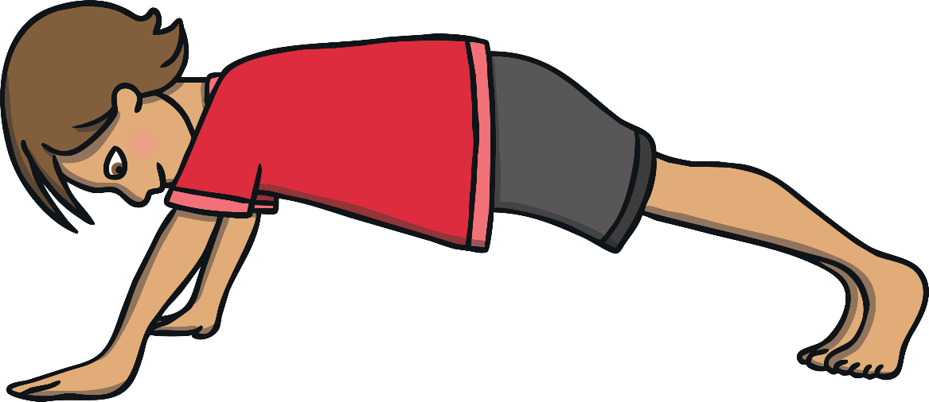
Home
Plank
Go onto all fours, with your body not touching the ground.
Place your forearms on the ground so that there is a 90 degree angle at your elbow.
Hold this position without raising or dropping your bottom.
Your body should be as straight as possible.
For a simpler plank, put your knees on the ground.

Slide 11
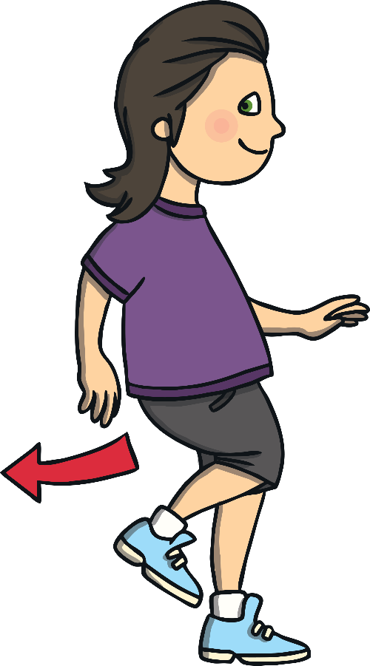
Home
Box Step
You are going to take four steps to make the shape of a square on the floor.
Step forward and bring feet together.
Step to the side and bring feet together.
Step backwards and bring feet together.
Step back to your original starting position and bring feet together.
Wave you arms as you go!

Slide 12
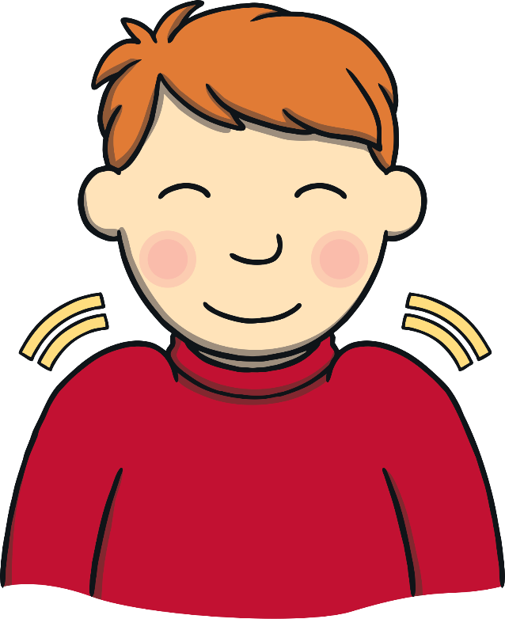
Home
Shimmy
Side step and bring feet together.
While side stepping, have your arms out to the side, in line with your shoulders and shake your shoulders forward and back.
Side step back to your original position while doing some more shoulder shimmies!

Slide 13
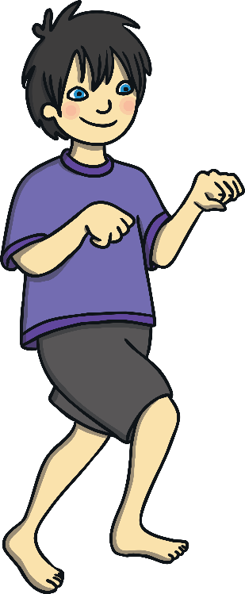
Home
Gallop
Take three large, galloping steps to the side.
It should be quicker than a side step and should be like skipping.
While you move swing both arms together, round in a circle in front of your body.
Take three galloping steps back and swing arms in a circle in the opposite direction.

Slide 14
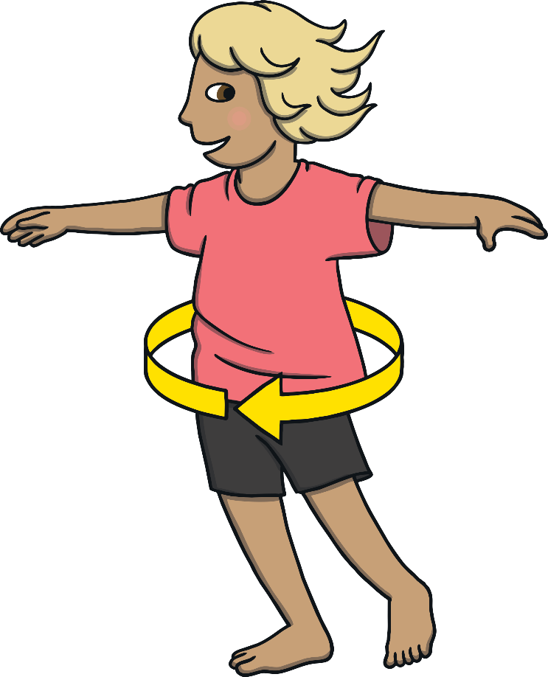
Home
Spin!
Hold your arms out to the side and spin on the spot.

Slide 15
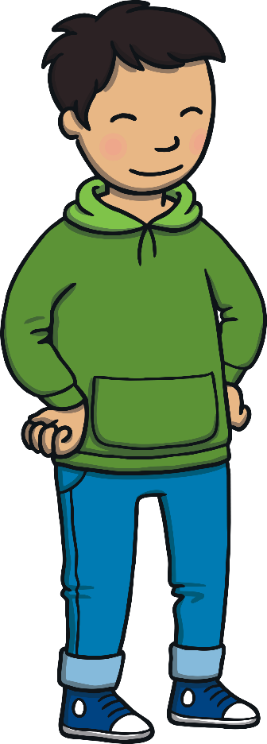
Home
Sway!
Put your hands on your hips.
Sway your hips from side to side.

