Slide 2
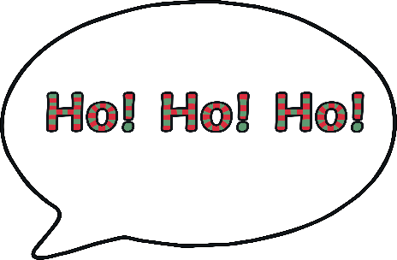
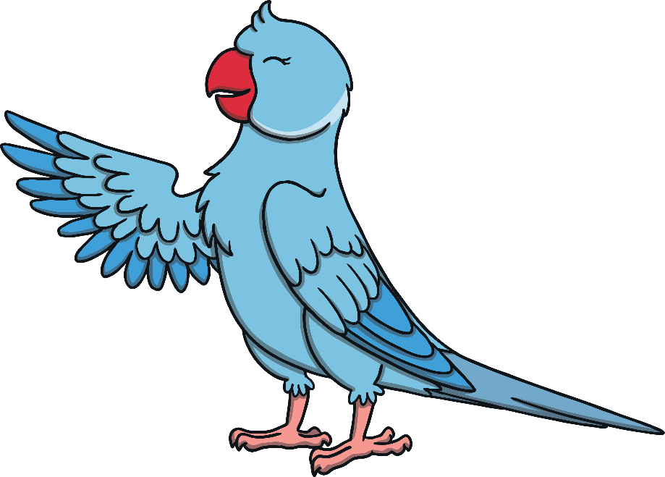
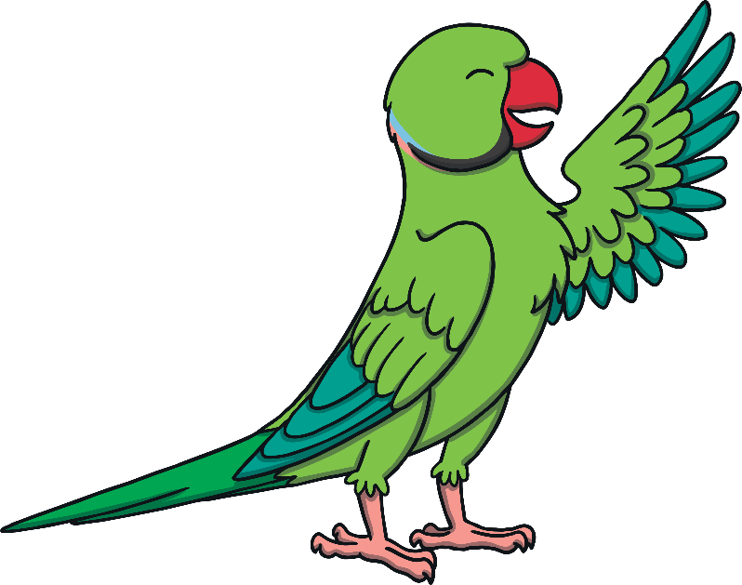
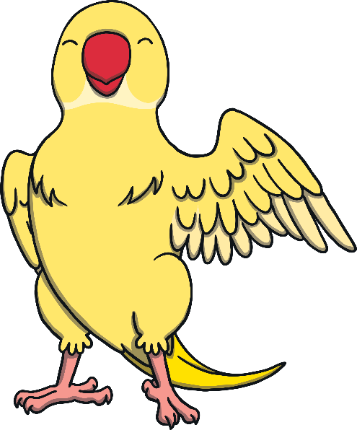
The Phonics Parrots
These are the Phonics Parrots.
They love to carefully copy sounds that they hear.
Hello, I’m called Pip.
Hi, my name is Peg.
Hello, I’m Pat.

Slide 3
What Do I Do?
Listen to your teacher say each sound and then copy it, like the Phonics Parrots do.
Look at the letter on the screen as you say each sound.

Slide 4
s

Slide 5
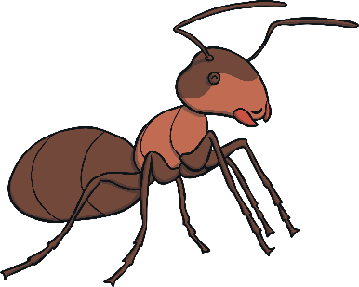
a

Slide 6
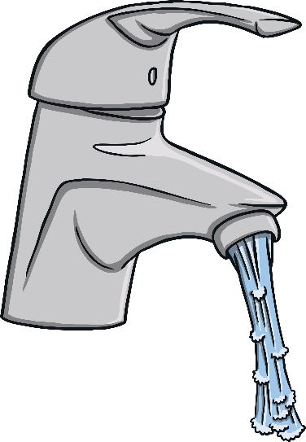
t

Slide 7
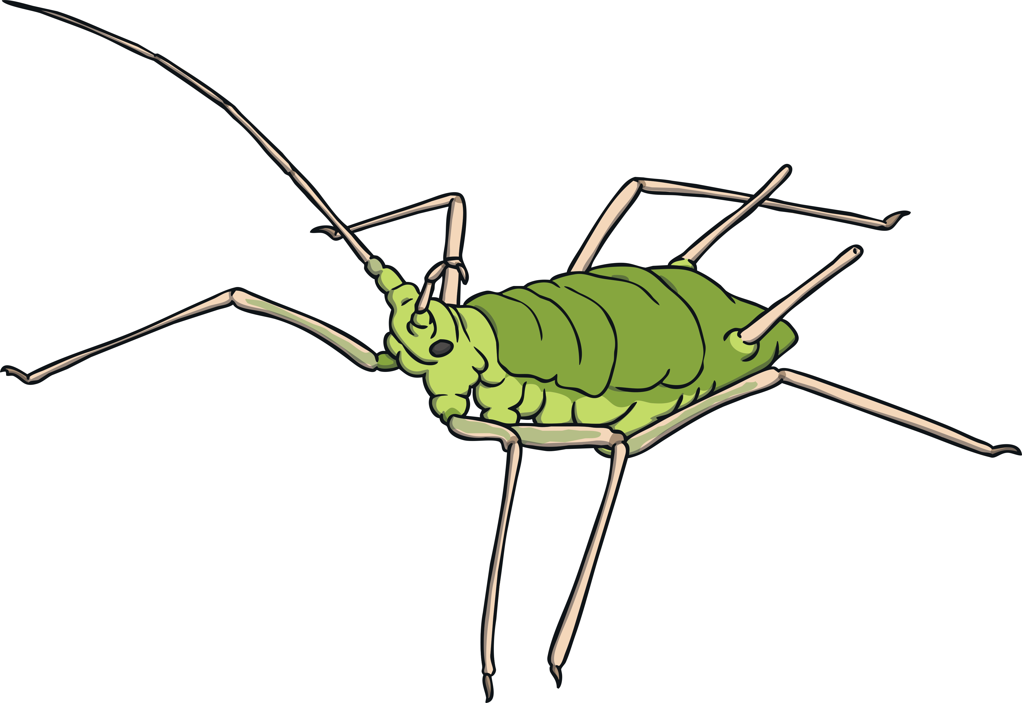
i

Slide 8
p

Slide 9
n

Slide 10
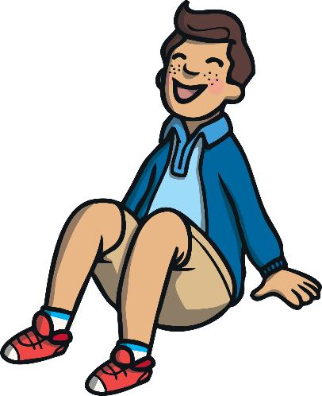
Word Building
Click the correct sounds in the right order, to spell the word.
t
a
s

Slide 11
Word Building
Click the correct sounds in the right order, to spell the word.
a
t
P

Slide 12
Word Building
Click the correct sounds in the right order, to spell the word.
p
a
i
s
t
n

Slide 13
Word Building
Click the correct sounds in the right order, to spell the word.
s
t
n
a
p
i

Slide 14
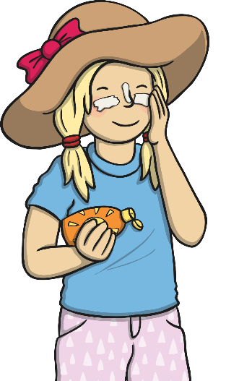
Word Building
Click the correct sounds in the right order, to spell the word.
s
t
p
n
i
a

Slide 15
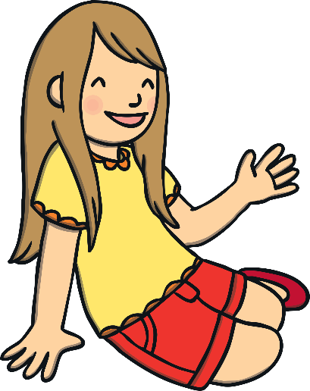
Word Building
Click the correct sounds in the right order, to spell the word.
a
s
t
i
p
n

Slide 16
Word Building
Click the correct sounds in the right order, to spell the word.
s
t
p
n
i
a

Slide 17
Word Building
Click the correct sounds in the right order, to spell the word.
p
n
t
s
i
a

Slide 18
Word Building
Click the correct sounds in the right order, to spell the word.
s
a
t
i
n
p

Slide 19
Word Building
Click the correct sounds in the right order, to spell the word.
s
p
n
t
a
i

Slide 20
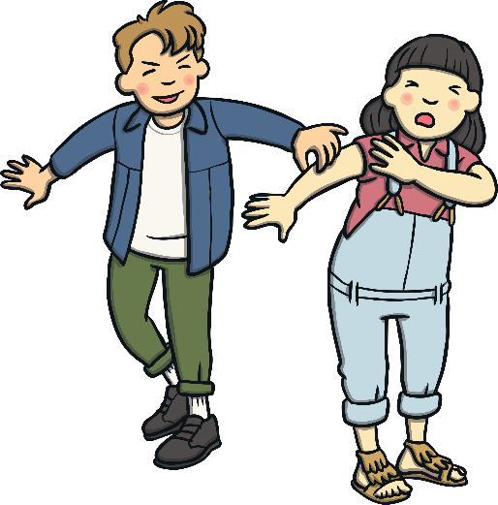
Word Building
Click the correct sounds in the right order, to spell the word.
s
t
n
p
i
a

Slide 21
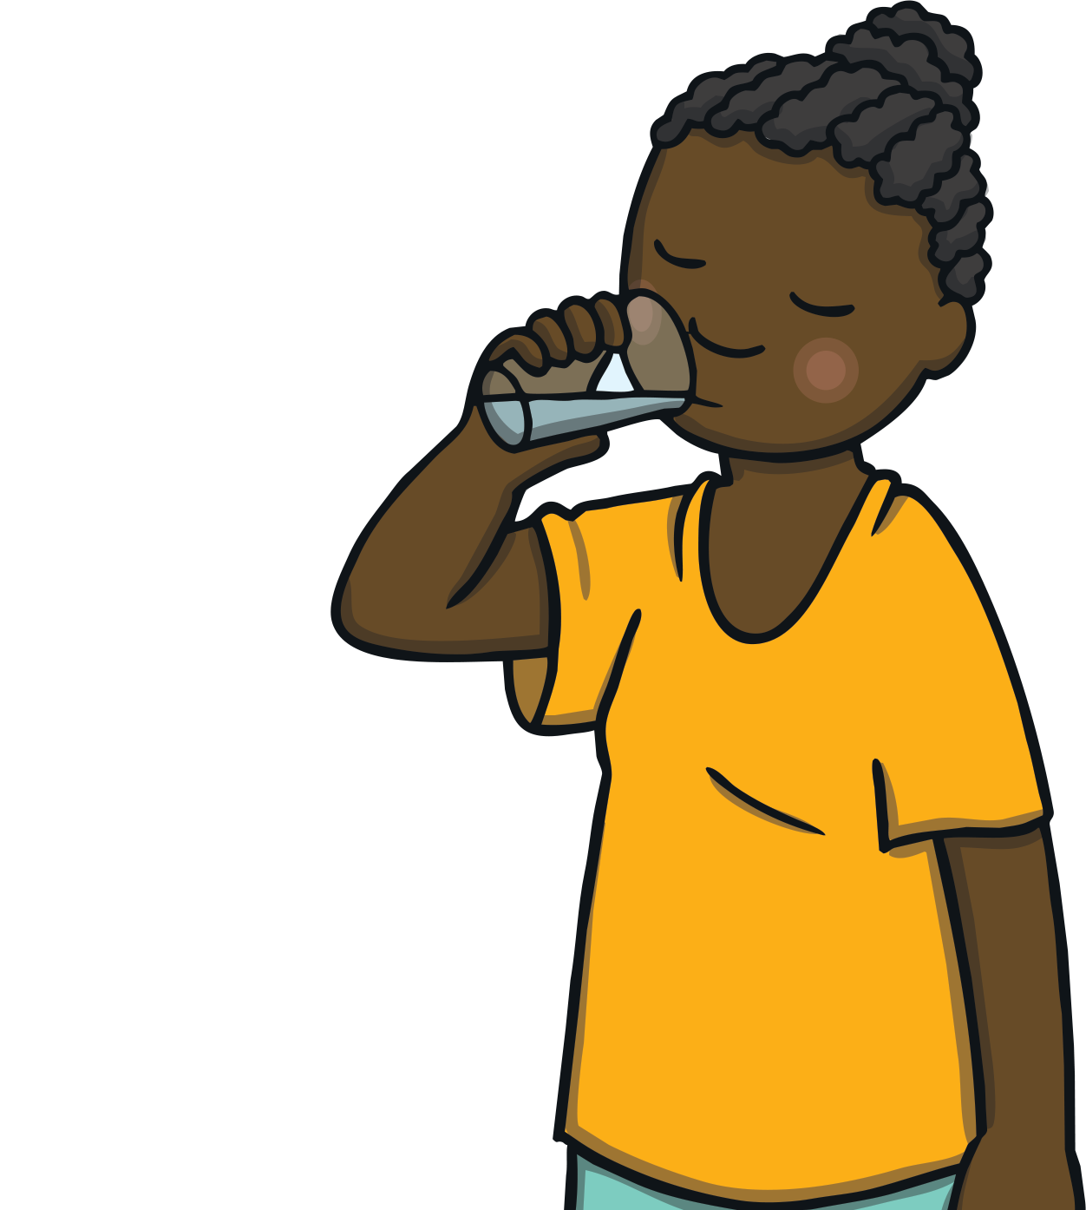
Word Building
Click the correct sounds in the right order, to spell the word.
s
p
n
a
t
i

Slide 22
Word Building
Click the correct sounds in the right order, to spell the word.
s
p
i
t
a
n

Slide 23
Word Building
How many two-letter words can you build using these letters?
t
s
a
p
n
i

Slide 24
Well Done!
Great work! Now, you are ready to move on to new sounds.
The next PowerPoint looks at:
m, o, c, f, r, u, d, h, g, k, b
and the sounds you have already worked with.

