Slide 1
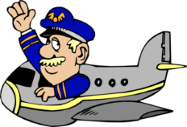
Captain Andrews’
Flight Experience…
…Lesson 4
THRUST

Slide 2
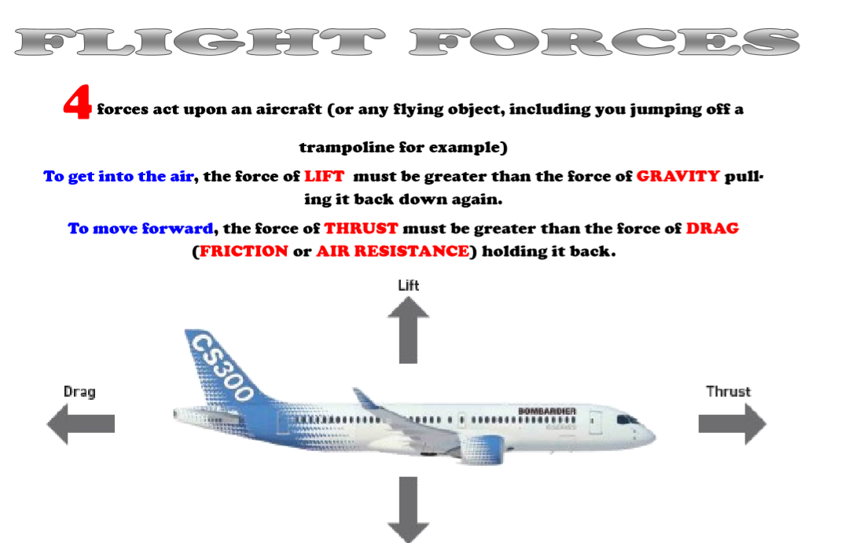

Slide 3
The forces of
FLIGHT
THRUST

Slide 4
The forces of
FLIGHT
WALT:
To know that a force called ‘thrust’ helps an aircraft to fly

Slide 5
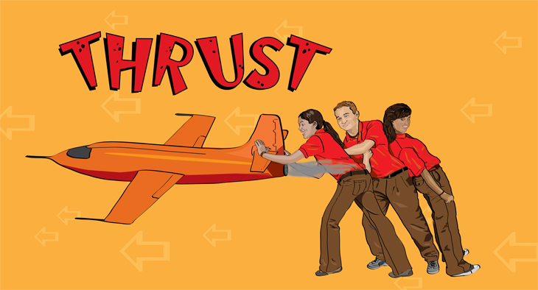
Thrust is a forward PUSH force.
It’s what keeps the object moving forward

Slide 6
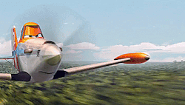
The forward thrust in an aircraft is supplied by the propeller or the jet engine

Slide 7
It pushes (a force, of course) the aircraft through the air…
… but it must be greater than the ‘drag’ force holding it back!

Slide 8
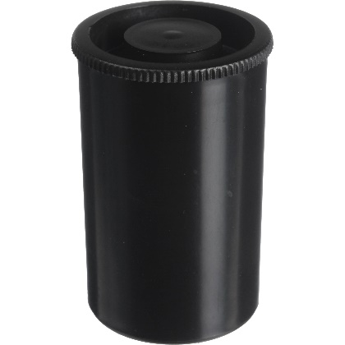
For today’s first experiment you’ll need:
A soluble vitamin tablet
Water
A small container with a tight fitting lid (you could use the vit tablet tube)
Alternatively, you can watch here.

Slide 9
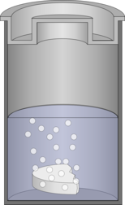
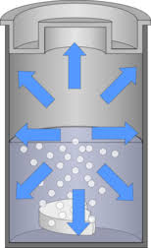
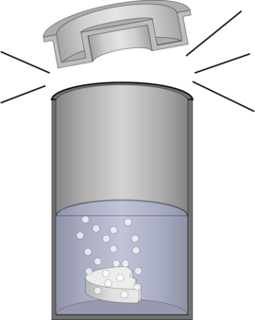
Tab in water with lid closed
Thrust
lifts
lid
Pressure
(force)
builds

Slide 10
Or try this. You can print off the template mouse.

Slide 12
The forces of
FLIGHT
WALT:
To know that a force called ‘thrust’ helps an aircraft to fly

Slide 13
Captain Andrews’
Flight Experience…
…Lesson 4
THRUST

