Slide 1
Persuasive Writing
WALT: Recognise types of persuasive writing, and plan and write our own persuasive advertisement

Slide 2
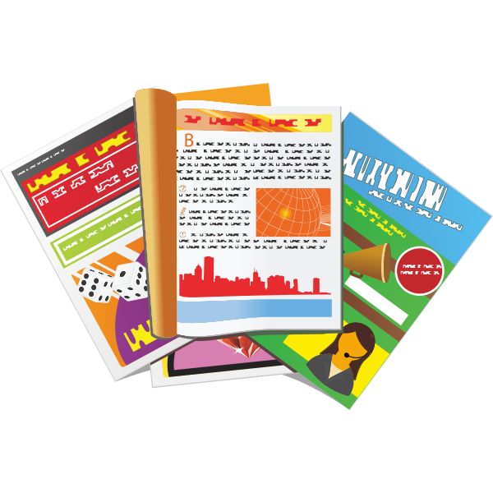
What is Persuasive Writing?
Persuasive writing is a genre of writing which intends to convince the reader to believe in an idea or opinion and to do an action.
It comes in lots of different forms…
https://www.youtube.com/watch?v=hD9arWXIddM&app=desktop

Slide 3
What is Persuasive Writing?
If it is trying to persuade or convince the reader to believe or do something, then it’s...
Persuasive Writing
Let’s look at a few examples of different types of persuasive writing!

Slide 4
A persuasive letter
What is this letter trying to persuade the reader to believe or do?
Can you find some sentences or phrases that are particularly persuasive?

Slide 5
A persuasive letter
What is this letter trying to persuade the reader to believe or do?
Can you find some sentences or phrases that are particularly persuasive?

Slide 6
A persuasive Article
Remember our “balanced argument” article on whether single-use plastic should or shouldn’t be banned? Although we made sure we showed both sides of the argument, that was still persuasive writing! What did you try to persuade your readers to believe or do by the time you came to your conclusion?
What is this article trying to persuade the reader to believe or do?
Can you find some sentences or phrases that are particularly persuasive?
(See next slide for rest of article)

Slide 7
A persuasive Article
Remember our “balanced argument” article on whether single-use plastic should or shouldn’t be banned? Although we made sure we showed both sides of the argument, that was still persuasive writing! What did you try to persuade your readers to believe or do by the time you came to your conclusion?
What is this article trying to persuade the reader to believe or do?
Can you find some sentences or phrases that are particularly persuasive?

Slide 8
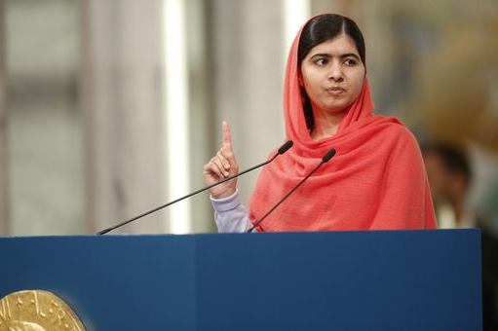
A persuasive Speech
“Why is it that countries which we call “strong” are so powerful in creating wars but so weak in bringing peace? Why is it that giving guns is so easy but giving books is so hard? Why is it that making tanks is so easy, but building schools is so difficult?
As we are living in the modern age, the 21st century and we all believe that nothing is impossible. We can reach the moon and maybe soon will land on Mars. Then, in this, the 21st century, we must be determined that our dream of quality education for all will also come true.”
Speeches are often given to a nation- or world-wide audience by leaders, politicians, activists and environmentalists among others.
What is this speech by Malala Yousafzai - the youngest recipient of a Nobel Peace Prize - trying to persuade the listener to believe or do?
Can you find some sentences or phrases that are particularly persuasive?
“So let us bring equality, justice and peace for all. Not just the politicians and the world leaders, we all need to contribute. Me. You. It is our duty.”
“So we must work … and not wait. I call upon my fellow children to stand up around the world. Dear sisters and brothers, let us become the first generation to decide to be the last. The empty classrooms, the lost childhoods, wasted potential-let these things end with us.”

Slide 9
A persuasive Speech
“Why is it that countries which we call “strong” are so powerful in creating wars but so weak in bringing peace? Why is it that giving guns is so easy but giving books is so hard? Why is it that making tanks is so easy, but building schools is so difficult?
As we are living in the modern age, the 21st century and we all believe that nothing is impossible. We can reach the moon and maybe soon will land on Mars. Then, in this, the 21st century, we must be determined that our dream of quality education for all will also come true.”
Speeches are often given to a nation- or world-wide audience by leaders, politicians, activists and environmentalists among others.
What is this speech by Malala Yousafzai - the youngest recipient of a Nobel Peace Prize - trying to persuade the listener to believe or do?
Can you find some sentences or phrases that are particularly persuasive?
“So let us bring equality, justice and peace for all. Not just the politicians and the world leaders, we all need to contribute. Me. You. It is our duty.”
“So we must work … and not wait. I call upon my fellow children to stand up around the world. Dear sisters and brothers, let us become the first generation to decide to be the last. The empty classrooms, the lost childhoods, wasted potential-let these things end with us.”

Slide 10
A persuasive Speech
Rhetorical Questions
“Why is it that countries which we call “strong” are so powerful in creating wars but so weak in bringing peace? Why is it that giving guns is so easy but giving books is so hard? Why is it that making tanks is so easy, but building schools is so difficult?
As we are living in the modern age, the 21st century and we all believe that nothing is impossible. We can reach the moon and maybe soon will land on Mars. Then, in this, the 21st century, we must be determined that our dream of quality education for all will also come true.”
What are these type of questions called?
“So let us bring equality, justice and peace for all. Not just the politicians and the world leaders, we all need to contribute. Me. You. It is our duty.”
These are questions which are being asked for effect, and don’t require an answer.
They are particularly useful in Persuasive Writing!
“So we must work … and not wait. I call upon my fellow children to stand up around the world. Dear sisters and brothers, let us become the first generation to decide to be the last. The empty classrooms, the lost childhoods, wasted potential-let these things end with us.”

Slide 11
A persuasive Advert
What is this advert trying to persuade the reader to believe or do?
Can you find some sentences or phrases that are particularly persuasive?

Slide 12
A persuasive Advert
Here’s another one!
What is this advert trying to persuade the reader to believe or do?
Can you find some sentences or phrases that are particularly persuasive?

Slide 13
A persuasive Advert
One more!
What is this advert trying to persuade the reader to believe or do?
Can you find some sentences or phrases that are particularly persuasive?

Slide 14
The type of persuasive writing we will be planning and creating is...
A Persuasive Advert
It’s entirely up to you which type of product you would like to advertise! Here are a few ideas:
Food Product - Holiday Resort - Charity Organisation - Restaurant - An Event A Game - Beauty/Cosmetic Product - Theme Park
Task 1: Complete the “What Shall I Advertise?” Planning Sheet (Find the PDF on the school website along with this PowerPoint)

Slide 15
Features of a Persuasive Advert
Now that you’ve decided on what you’re advertising,
who your target customer is,
and the name of your product,
let’s consider all the features we need to include in our advertisement to make it appeal to the reader...

Slide 16
Features of a Persuasive Advert
Adjectives and Adverbs to describe how appealing your product is
Questions to encourage the reader to relate personally to the product
Repetition of the brand name
Imperative verbs (“bossy” verbs) telling the reader what they should do
Special offers to entice to reader to buy
Reviews from other previous customers, to show how reliable and great the product is

Slide 17
Features of a Persuasive Advert
Alliteration can really make your advert stand out
A slogan or catchy phrase is a great feature to include
Images of how the product looks will allow your reader to imagine it
Rhetorical Questions will put ideas into your reader’s mind

Slide 18
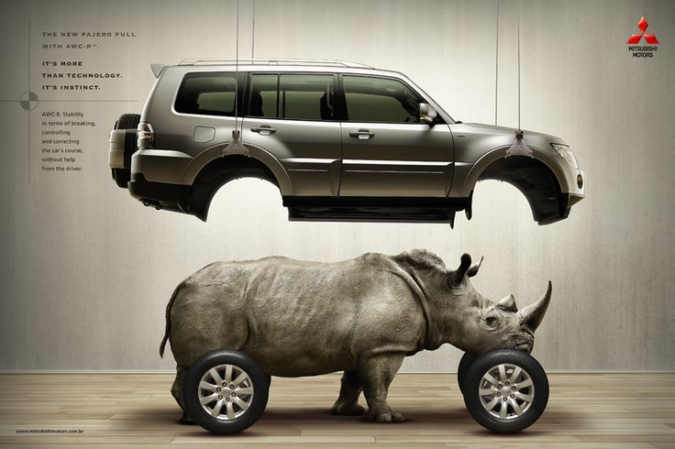
Features of a Persuasive Advert
Similes and Metaphors are used really effectively in persuasive adverts. Will you include some in yours?

Slide 19
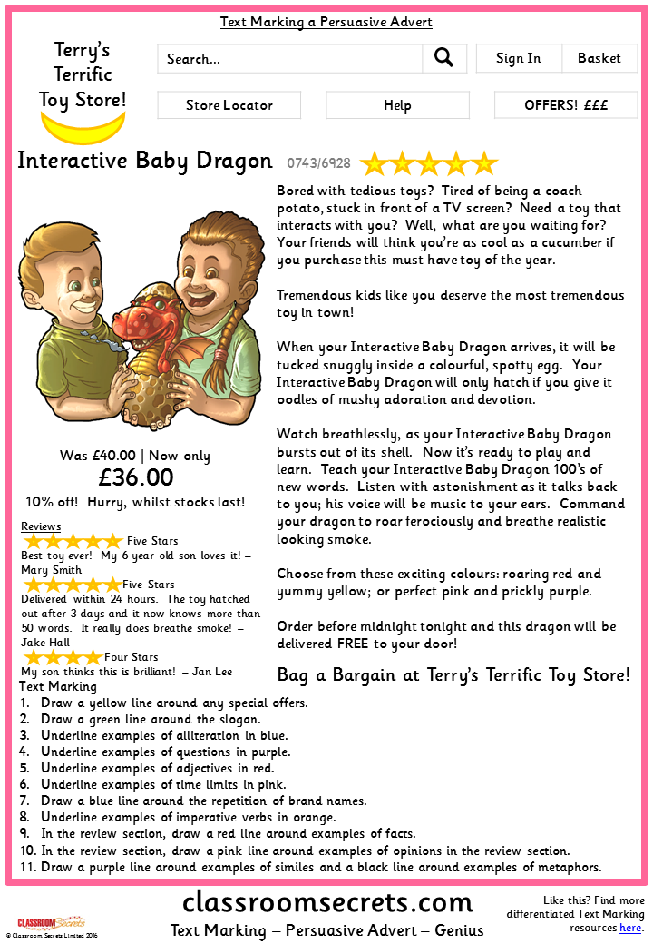
Features of a Persuasive Advert
Task 2: Can you find the key features of a persuasive advert by text marking this one?

Slide 20
Very Vast Vocabulary
Enticing Adjectives & Adverbs
List of Alliteration
Suitable Slogans
Along with eye-catching images, bold titles and an interesting layout,
words
are what will really entice your reader and make them want to buy your product!
Task 3: Create three vocabulary lists based on the headings to the right. Then, judge your ideas by ordering your lists from “best” ideas to “worst” ideas. Use your best ideas for task 4!

Slide 21
The Real Deal
Have I included…
Enticing Adjectives & Adverbs
Rhetorical Questions
A clear, bold title of the brand name
Repetition of the brand name throughout
Imperative “bossy” verbs
The price of your product
Special Offers
Reviews from previous customers
Alliteration
A slogan or catchy phrase
Metaphors and Similes
A colourful, eye-catching layout!
The moment is here - you’re ready to create your advertisement!
Task 4: Use the checklist to the right to create an advertisement for your product which will appeal to your target customer
You may create a handwritten advert, or use any computer programs or iPad apps you are familiar with!

Slide 22
ICT Extension Activities
Can you complete some ICT extension activities based on your advert?
Bring it to Life:
Use iMovie to produce a TV version of your advert with your brand name and slogan read aloud, real customers telling us how brilliant the product was, and some background music!
Self-Assess your Work:
Photograph your advert and position it on a BookCreator book. Annotate your work by circling and underlining key features, then add an arrow and a voice clip explaining what you did and how this will convince your customer.
Video Tutorial & Review:
You are a customer who has purchased the product. Create a video tutorial on how to use it, and provide an honest review of how much you liked or disliked it and why.

