Slide 2
https://www.youtube.com/watch?v=CDrnuPj7xfs

Slide 3
Something I am glad I have learned at this school is…
Something I am looking forward to this year is ...
One thing I will try to do differently in future is ...
One thing I still feel I need help to do in school is ...
A concern I have this year is ...
As you come to the final term of P7, ask yourselves the following questions.

Slide 4
In a few months you will move on to your next school. How do you think this will affect you?
What will change?
What might change?
Who will be there to help?
What will stay the same?
What will they expect from me?

Slide 5
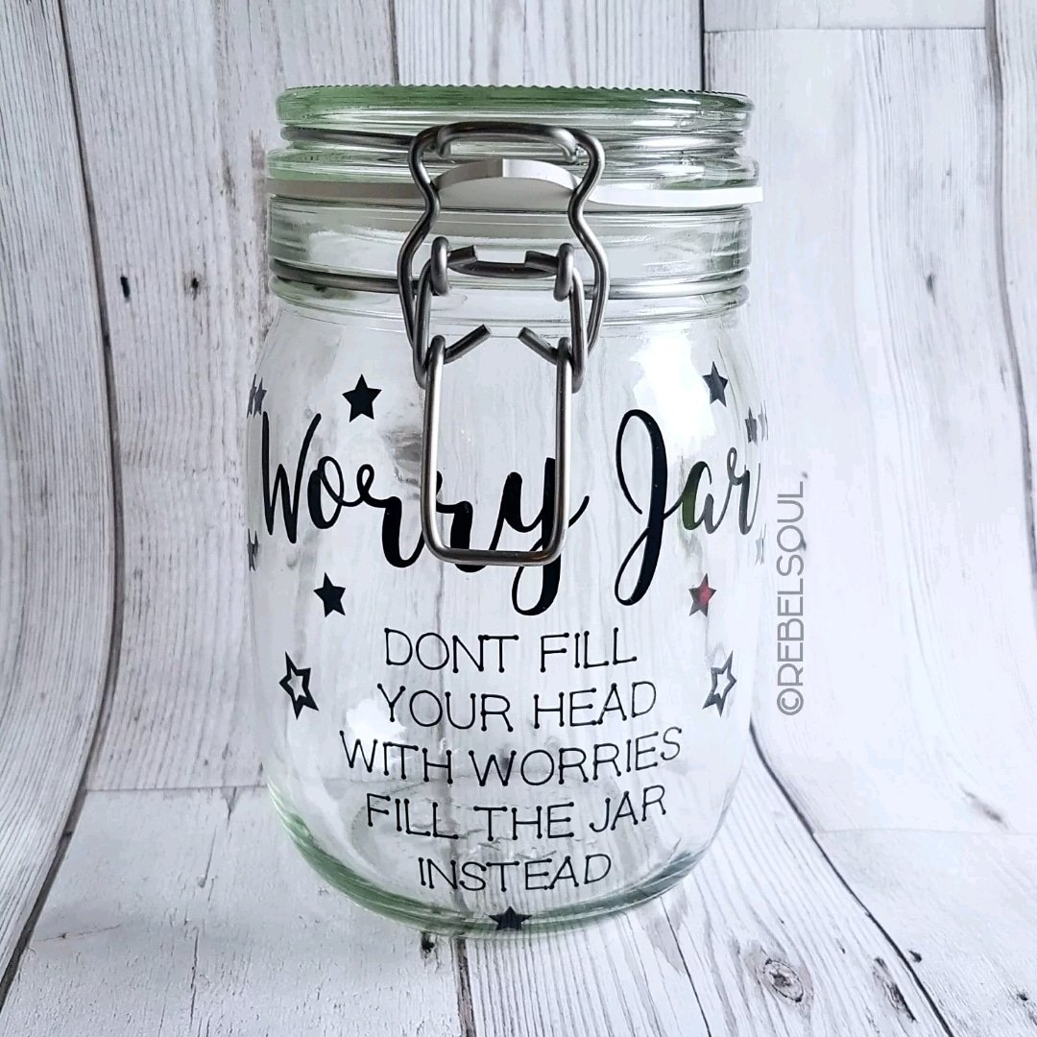
Don’t leave worries rattling around in your head. It may help to write them down and put them somewhere,
Now that you’ve expressed them, they’re out of your mind!
BUT it’s IMPORTANT to TALK!
Take a written worry and discuss it with an older sibling, parent or trusted adult…

Slide 6
Click on the image to watch the story.
OK, so it’s a picture book, but the story’s message is really important!

Slide 7
It is better to share a worry because someone might have a simple answer.
It is better to share the worry early so that it can be removed/lessened quickly.
Many people have the same worry but if you don’t talk about it, you’ll never know!

Slide 8
Read the following fictional story, the try to answer the questions for yourself.
You do not need to write the answers!

Slide 11
Are the representations of Elaine and Mary fair?
- Should Mary have continued to be friends with Elaine?
- Has she forgiven Elaine?
Should she forgive Elaine?
- Should she end her friendship with Elaine?
- Should Elaine end her friendship with Mary?
What does Mary need to do to feel better about herself?
- What do Mary and Elaine each need to do to manage the situation so that each person feels better?

Slide 12
you

Slide 17
EITHER: Get someone to draw around your body on an old piece of wall paper to make a life-sized outline of you.
OR: You can use the mini-template provided.
THEN: Write and/or draw positive things about yourself inside the body. Think of your qualities, achievements, talents and skills. If you feel like it, ask others to contribute positive statements about you to your drawing. BE PROUD of who you are.

Slide 18
Print off the head template and fill it with the dreams that you have for the future: how you would like to look, where you would like to be, what you would like to happen. You can draw or cut out images from magazines and newspapers to help.

Slide 19
You’ve now thought a lot about your skills, talents attitudes, hopes and aspirations.
You’ll still have all of these when you’re at a new school but you may have to apply them in a different set of circumstances.

