Slide 1
Weather and Climate Measuring the Weather

Slide 2
Learning Objective
To understand how weather instruments are used to measure the weather.
Success Criteria
To identify weather instruments and what they measure.
To explain which groups of people would find the weather forecast useful.

Slide 3
Starter
Unscramble these weather anagrams.
UPTERMTAREE
TEMPERATURE
IRAN
RAIN
SHINSNUE
SUNSHINE
DINW
WIND
COLDU
CLOUD
ARESURPRISE
AIR PRESSURE
Does your family own any weather instruments? What do they measure?

Slide 4
Starter
Unscramble these weather anagrams.
UPTERMTAREE
TEMPERATURE
IRAN
RAIN
SHINSNUE
SUNSHINE
DINW
WIND
COLDU
CLOUD
ARESURPRISE
AIR PRESSURE
Does your family own any weather instruments? What do they measure?

Slide 5
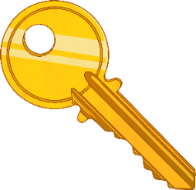
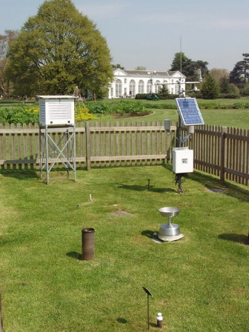
How Do We Measure the Weather?
Key Terms
Weather instruments are used to measure and record the weather.
Weather instruments can be found in weather stations on land. The Met Office has hundreds of weather stations all over the UK.
Have you ever seen a weather station?
This is a weather station in Kew Gardens, London. You can see the weather instruments inside the fence.
Photo © David Hawgood (cc-by-sa/2.0)

Slide 6
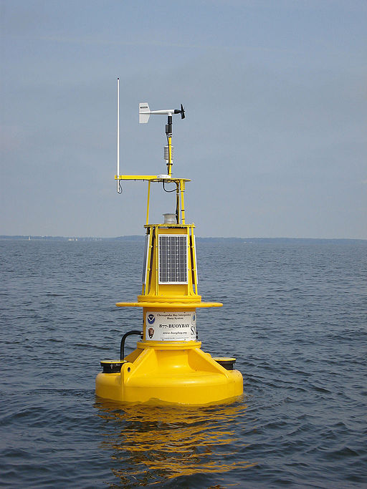
How Do We Measure the Weather?
Key Terms
Weather instruments are used to measure and record the weather.
Weather instruments are also found at sea. They are found on some ships, but mainly on weather buoys designed to monitor weather and sea conditions.
Photo © David Hawgood (cc-by-sa/2.0)

Slide 7
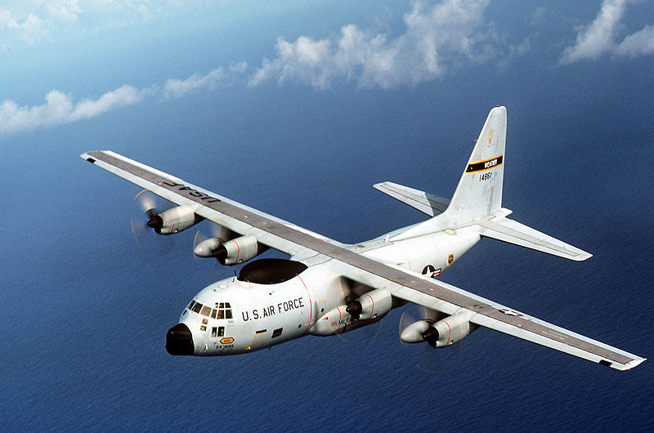
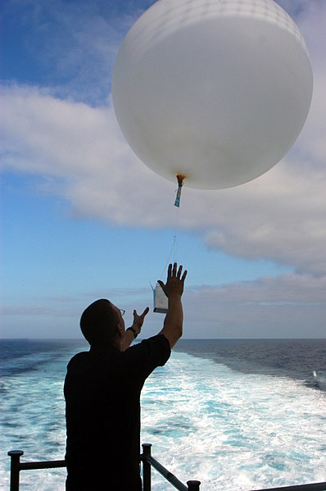
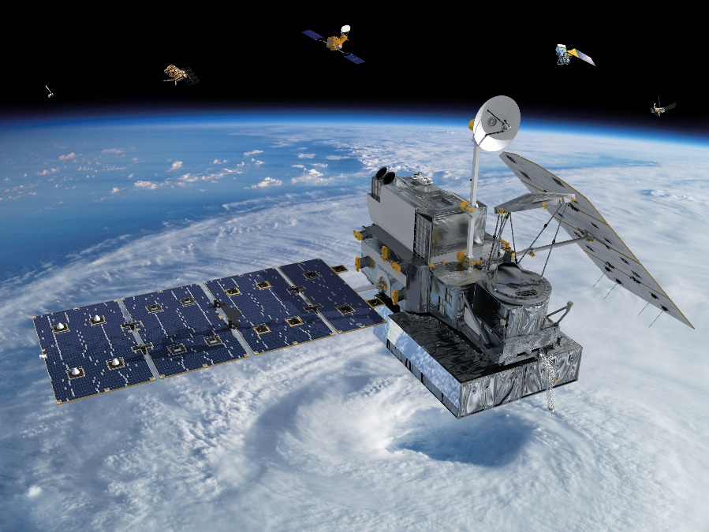
How Do We Measure the Weather?
Planes, weather balloons and satellites also have weather instruments to measure the weather away from the Earth’s surface.

Slide 8
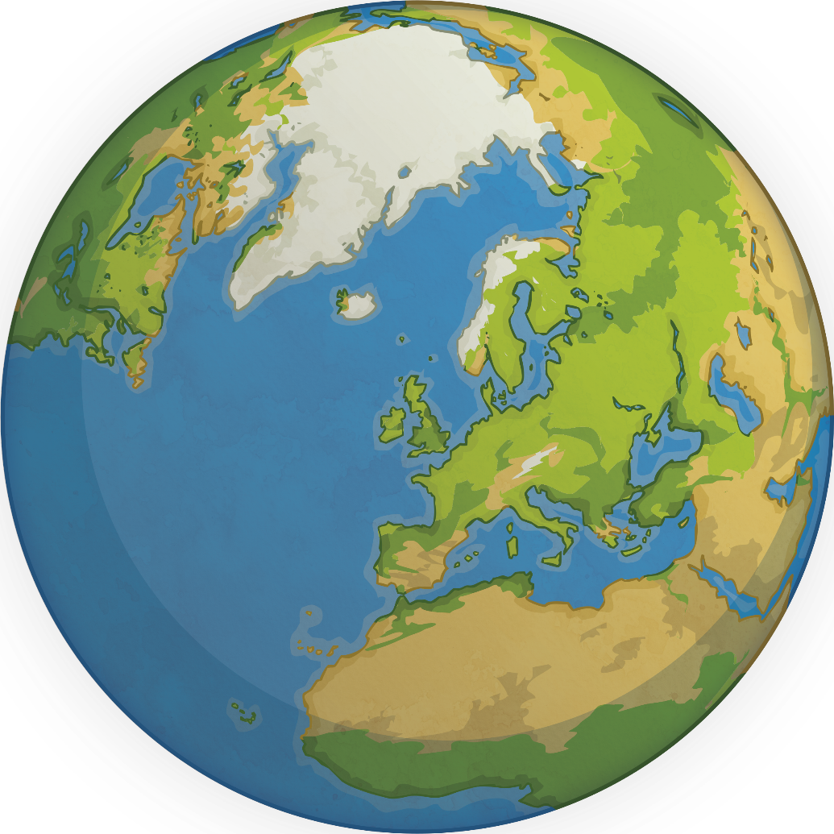
How Do We Measure the Weather?
Study the images of five different weather instruments. What do you think are the units of measurement?
Use this information to complete your Weather Instrument Activity Sheet.

Slide 9
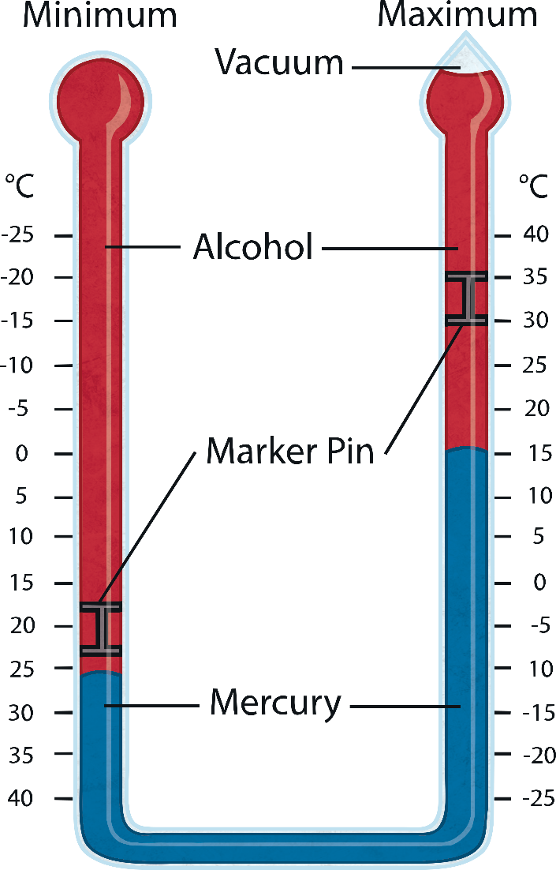
How Do We Measure the Weather?
A Max/Min thermometer
A Max/Min thermometer is a special thermometer which measures the maximum and minimum air temperature over a 24-hour period.
Unit: Degrees Celsius

Slide 10
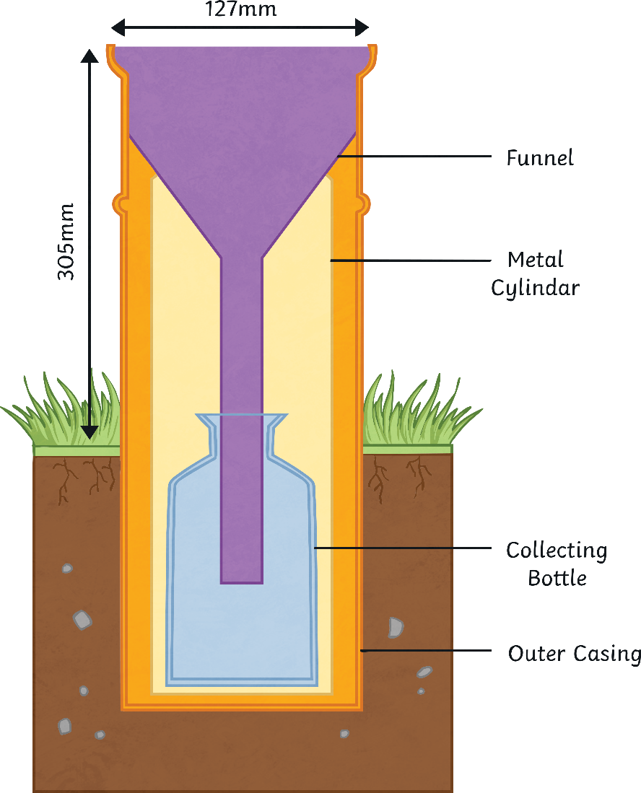
How Do We Measure the Weather?
rain gauge
A rain gauge measures the amount of precipitation (rain, sleet, hail or snow) that has fallen in a 24-hour period.
The rain gauge should always be placed in an open space away from trees and buildings.
Can you suggest why?
To prevent precipitation being intercepted (caught) by trees and buildings which would affect how much water is collected.
Unit: Millimetres

Slide 11
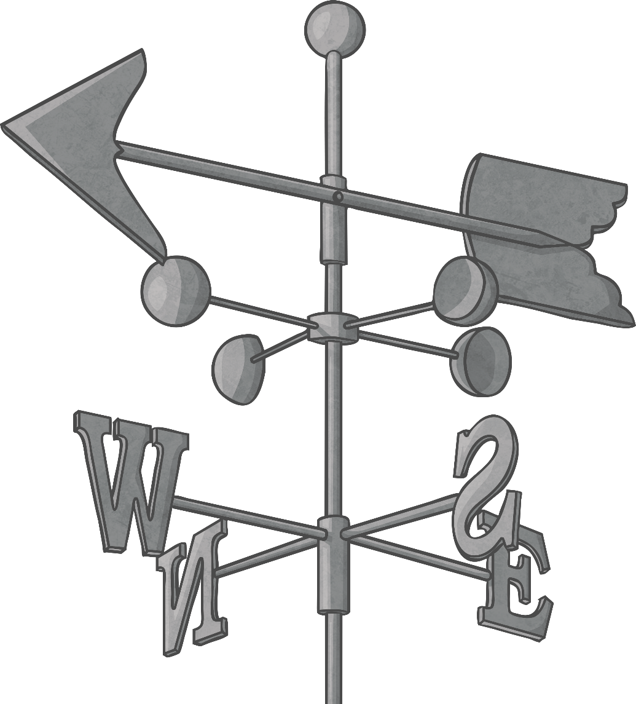
How Do We Measure the Weather?
wind vane
A wind vane shows the wind direction.
The arrow points in the direction the wind is blowing from.
What is the wind direction shown in the photo?
Westerly wind

Slide 12
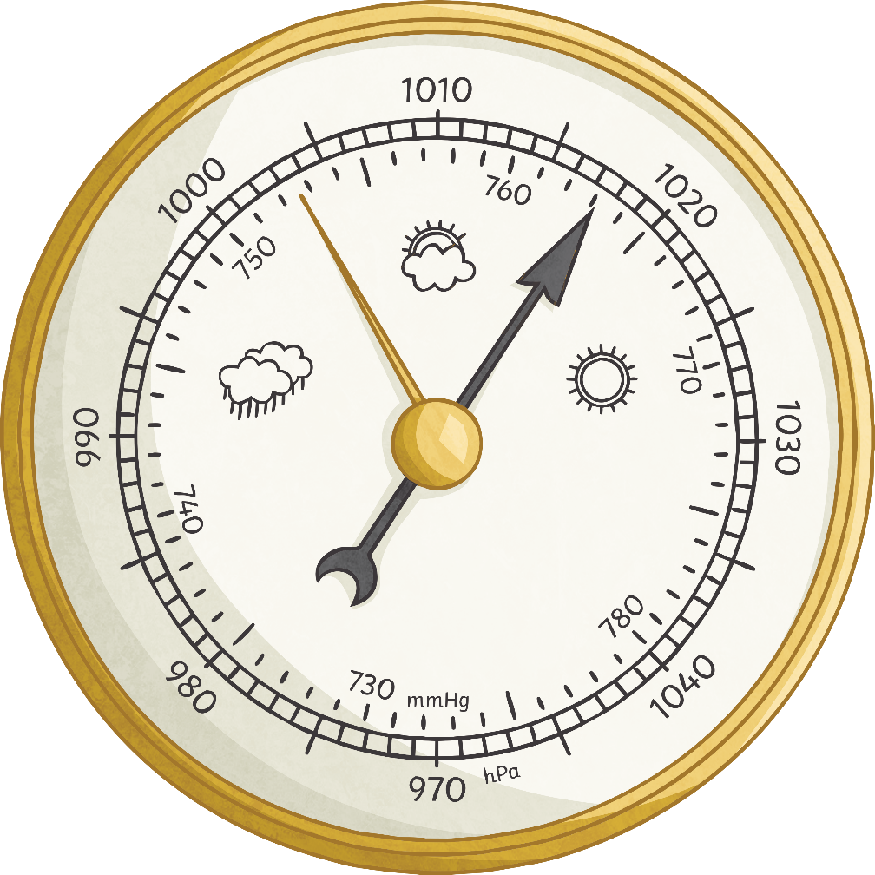
How Do We Measure the Weather?
barometer
A barometer measures air pressure. This is the force or weight of the air above us.
A high pressure reading means sunny and dry conditions.
A low pressure reading means stormy and wet conditions.
What air pressure is shown in this barometer?
Unit: mmHg

Slide 13
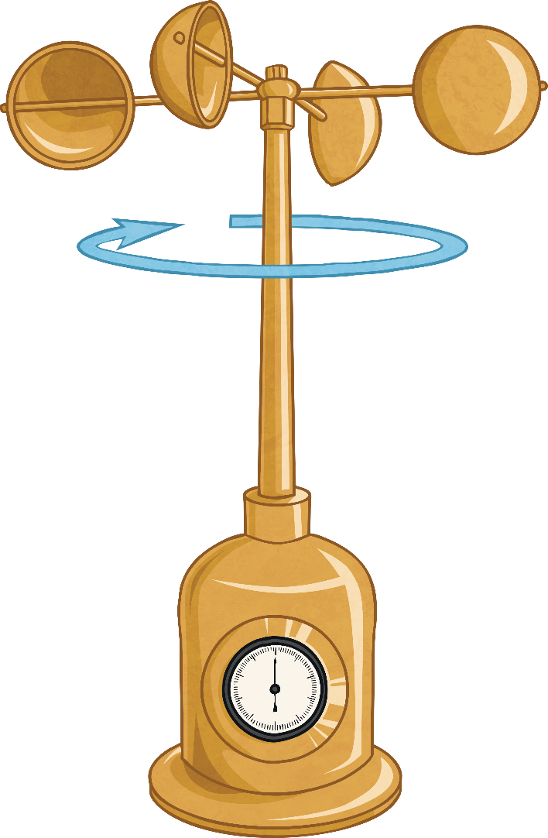
How Do We Measure the Weather?
anemometer
An anemometer is used to measure wind speed. The cups rotate in the wind and turn a vertical rod. The stronger the wind blows, the faster the cups and the rod spin. The anemometer counts the number of rotations which is used to calculate wind speed.
Unit: miles or km per hour

Slide 14
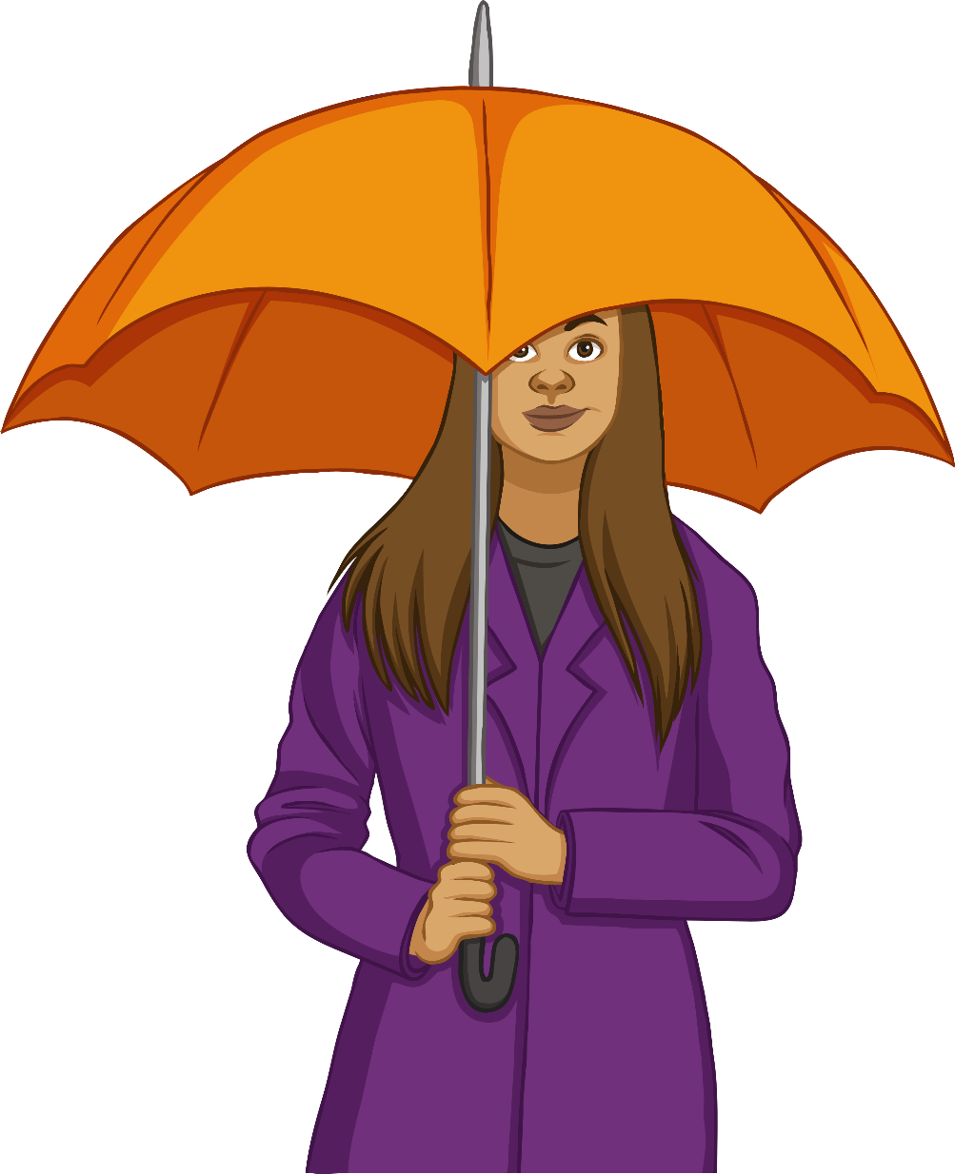
Weather Forecasting
Information from weather instruments and weather satellites is used to create a weather forecast.
weather forecast
a prediction of what the weather will be like in the next few hours, days, weeks or even months.
prediction
what someone thinks will happen.
Think of four different groups of people who would find a weather forecast useful.

Slide 15
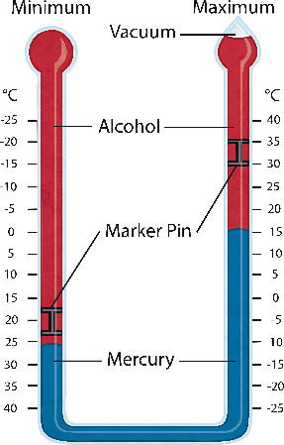
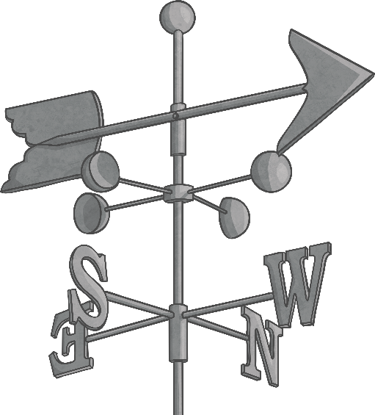
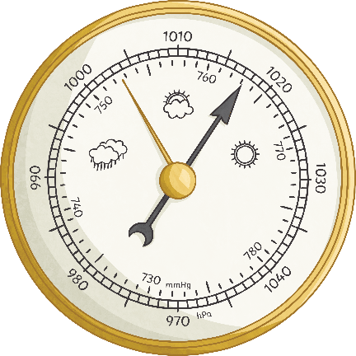
Name the Weather Instrument
Can you name the weather instruments and give one fact about each?
anemometer
Max/Min Thermometer
rain gauge
barometer
wind vane

Slide 16
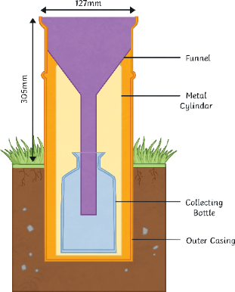
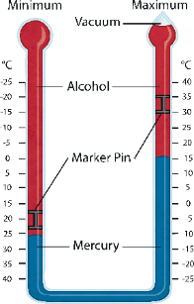
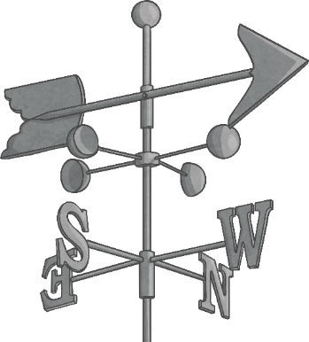
Name the Weather Instrument
Our weather instruments in school look very different. On your worksheet, link the pictures of these weather instruments to the ones we use and then label them.

