Slide 1
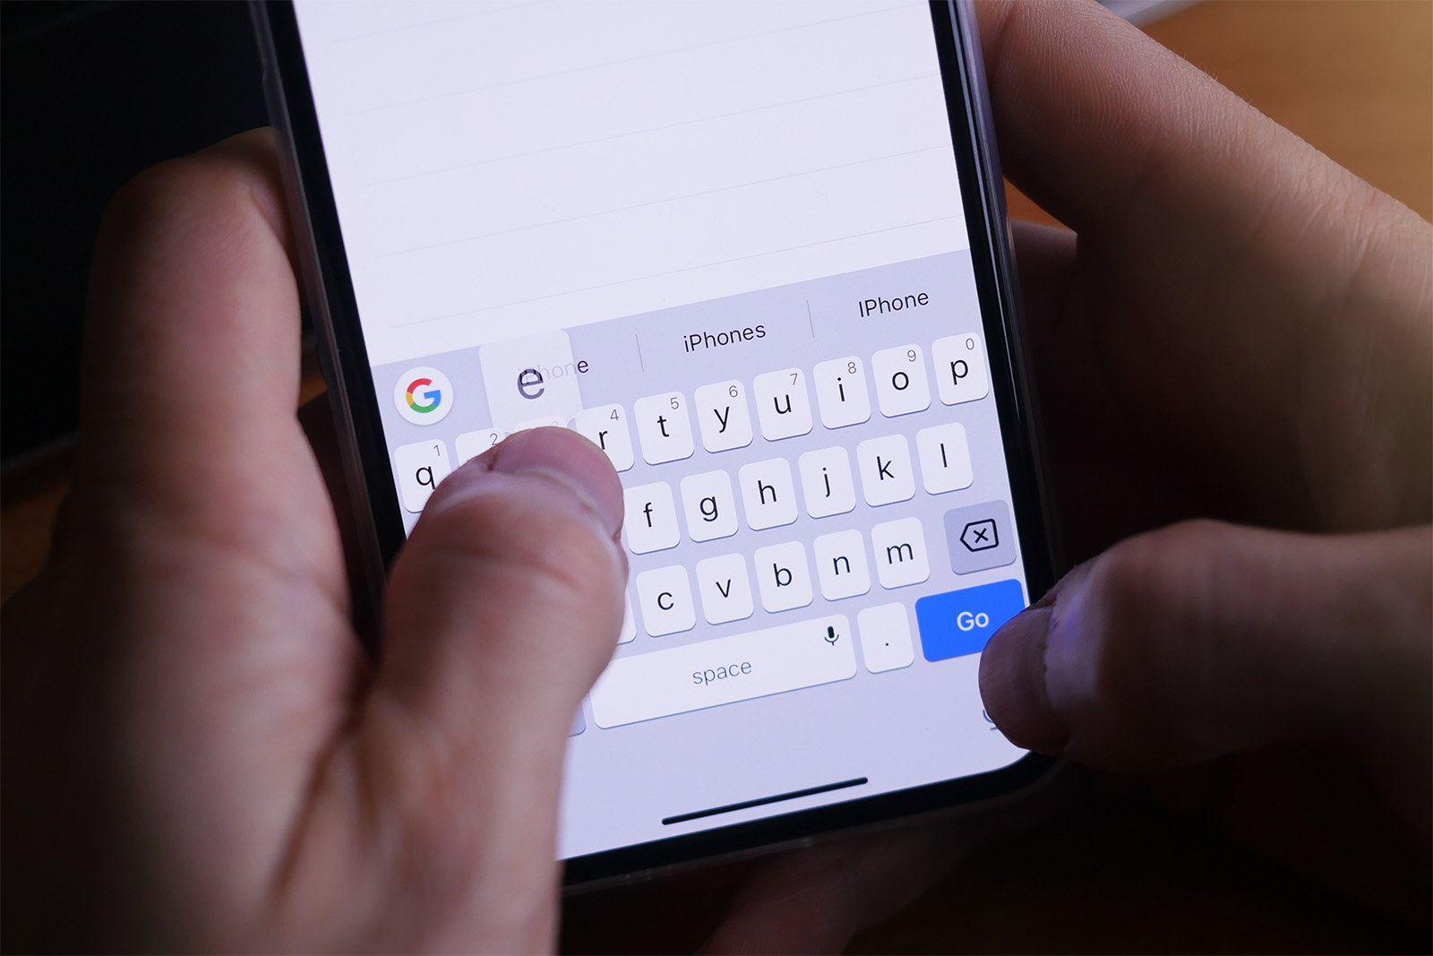
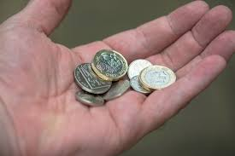
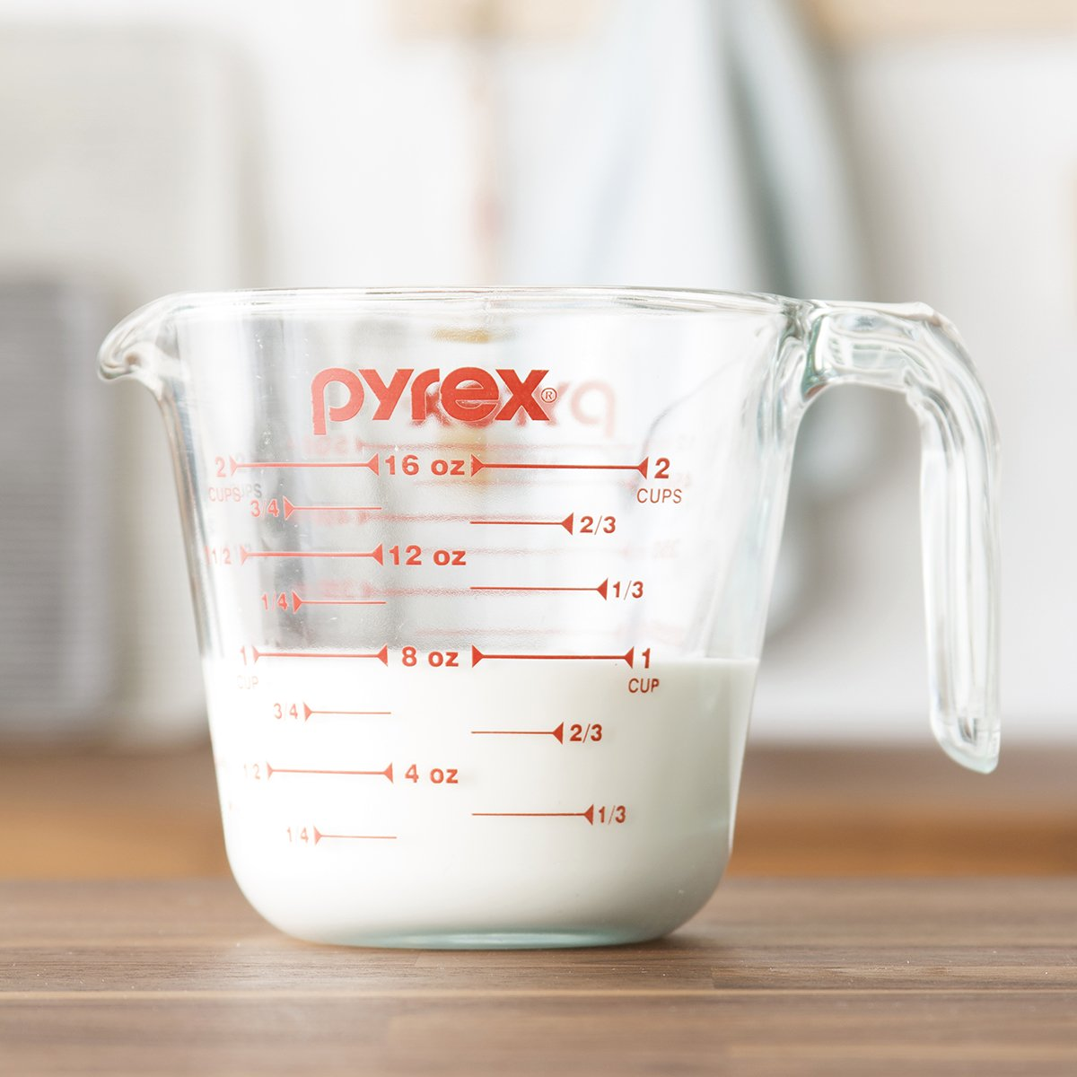
Typing a message to your friend
In order to do all of these basic everyday things, what do you need?
Reading a food packet at the shop
Checking you leave the house on time
Education
Measuring out ingredients to cook dinner with
Counting out enough money to buy something

Slide 2
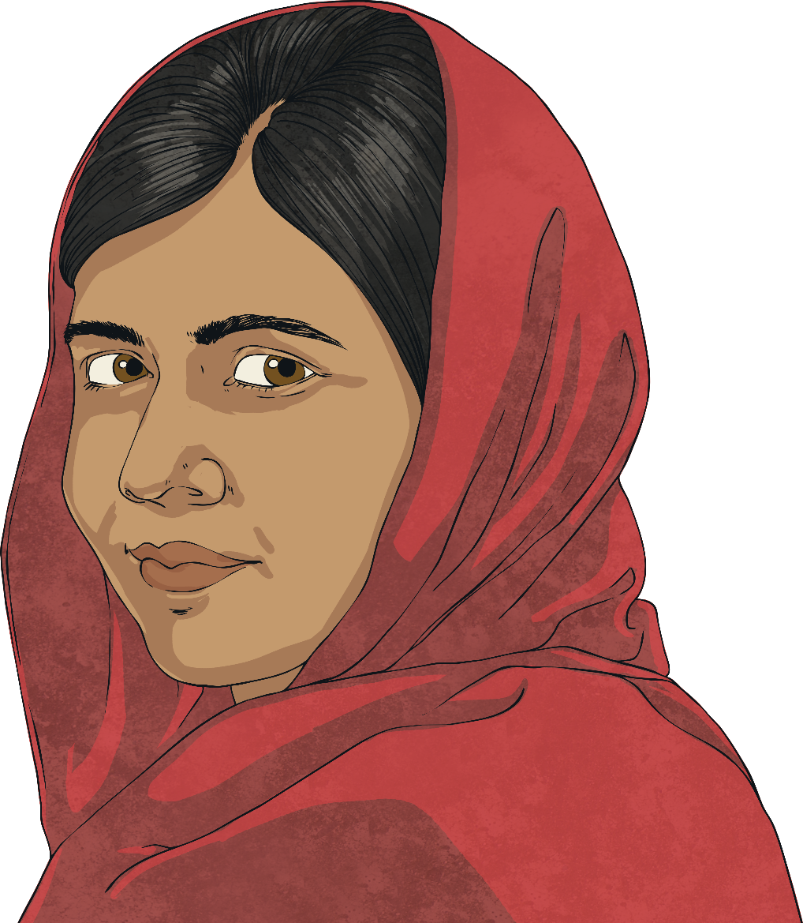
This month’s PERMA Person
of Interest is…
Malala Yousafzai

Slide 3
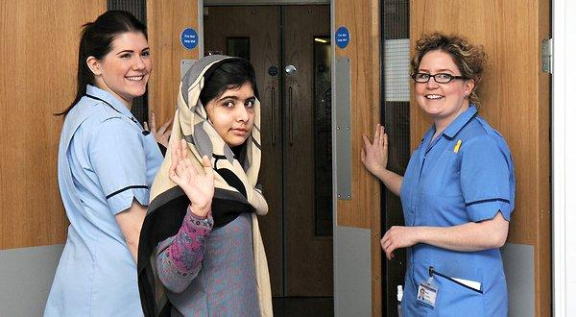
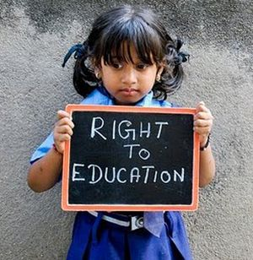
Do any of these images give you some insight into Malala’s story?

Slide 4
Malala was born on the 12th July in Mingora, in Pakistan, at home with the help of a neighbour as her family did not have enough money for a hospital birth.
She has two younger brothers named Khushal and Atal.

Slide 5
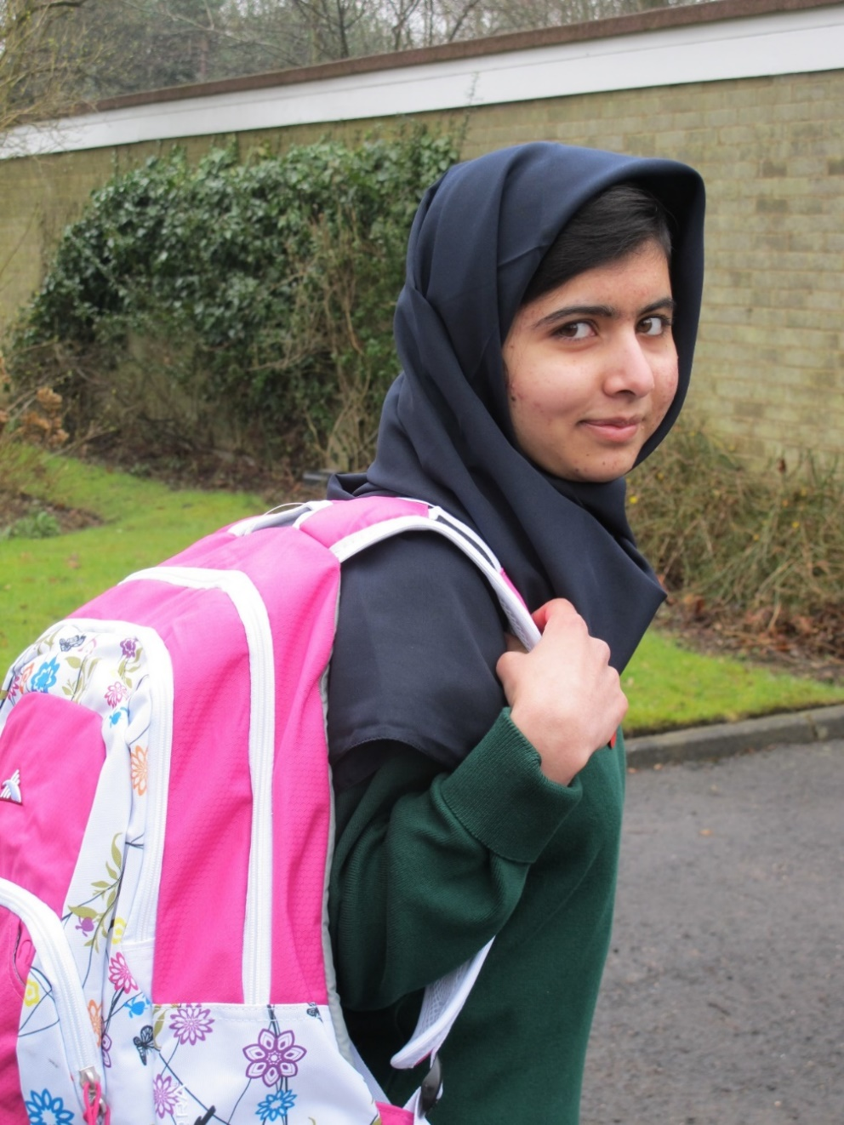
Education
The Qur’an states that all Muslims should acquire knowledge.
This influenced her father, who believed in education for all. He founded a number of schools in Pakistan, one of which Malala attended.

Slide 6
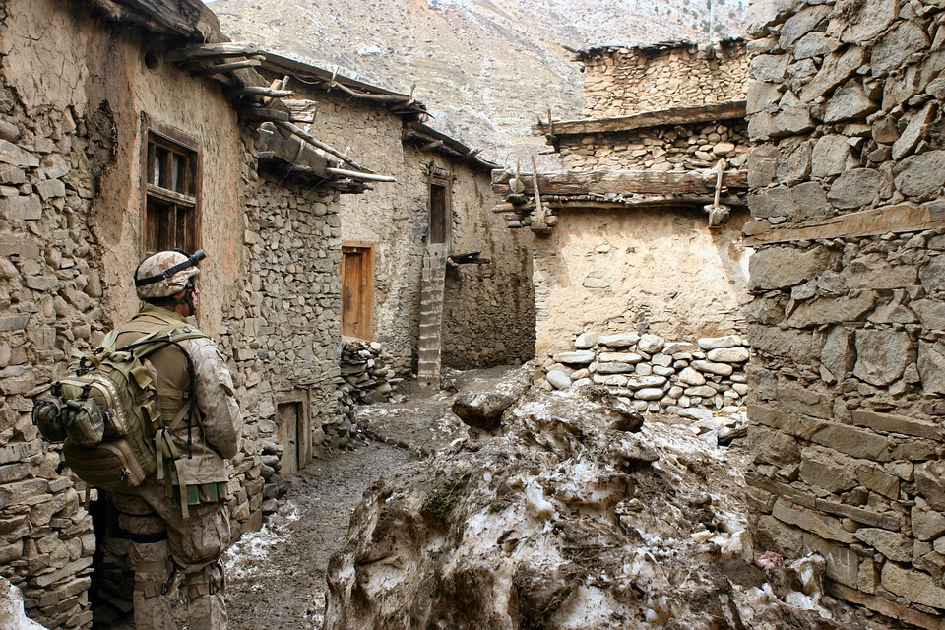
Taliban
In 2007, The Taliban, a terrorist group from Afghanistan, started to take control of the areas where Malala was living. They banned education for girls over the age of eight.
They also banned many cultural activities like watching television and dancing.
Malala continued to believe in her right (and the right of every girl) to an education and became a critical target to the Taliban.
Photo courtesy of Southbank Centre (@flickr.com) - granted under creative commons licence – attribution

Slide 7
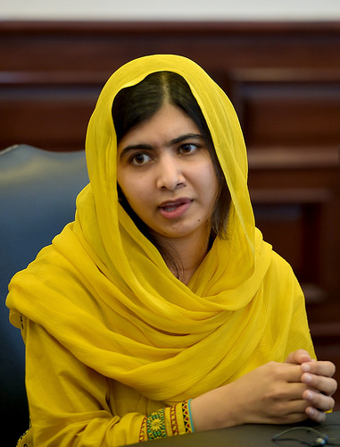
Malala’s Blog
In 2009, Malala began to write a blog for the BBC Urdu service. She wrote using someone else’s name (a “Pseudonym”). In it she described her desire to go to school and her fears living under Taliban rule.
Women were being stopped from going out shopping. Even when Malala and her father received death threats for speaking out and sharing their fears with the world, they did not stop reporting what was happening in their local area. They became well known in Pakistan for their beliefs.
Malala was awarded Pakistan’s National Youth Peace Prize for her work in 2011.

Slide 8
What Happened Next…?

Slide 9
What Happened Next…?

Slide 10
What Happened Next…?

Slide 11
Can you make any predictions?

Slide 12
Can you make any predictions?

Slide 13
Can you make any predictions?

Slide 14
Can you make any predictions?

Slide 15
I am Malala
Whilst travelling home from school on a bus on 9th October 2012, when she was 15, Malala was shot in the head by a masked Taliban gunman. Two of her friends were injured in the attack.
Malala was flown to Birmingham, United Kingdom for treatment and she stayed in hospital for three months.
In March 2013 she was able to go to school in Birmingham. Later that year she published a book, ‘I am Malala’, describing her experiences.

Slide 16
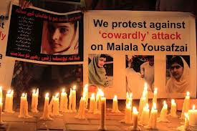
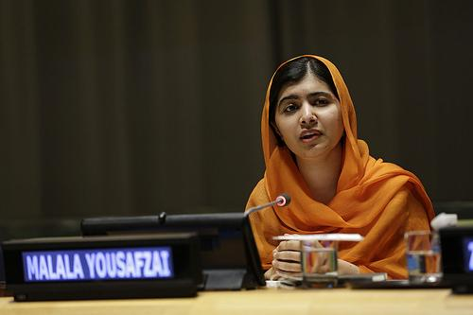
Securing Human Rights
The Taliban’s attack on Malala led to widespread protests across Pakistan and world wide shock. Over 2 million people signed a right to education petition, and the Right to Free and Compulsory Education Bill was passed in Pakistan.
Now, every child in Pakistan is given the chance to go to school.
In 2013, the Malala Fund was set up. The organisation campaigns for all girls to have 12 years of education. Malala is still an active campaigner for the rights of girls around the world to have an education.

Slide 17
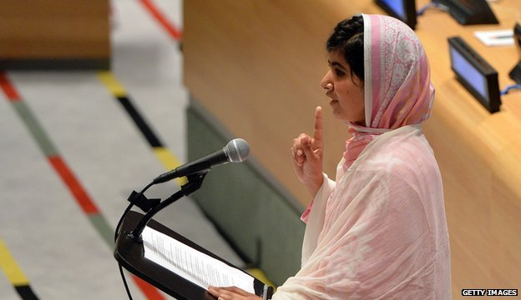
Securing Human Rights
On 12th July 2012 Malala stood up and spoke at the UN headquarters in New York.
It was her 16th birthday and her speech was broadcast around the world.
http://www.youtube.com/watch?v=gCg2FyTiBoI
In 2013, the Malala Fund was set up. The organisation campaigns for all girls to have 12 years of education.
Malala is still an active campaigner for the rights of girls around the world to have an education.
"One child, one teacher, one book, one pen can change the world”

Slide 18
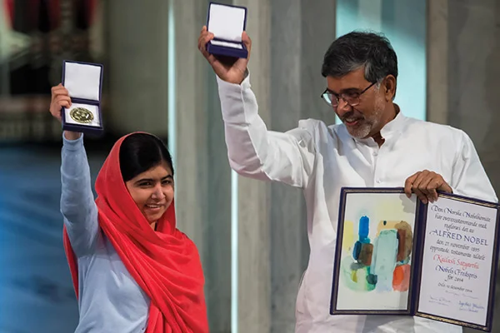
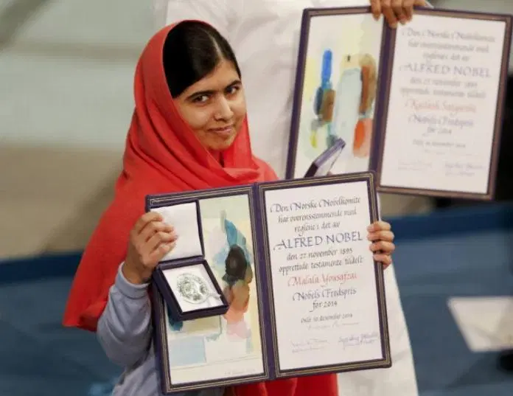
Nobel Peace Prize Winner
Malala’s tireless campaigning was recognised in 2014 when she was named as the co-recipient of the Nobel Peace Prize.
She shared the prize with Kailash Satyarthi, a children‘s rights activist from India.
At the age of 17 she is the youngest recipient of the prize.
Malala donated the prize money of more than $500,000 to build a secondary school for girls in Pakistan.

Slide 19
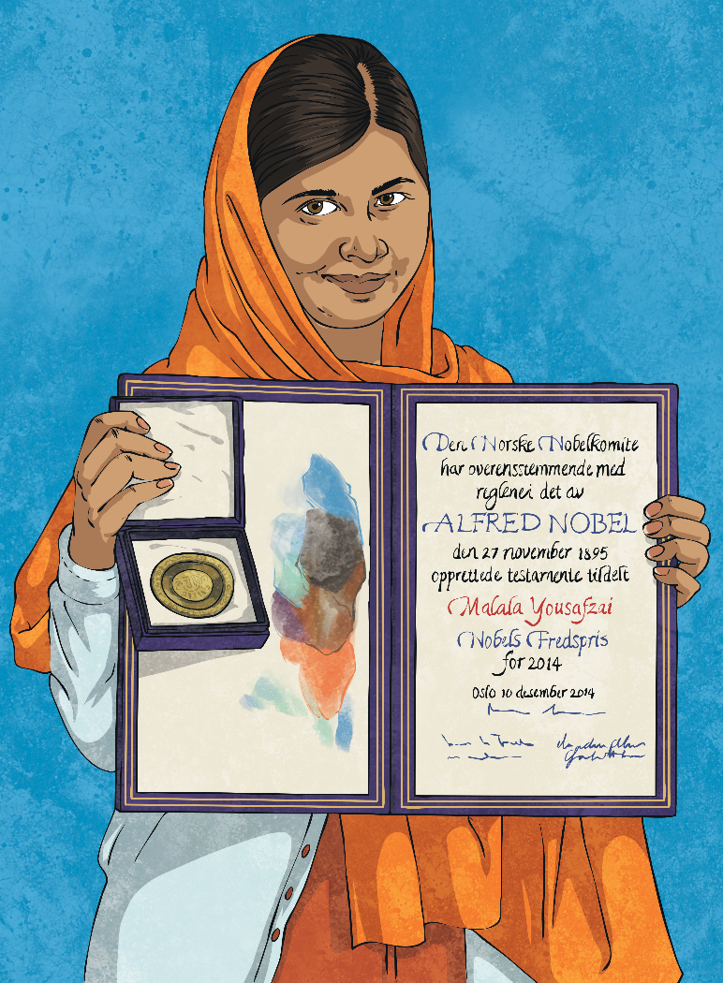
What Can We Learn From Malala?
Positivity
Engagement
R elationships
Meaning
A chievement
Consider, using the 5 pillars of PERMA to help you, what we can learn from Malala. Write your ideas on the activity sheet.

Slide 20
What Can We Learn From Malala?
Women
Equal
Education
Freedom
Human rights
Courageous
Vigil
Beliefs
Taliban
Inequality
Can you write a short poem conveying what you have learned or been inspired by through hearing Malala’s story? Here are some keywords to help you.

