Slide 1
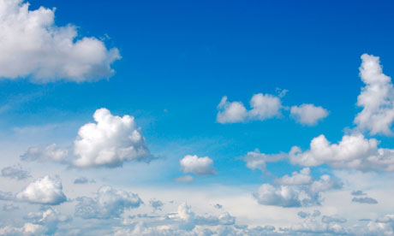
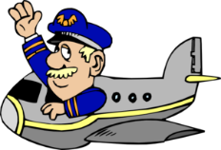
Captain Andrews’
Flight Experience…
…Lesson 3
LIFT

Slide 2
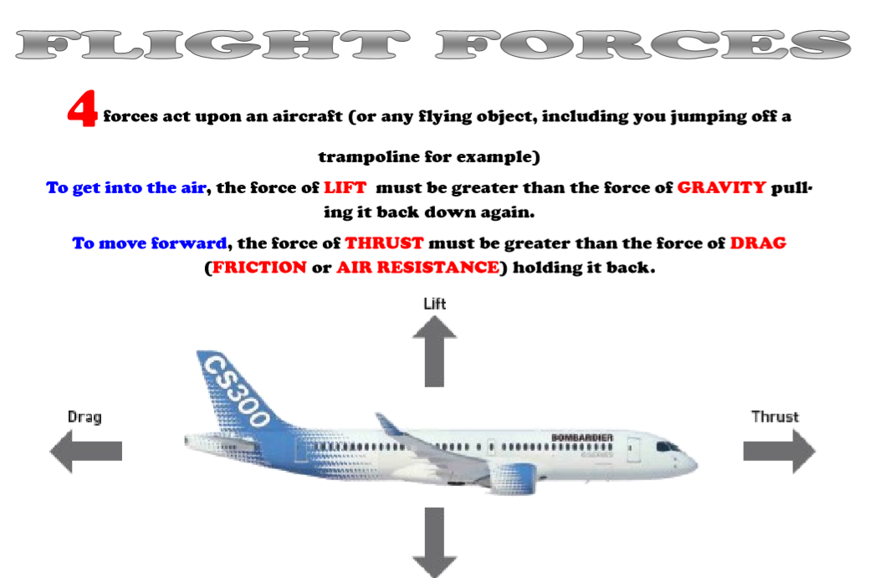

Slide 3
The forces of
FLIGHT
LIFT

Slide 4
The forces of
FLIGHT
WALT:
To know that a force called ‘lift’ helps an aircraft to fly

Slide 5
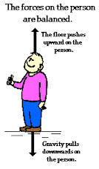
Forces are always in operation.
If there’s force going in one direction,
there’ll be another operating in the opposite direction.
If the forces acting are equal, they cancel one another out and there’s no movement!

Slide 6
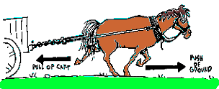
If one force is greater than the other, then there is movement in the direction of the greater force.
Here, the force produced by the horse is greater than the force of the cart pulling it back.
Result: Forward Movement!

Slide 7
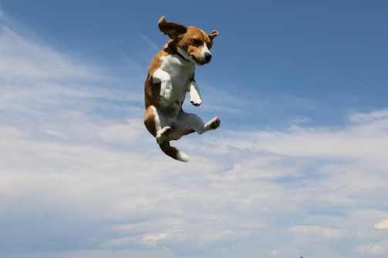
GRAVITY!
For the dog to jump into the air its leg muscles exert a force.
BUT….
…it comes back down to earth because another, greater force acts on it. Do you know what it’s called?

Slide 8
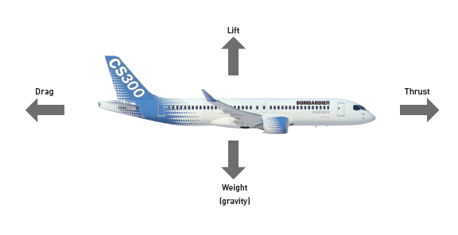
An aircraft has 4 forces acting upon it when in the air…

Slide 9
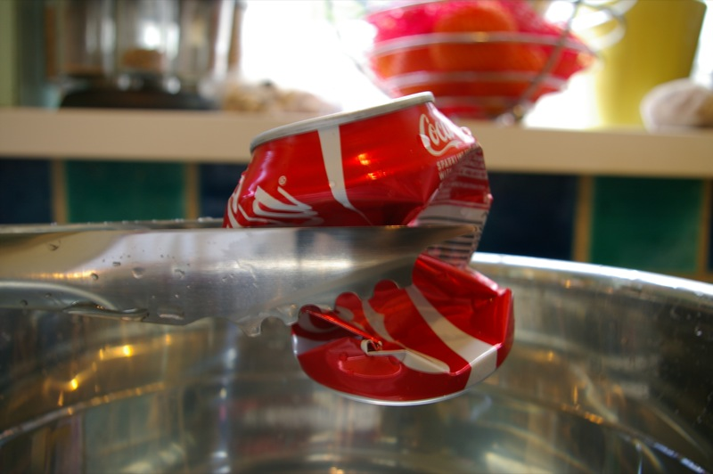
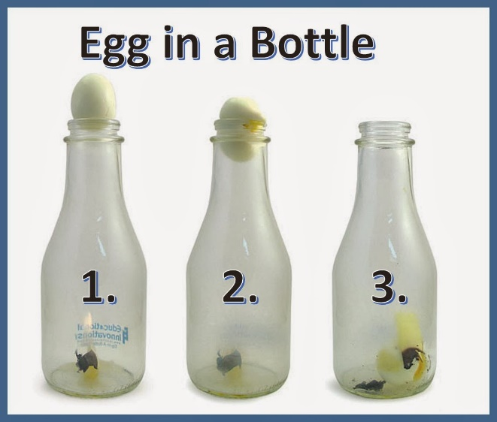
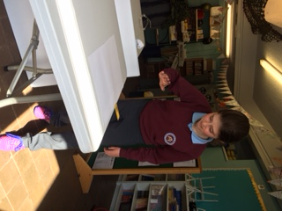
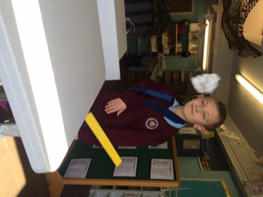
Can you recall what happened in these experiments?

Slide 10
So how does the force of air pressure get a plane in the air?
Air flows faster over the top of the
wing. The pressure is lower at
the top. The higher pressure
underneath pushes the wing up

Slide 11
FAST FLOW…..
…..PRESSURE LOW
Say the phrase above lots of times. It’s key to successful flight for planes, birds, bats….

Slide 12
FAST FLOW…..
…..PRESSURE LOW
The higher pressure under the wing LIFTS the plane into the air.

Slide 13


For this experiment you’ll need a hair drier and a ping-pong ball.
Put the ball into the flow of the air in an upwards direction.

Slide 14
• I think the ball will be pushed across the classroom.
• I think the ball will fall to the ground.
• I think the ball will shoot towards the ceiling and then fall to the ground.
• I think the ball will hover in the air

Slide 15
• I think the ball will be pushed across the classroom.
• I think the ball will fall to the ground.
• I think the ball will shoot towards the ceiling and then fall to the ground.
• I think the ball will hover in the air

Slide 16
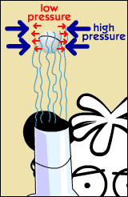
Here’s how it works.
Bernoulli's Principle
Remember……
Fast flow…..
Pressure low

Slide 17
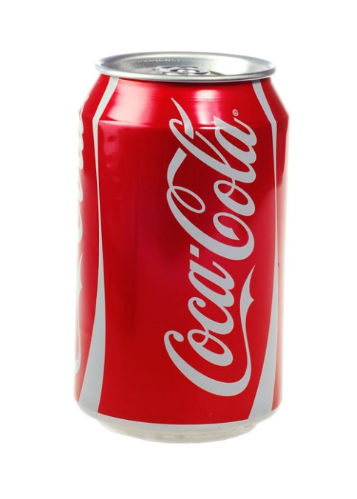
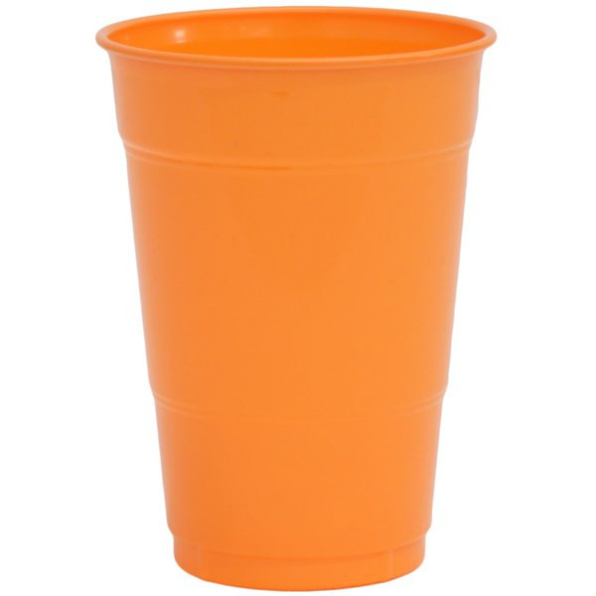
Over to you…..
https://www.youtube.com/watch?v=gVyuNmkatmM

Slide 18
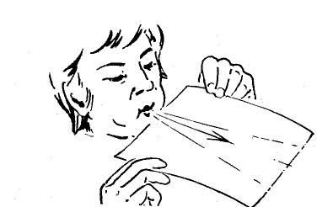
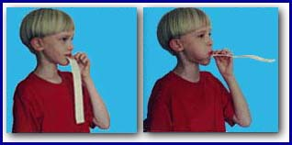
Now try this……

Slide 19
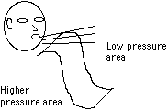
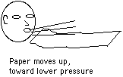

Slide 20
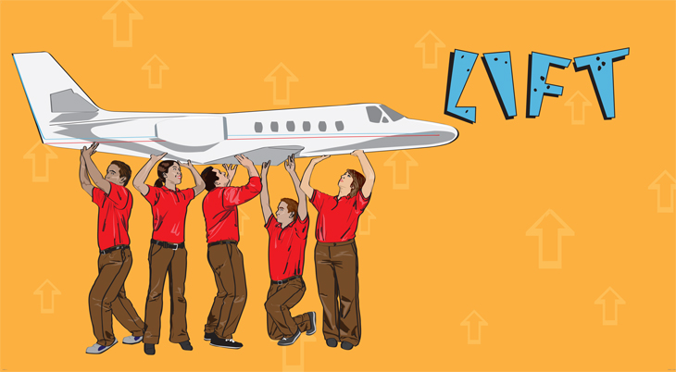
Remember,
Fast flow means pressure low.
High pressure under the wing
LIFTS the plane into the air

Slide 21
A little extra
FUN!

Slide 22
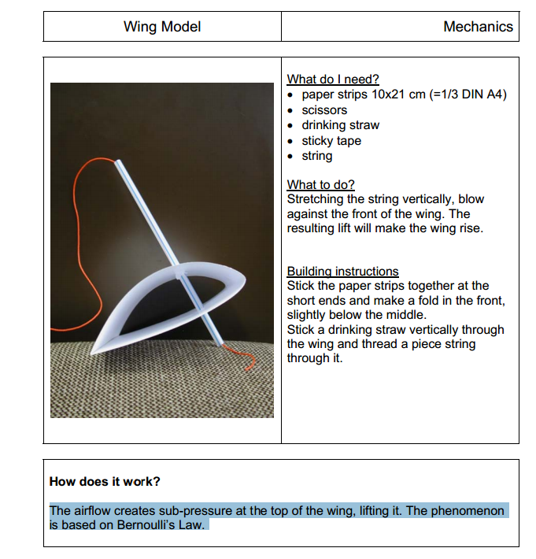

Slide 23
The forces of
FLIGHT
WALT:
To know that a force called ‘lift’ helps an aircraft to fly

Slide 24
Captain Andrews’
Flight Experience…
…Lesson 3
LIFT

