Slide 1
Frogs

Slide 2
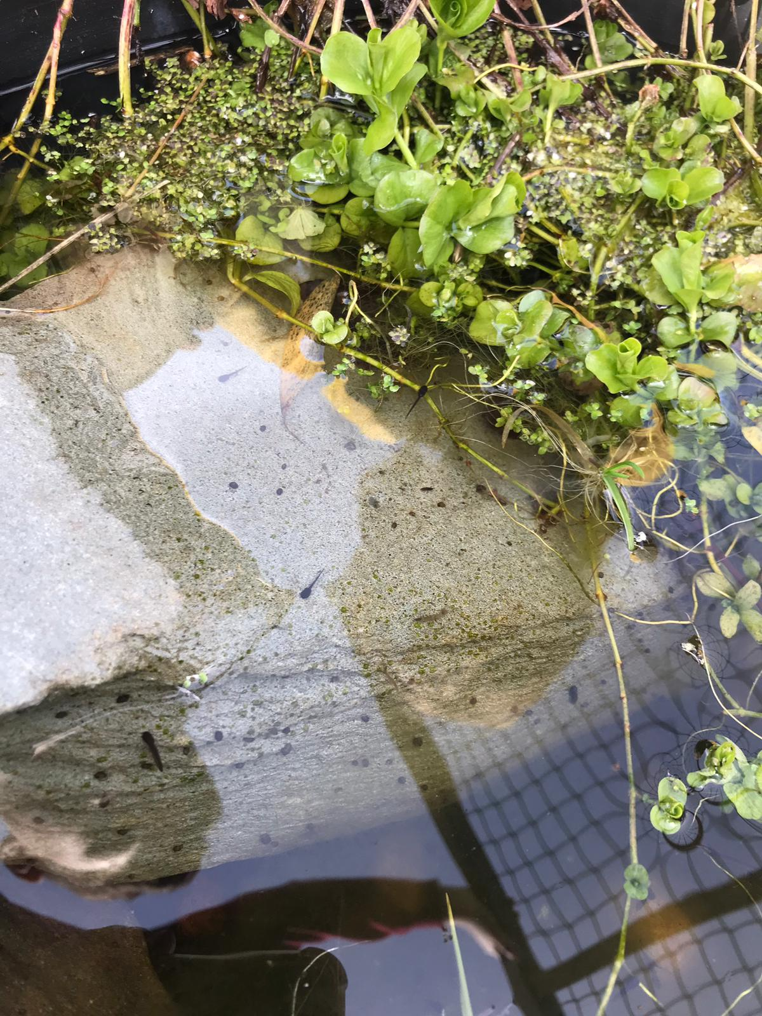
Here is our school pond
It has some frogspawn in it.

Slide 3
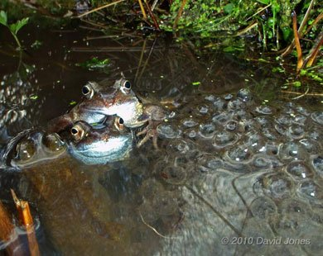
The lifecycle of a frog
In early March male frogs begin to look for a female frog who is about to lay frogspawn.
The male frog holds on to the female while she lays all the frogspawn.

Slide 4
Frogspawn
The spawn is made up of lots of single eggs. The black specks will become the tadpoles.
The jelly round the tadpole is the food that it eats while it begins to grow.

Slide 5
The Tadpoles are Nearly Ready to Hatch
After about two weeks the tadpole embryo has become longer and you can see its head and tail. It is nearly ready to hatch from the egg.

Slide 6
The Tadpoles Hatch
The tadpoles hatch after around three weeks. They feed altogether on the jelly at first.
Can you see their feathery-like gills on the side of their heads?

Slide 7
Tadpoles Develop Internal Gills
Around a week later, the feathery-like gills have grown a skin over them. The gills are now inside the tadpole's body so they cannot be seen.
The newt is looking for a meal. He is lucky, there are a lot of tadpoles to choose from. Can you see he is walking on the tadpoles?

Slide 8
The Tadpoles Grow Legs
By the summer each tadpole has grown first back legs and then front legs, which will be needed for hopping on the ground.
The tadpole's eyes have become more frog-like but it still has a long tail.

Slide 9
Froglets
Soon the froglet's tail disappears and it can climb out of the pond. By now it looks like its parents, but it is very tiny, only 1cm long.
Like its parents it eats insects, worms and slugs and in winter will hibernate at the bottom of a pond or under stones or logs.

Slide 10
Frogs
Most of the time frogs live on land. They go back to water on hot days, to hibernate in the mud in the winter and to breed when they are about five years old.

Slide 11
How many words can you think of that rhyme with frog?
Can you write them down?

Slide 12
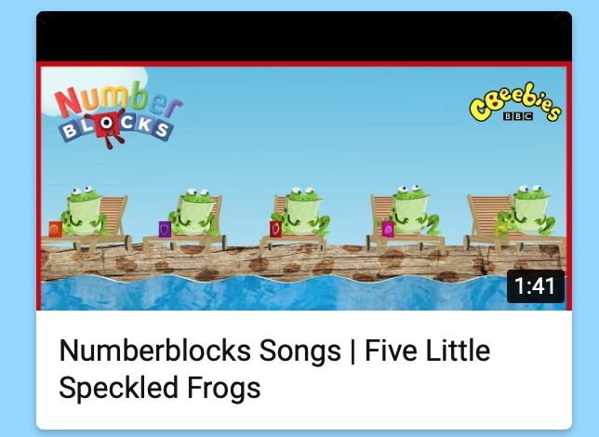
Five little speckled frogs
Enjoy singing this song at home.
https://www.youtubekids.com/watch?v=Q_hzAlnSw5w&hl=en-GB

Slide 13
The Wide Mouthed Frog
There is another super story about a frog called,
’The Big Wide Mouthed Frog’
You can listen to it here:
https://www.youtube.com/watch?v=9uYBV3Wq-r0

Slide 14
Here is a poem about frogs. Can you say it?

Slide 15
The lifecycle of a frog.
Now watch our friend Auntie Mabel tell us more about the lifecycle of a frog.
https://www.youtube.com/watch?v=lxlSGf9_amA

