Slide 1
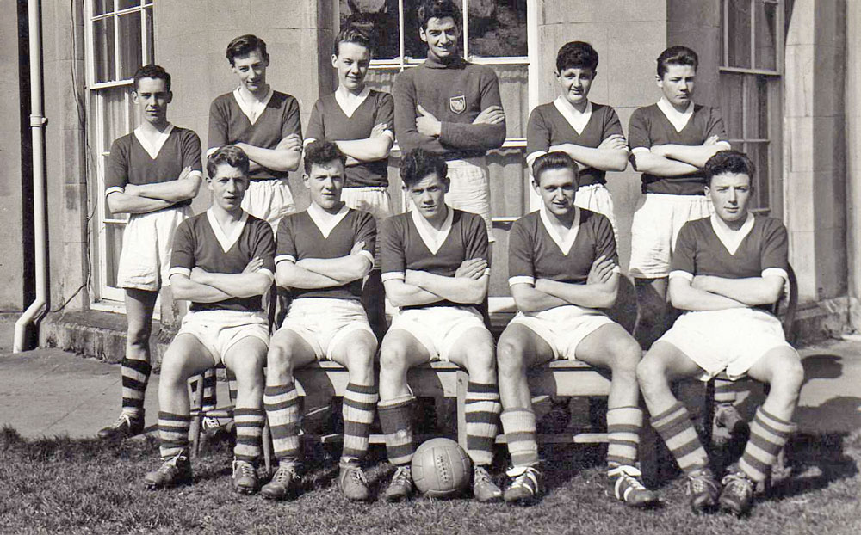
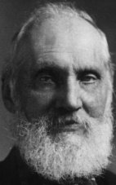
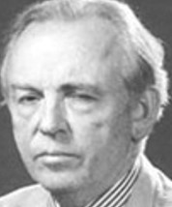
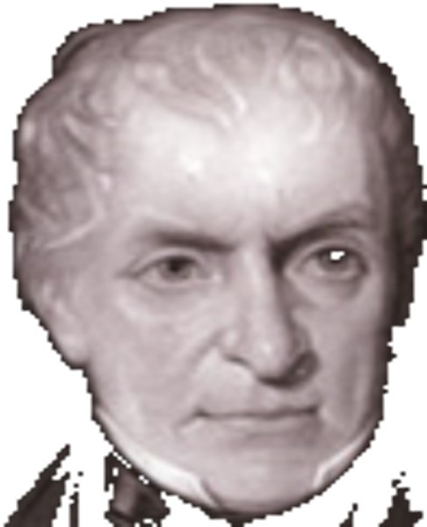
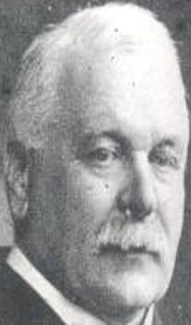
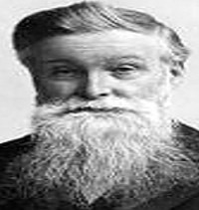
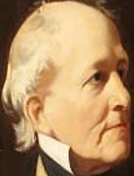
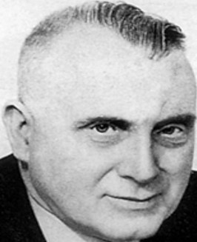
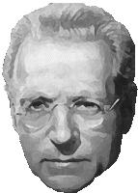
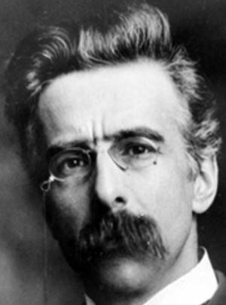
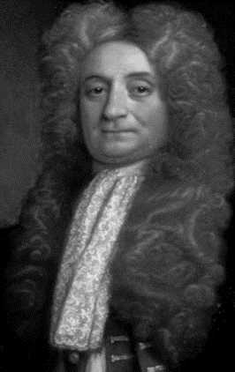

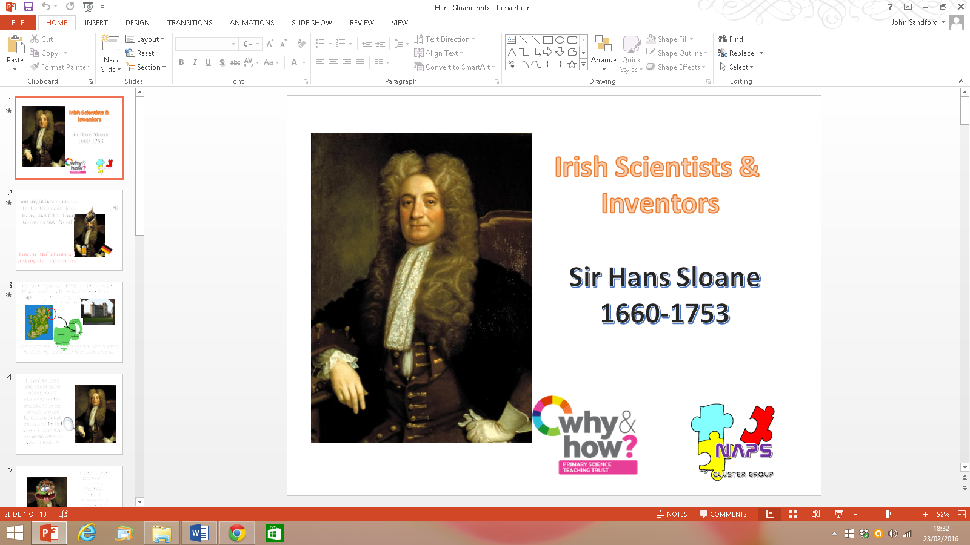
Irish Scientists - The First XI
A Project of The Newtownards Area Primary Science Cluster

Slide 2


Francis Beaufort
Man of Wind!

Slide 3

Sir Francis!
I descended from French refugees.
Was born in Navan, Co. Meath on 27th May 1774.
I grew up in Wales and Ireland until the age of 14.

Slide 4
I left school at 14,
Oh yeah!
I went to sea and continued my education.
I loved the sea life but I got ship wrecked at aged 15 because someone didn't do their homework properly – we’d faulty maps!!!
I survived, obviously, which is why you have heard of me today.

Slide 5
Call me Captain Beaufort!
I rose through the ranks of the Navy; Lieutenant, Commander and then became Captain.
While my friends were off playing football and fishing in their free time, I was star gazing and measuring shorelines.
This gave me new charts and maps and hopefully no more shipwrecks!

Slide 6
The Beaufort wind scale
During these first years of command I developed the first versions of my now famous wind scale and notation coding.
I used knots to indicate the speed of the wind. This chart shows wind speed in miles per hour, based on the conversion of 1 knot = 1.15 miles per hour.
I got other people to jump on board with my new idea and, ‘Hey Presto!’ we have the Beaufort Wind Scale.
I died an old man (83) but happy to have invented a useful weather scale!

Slide 7
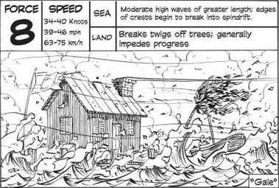
Here’s an example…

Slide 8











Contributors:
Heather Beattie; Bronagh Reid; Keith Pinkerton; Helen Martin; Daniel Watson; Heather Kinnier; Jeff Colville; Julie Balmer; Lorraine Hutton; Matthew Skimin; John Sandford

