Slide 1
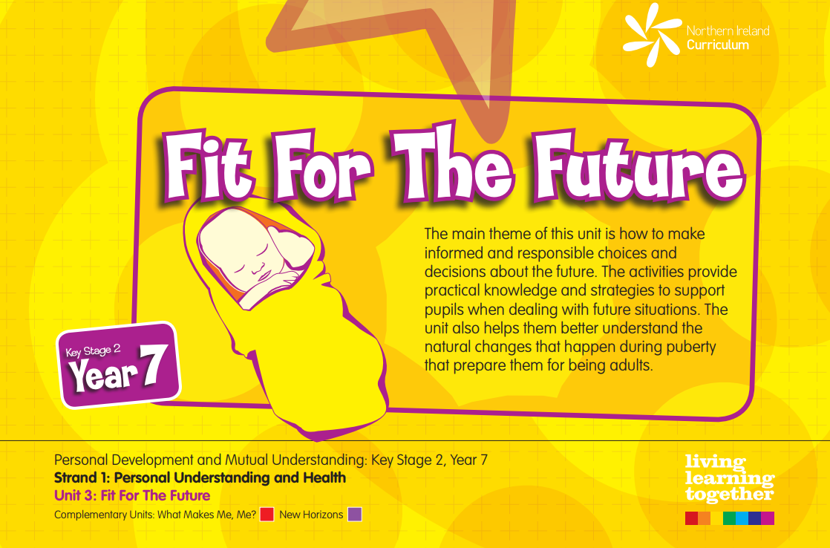
3 Lessons

Slide 2
What do you know about
Alcohol? Answer the following questions. Click to reveal the answer.

Slide 4
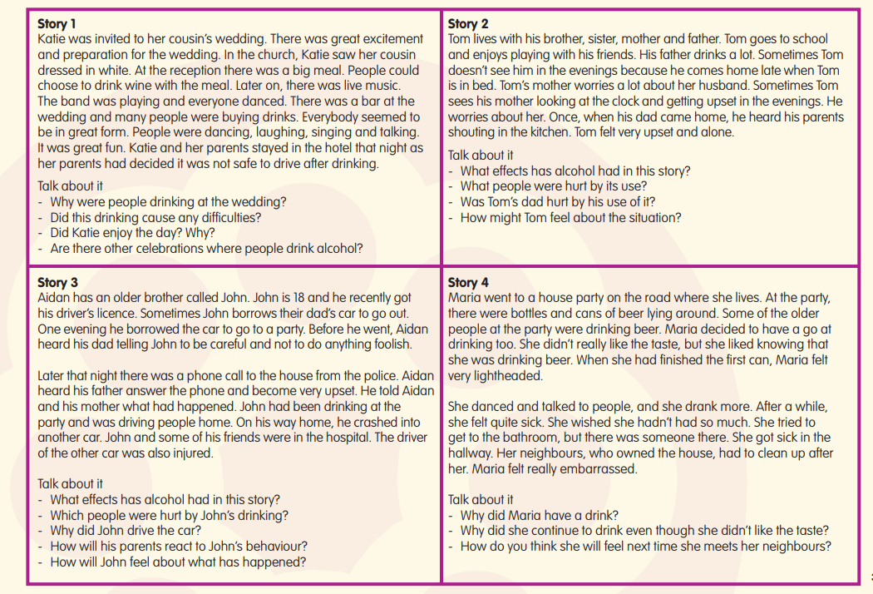
Read the scenarios below. If you can, discuss them with someone else. Think about issues such as peer-pressure, self-image and acceptance.

Slide 5
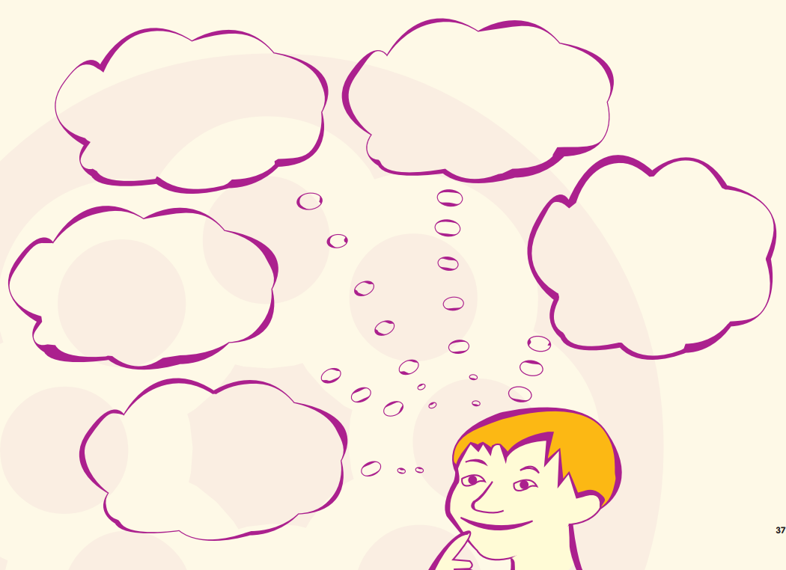
Additional information about alcohol and the law is available to download.
You’ll find a copy of this resource sheet to download.
Remember, this is an important issue. When you are older you’ll be able to consume alcoholic drinks, but it is a drug and, like all drugs, needs to be treated with care.

Slide 6
2:

Slide 7
What do you know about the sense of smell?
What would life be like if you couldn’t smell things?
Why is the sense of smell important?

Slide 8
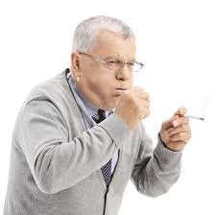
What effects can smoking have on someone’s health? Discuss with someone at home.
If you don’t ever smoke, are you safe from the effects of smoking?

Slide 9
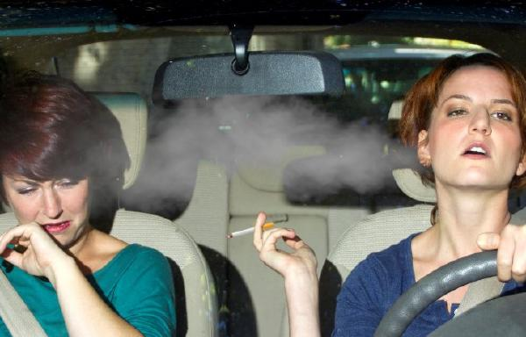
What’s happening in this picture?
Will the car passenger experience anything different to the lady smoking the cigarette?

Slide 10
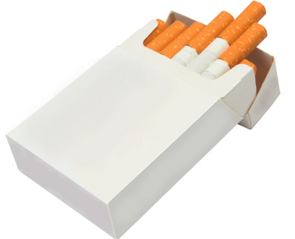
This is called:
SECOND HAND SMOKING
Second Hand
Smoke
SHS
Suggest why it is given this name

Slide 11
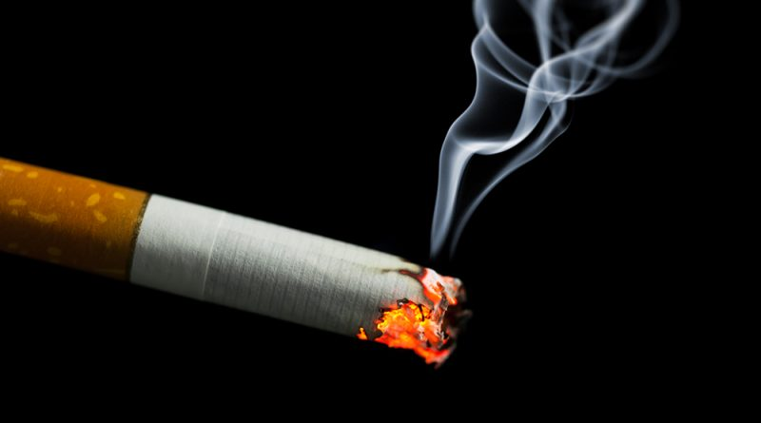
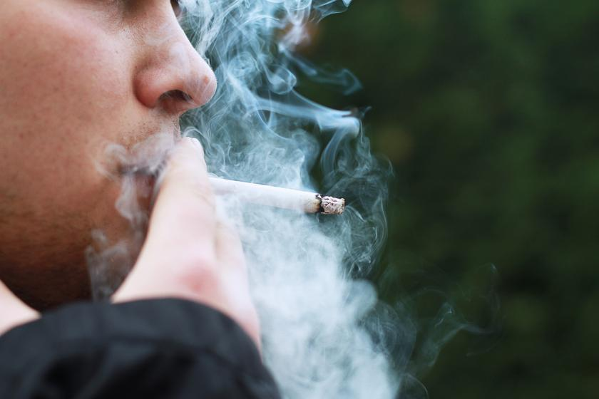
Second Hand
Smoke
Sidestream
Mainstream
Sidestream smoke (SSM) is defined as the smoke that is released from the end of a burning cigarette, cigar, or pipe
Mainstream smoke (MSM) refers to the smoke that is inhaled by a smoker and then exhaled into the environment.

Slide 12
Second Hand
Smoke
Sidestream
Mainstream
Which is most harmful? Discuss with someone at home if you can.

Slide 13
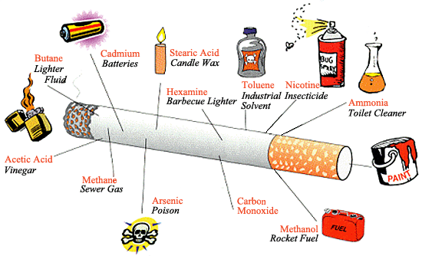
ANSWER? – Probably sidestream, as it’s undiluted
Examine the picture. They are the actual contents of a cigarette!

Slide 14
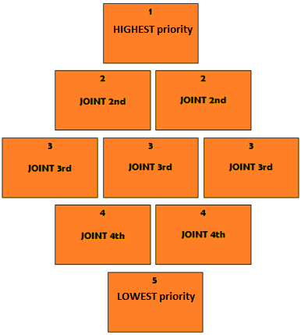
Download the diamond 9 activity and make decisions about important smoking facts!
Diamond Nine Ranking

Slide 15
Cigarette smoking harms nearly every organ of the body, causes many diseases, and reduces the health of smokers in general.
Within two years of stopping smoking, your risk of stroke is reduced to half that of a smoker and within five years it will be the same as a non-smoker
Smoking doubles your risk of having a heart attack
On average, most people who quit save around £250 each month.
Smoking causes 84% of deaths from lung cancer
If you smoke, your skin ages more quickly and looks grey and dull.
Smoking causes problems such as bad breath and stained teeth, and can also cause gum disease and damage your sense of taste
Whenever you light up, secondhand smoke is produced. This is the smoke exhaled by you. Secondhand smoke contains more than 4,000 chemicals

Slide 16
Be Sensible!
If you don’t start smoking
by the age of 18 –
you probably never will!
JUST SAY NO!

Slide 17
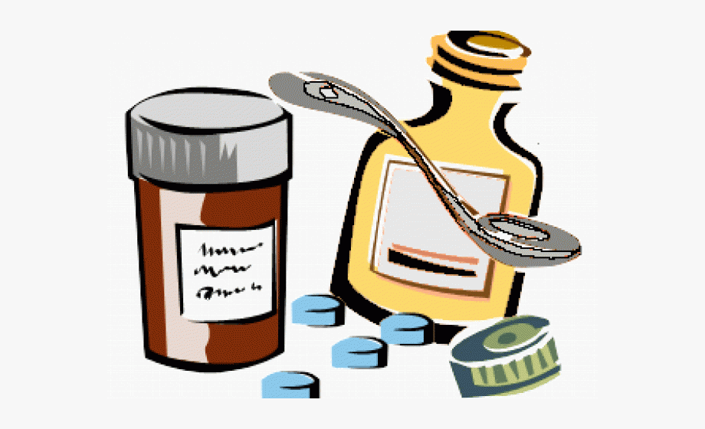
3:

Slide 18
One day Kyra and her friend Nicola went for a walk. They had been walking for a little while, when they noticed a bag on the side of the road. “Someone must have lost it,” said Nicola. “Maybe we can find its owner.” Kyra wondered what was inside the bag. She picked it up and looked inside. She turned to Nicola in surprise. “It’s full of drugs,” she said.
Complete the resource sheet which you can download for this lesson.
The next slide shows what kind of drugs may be found around an ordinary house.
Can you add to the list?
Make a poster, leaflet or PowerPoint slide clearly stating the Dos and Don’ts in relation to drugs around the home.

Slide 19
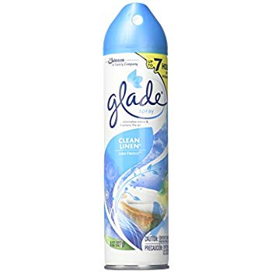
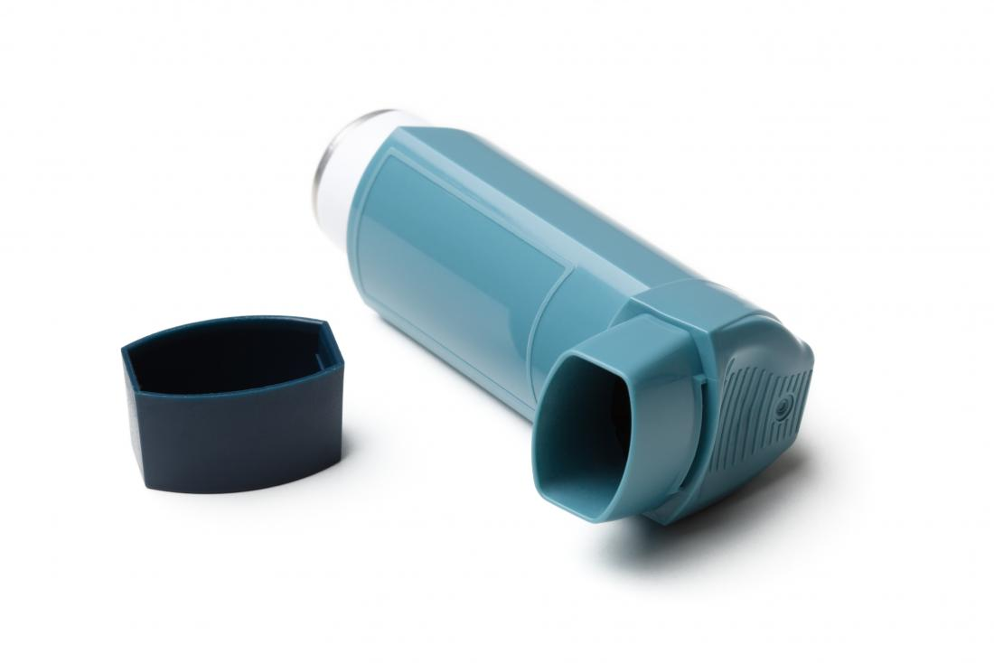
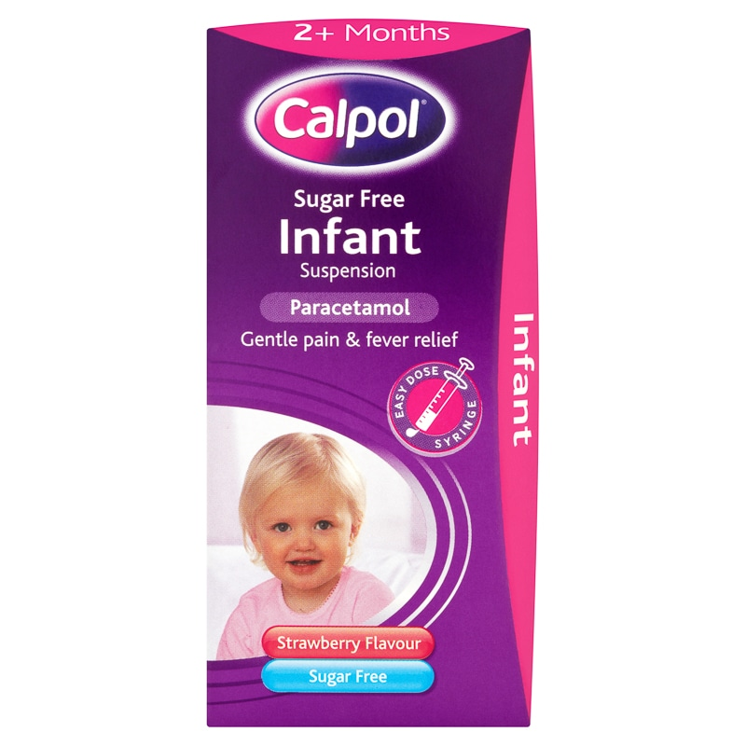
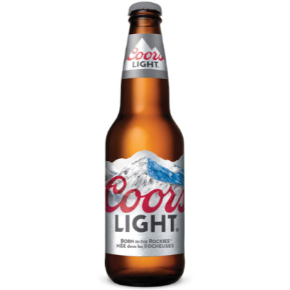
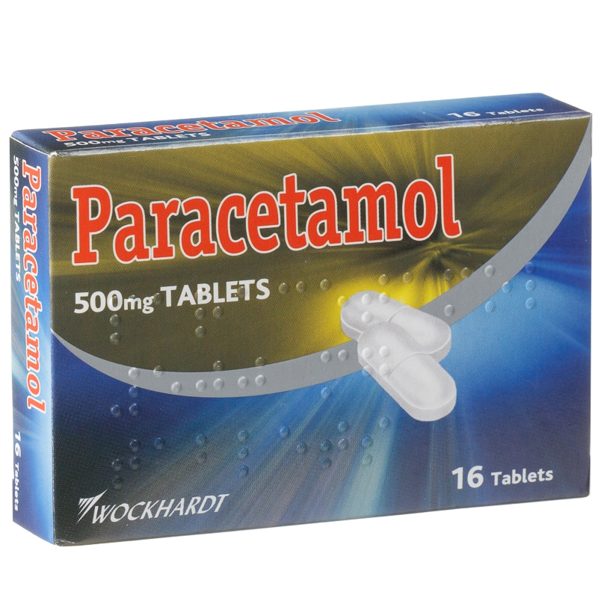
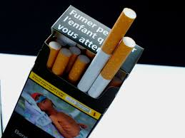

Slide 20
3 Lessons

