Slide 1
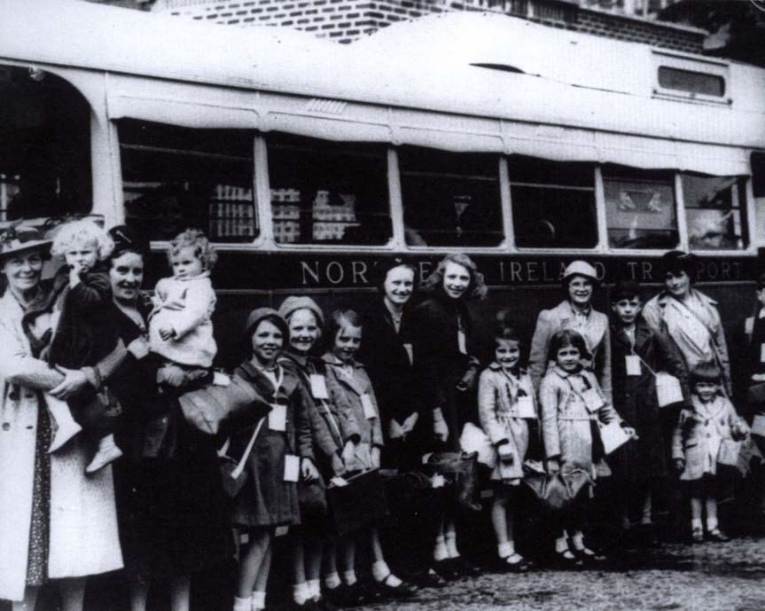
EVACUEES
WALT:
appreciate what life was like for a child evacuated to the country during World War 2

Slide 2
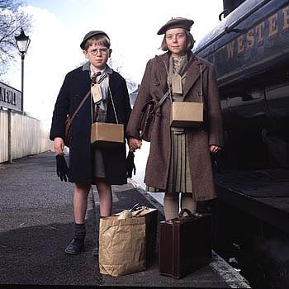
Click on the image

Slide 3
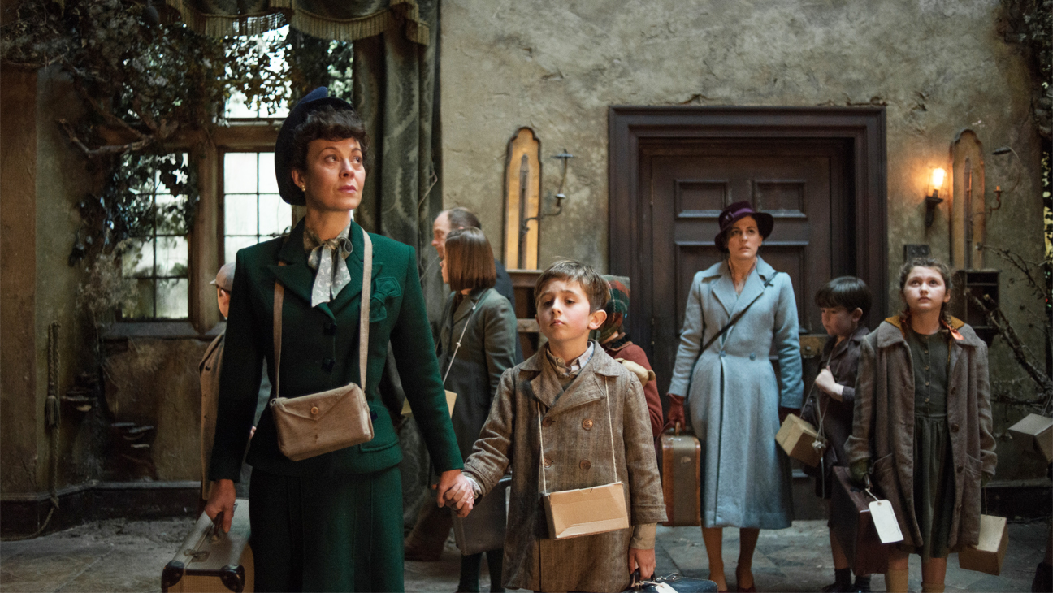
Click on the image to watch someone who
Experienced life as an evacuee.

Slide 4
The next three slides are taken from instruction books and posters that were published when children were being evacuated from Belfast to escape the bombing. The fourth slide is a popular song from the time which talks about parents’ feelings about evacuation.
Select information that you think is important from each.
You may find words/phrases that you’ll need to CLARIFY with someone.
Using all of today’s sources, create a poster/ video/ PowerPoint about some aspect of life as an evacuee during WW2

Slide 5
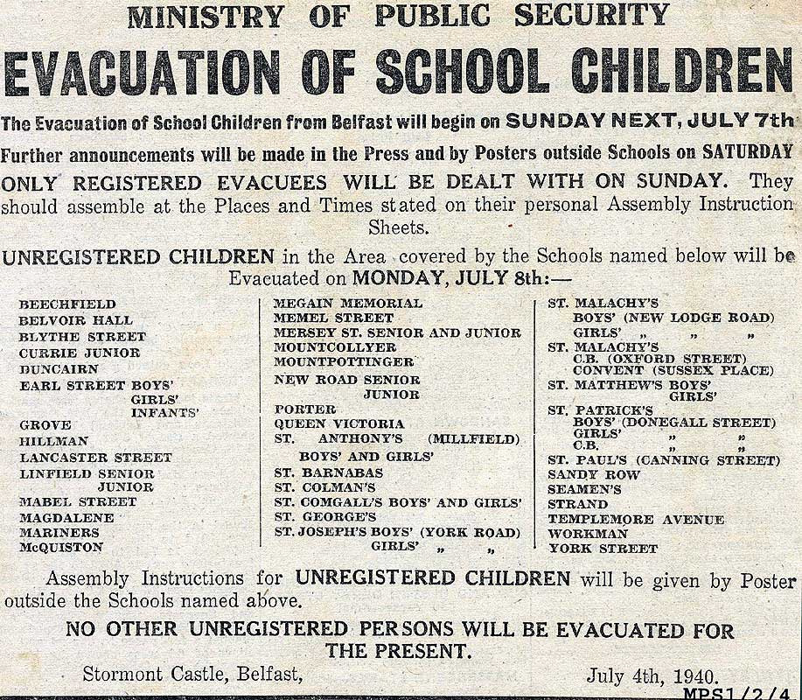

Slide 6
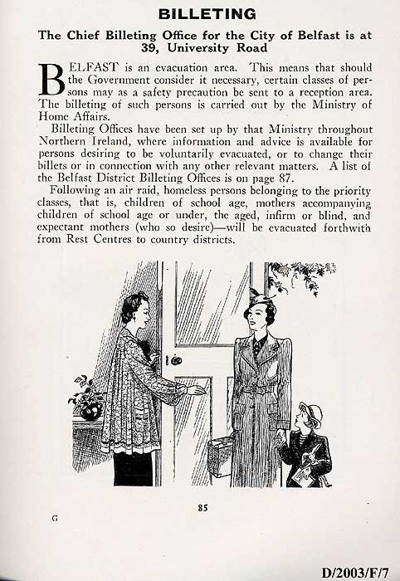

Slide 7
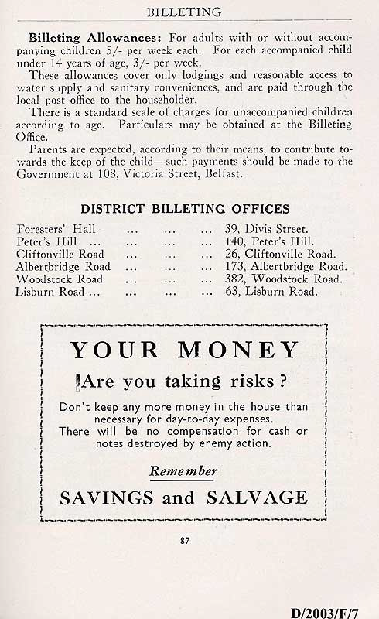

Slide 8
