Slide 1
World War II
Diamond Nine Activity

Slide 2
WALT:
Critically evaluate information and order its importance.

Slide 3
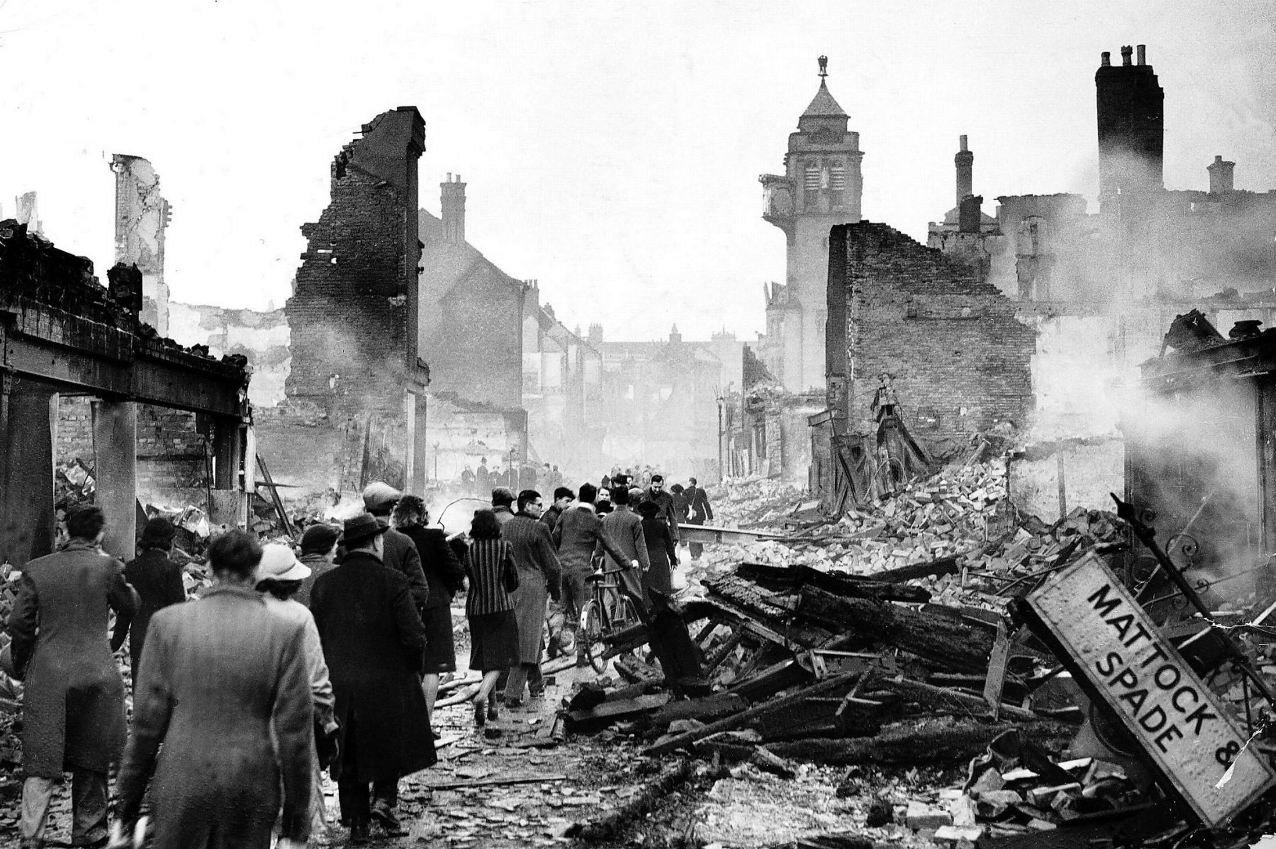
Around 40 000 British civilians were killed as a result of German bombing raids during WWII

Slide 4
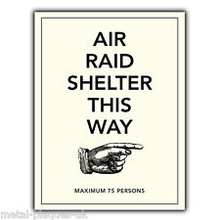
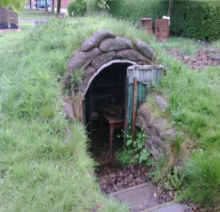
Action: Issue Anderson Shelters

Slide 5
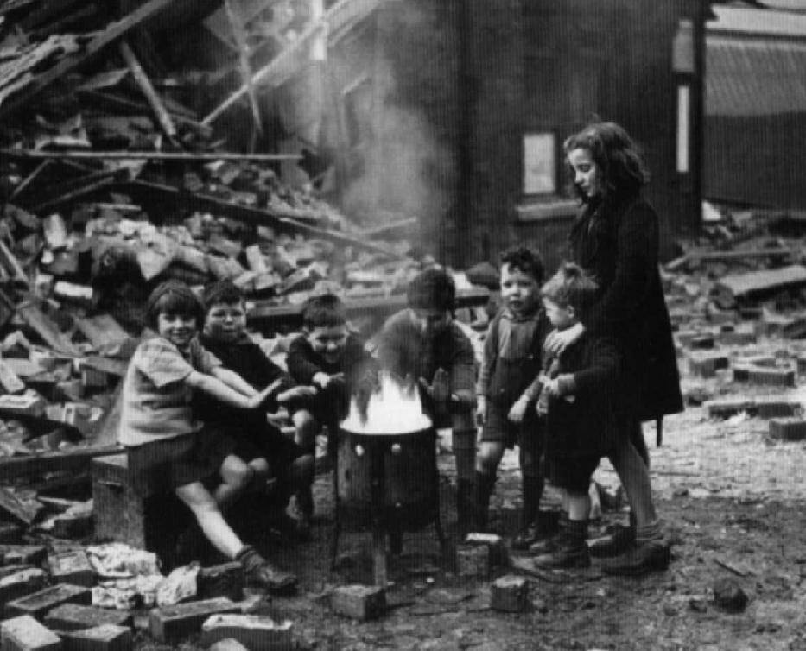
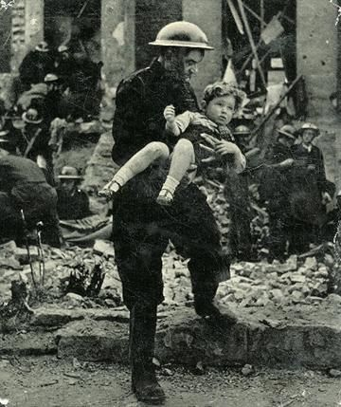
Children were in as much danger during bombing raids as adults.

Slide 6
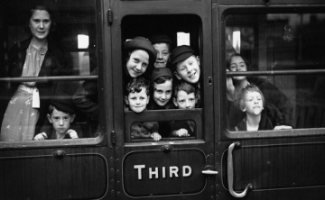
Action: Evacuation of children

Slide 7
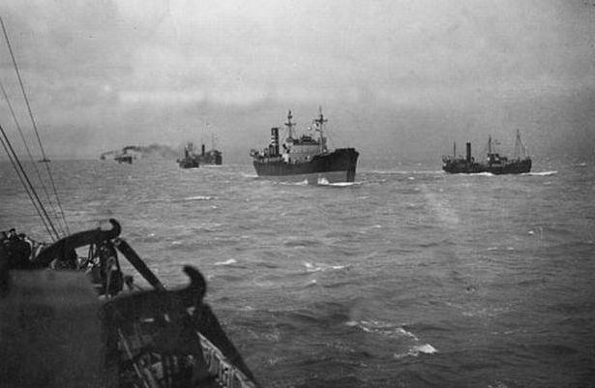
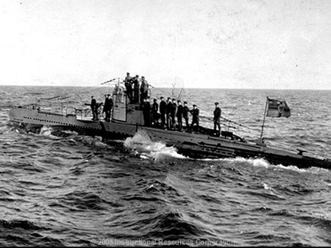
Most of Britain’s war time supplies had to be brought on ships from the Americas.

Slide 8
Action: Encourage people to grow their own food

Slide 9
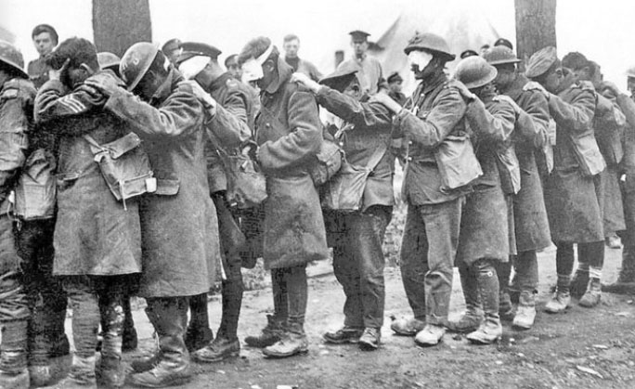
Gas attacks during World War I horrified both sides.

Slide 10
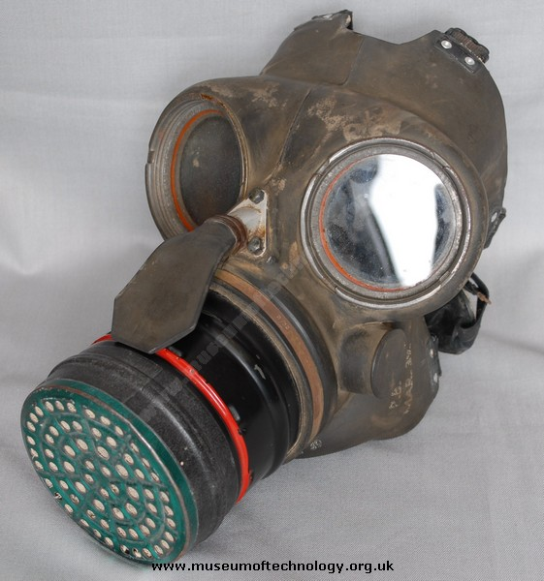
Action: Gas masks issued

Slide 11
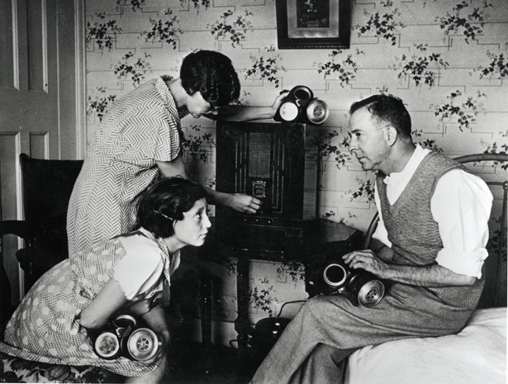
Information given to the public was carefully controlled by the government.

Slide 12
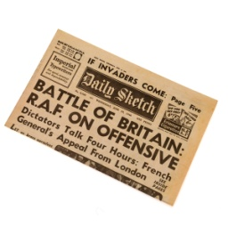
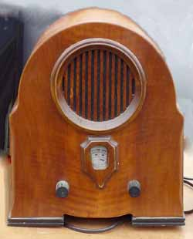
Action: Keep people informed

Slide 13
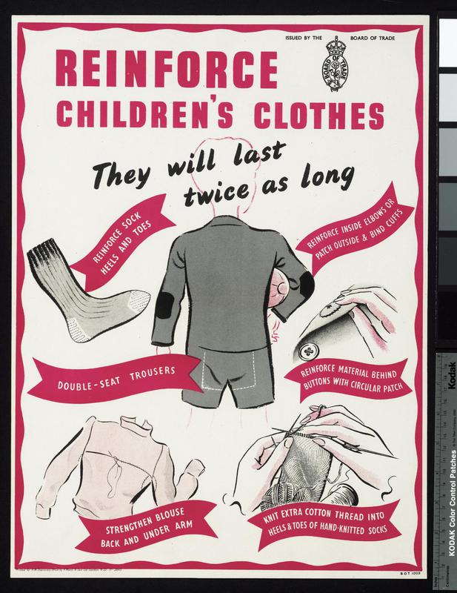
Cloth was in very short supply as it was needed by the military.

Slide 14
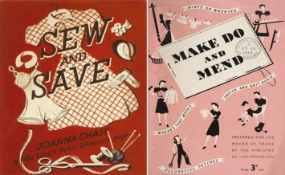
Action: Clothes rationing

Slide 15
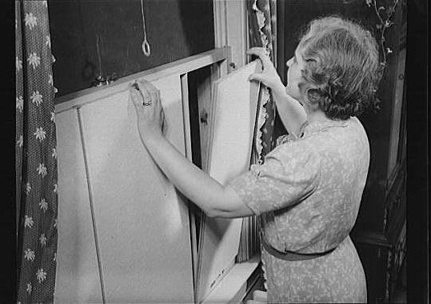
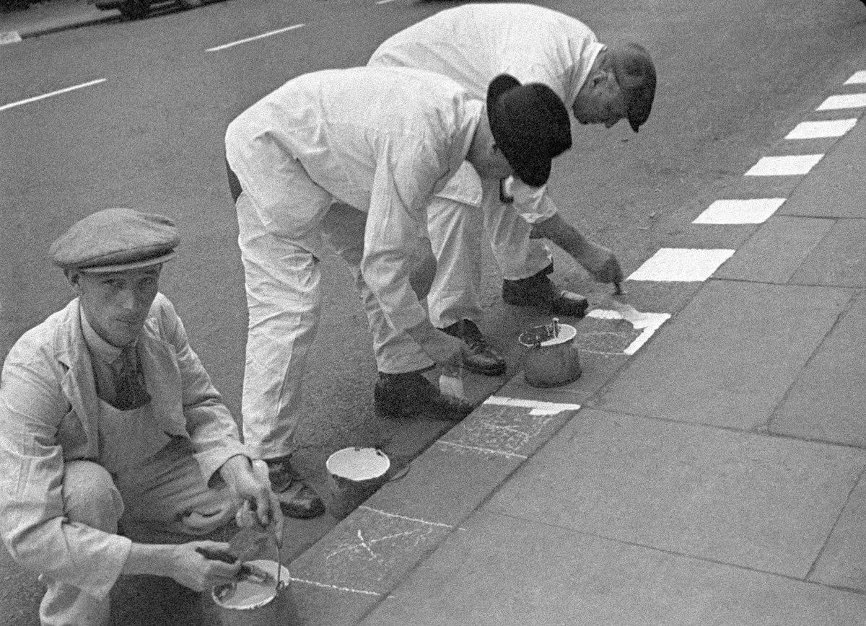
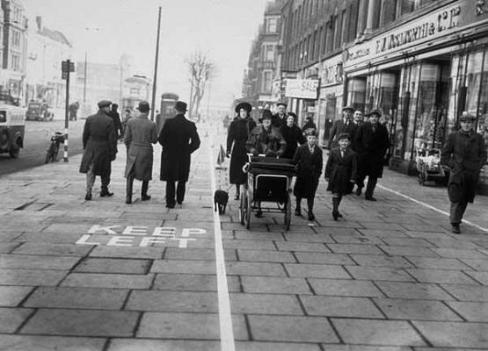
Enemy bombers could only spot targets at night if they were lit-up.

Slide 16
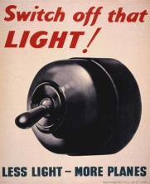
Action: Blackout!

Slide 17
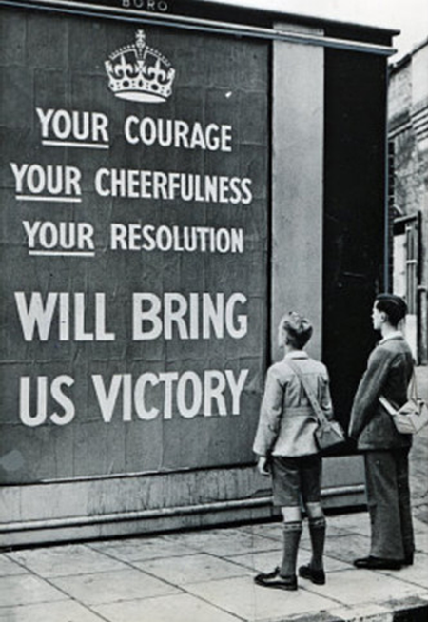
The government thought that it was important for people to ‘keep their spirits up’.

Slide 18
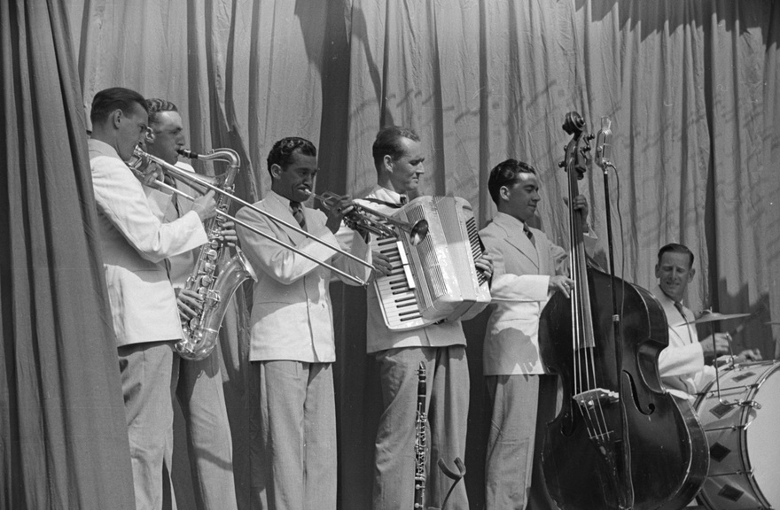
Action: Keeping people cheery

Slide 19
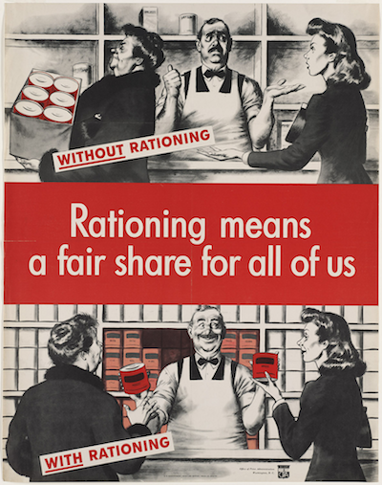
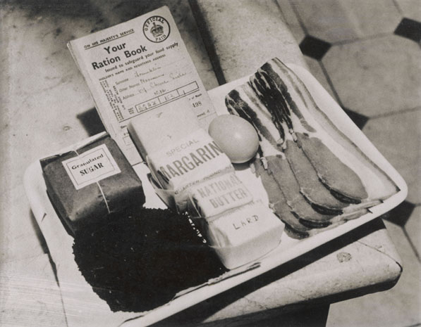
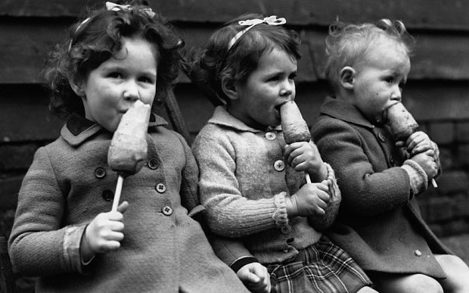
Food was in short supply, but the government sought to share it out as fairly as possible.

Slide 20
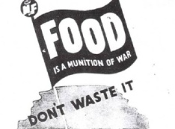
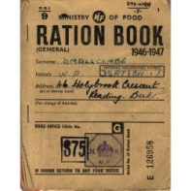
Action: Food Rationing

Slide 21
Now complete
The ‘Diamond 9’ activity.
Place the facts in the order that
YOU
think is important.

