Slide 1
Spring

Slide 2
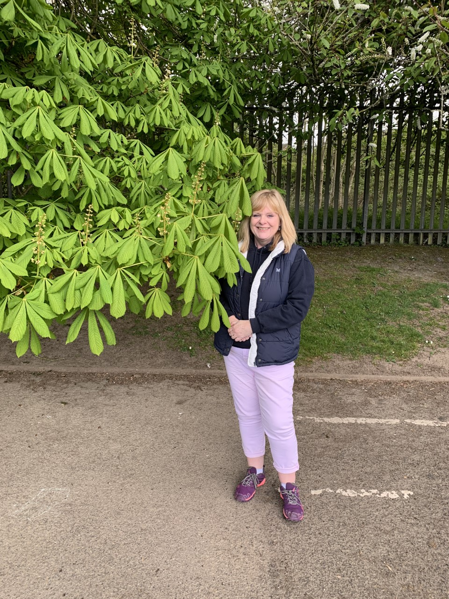
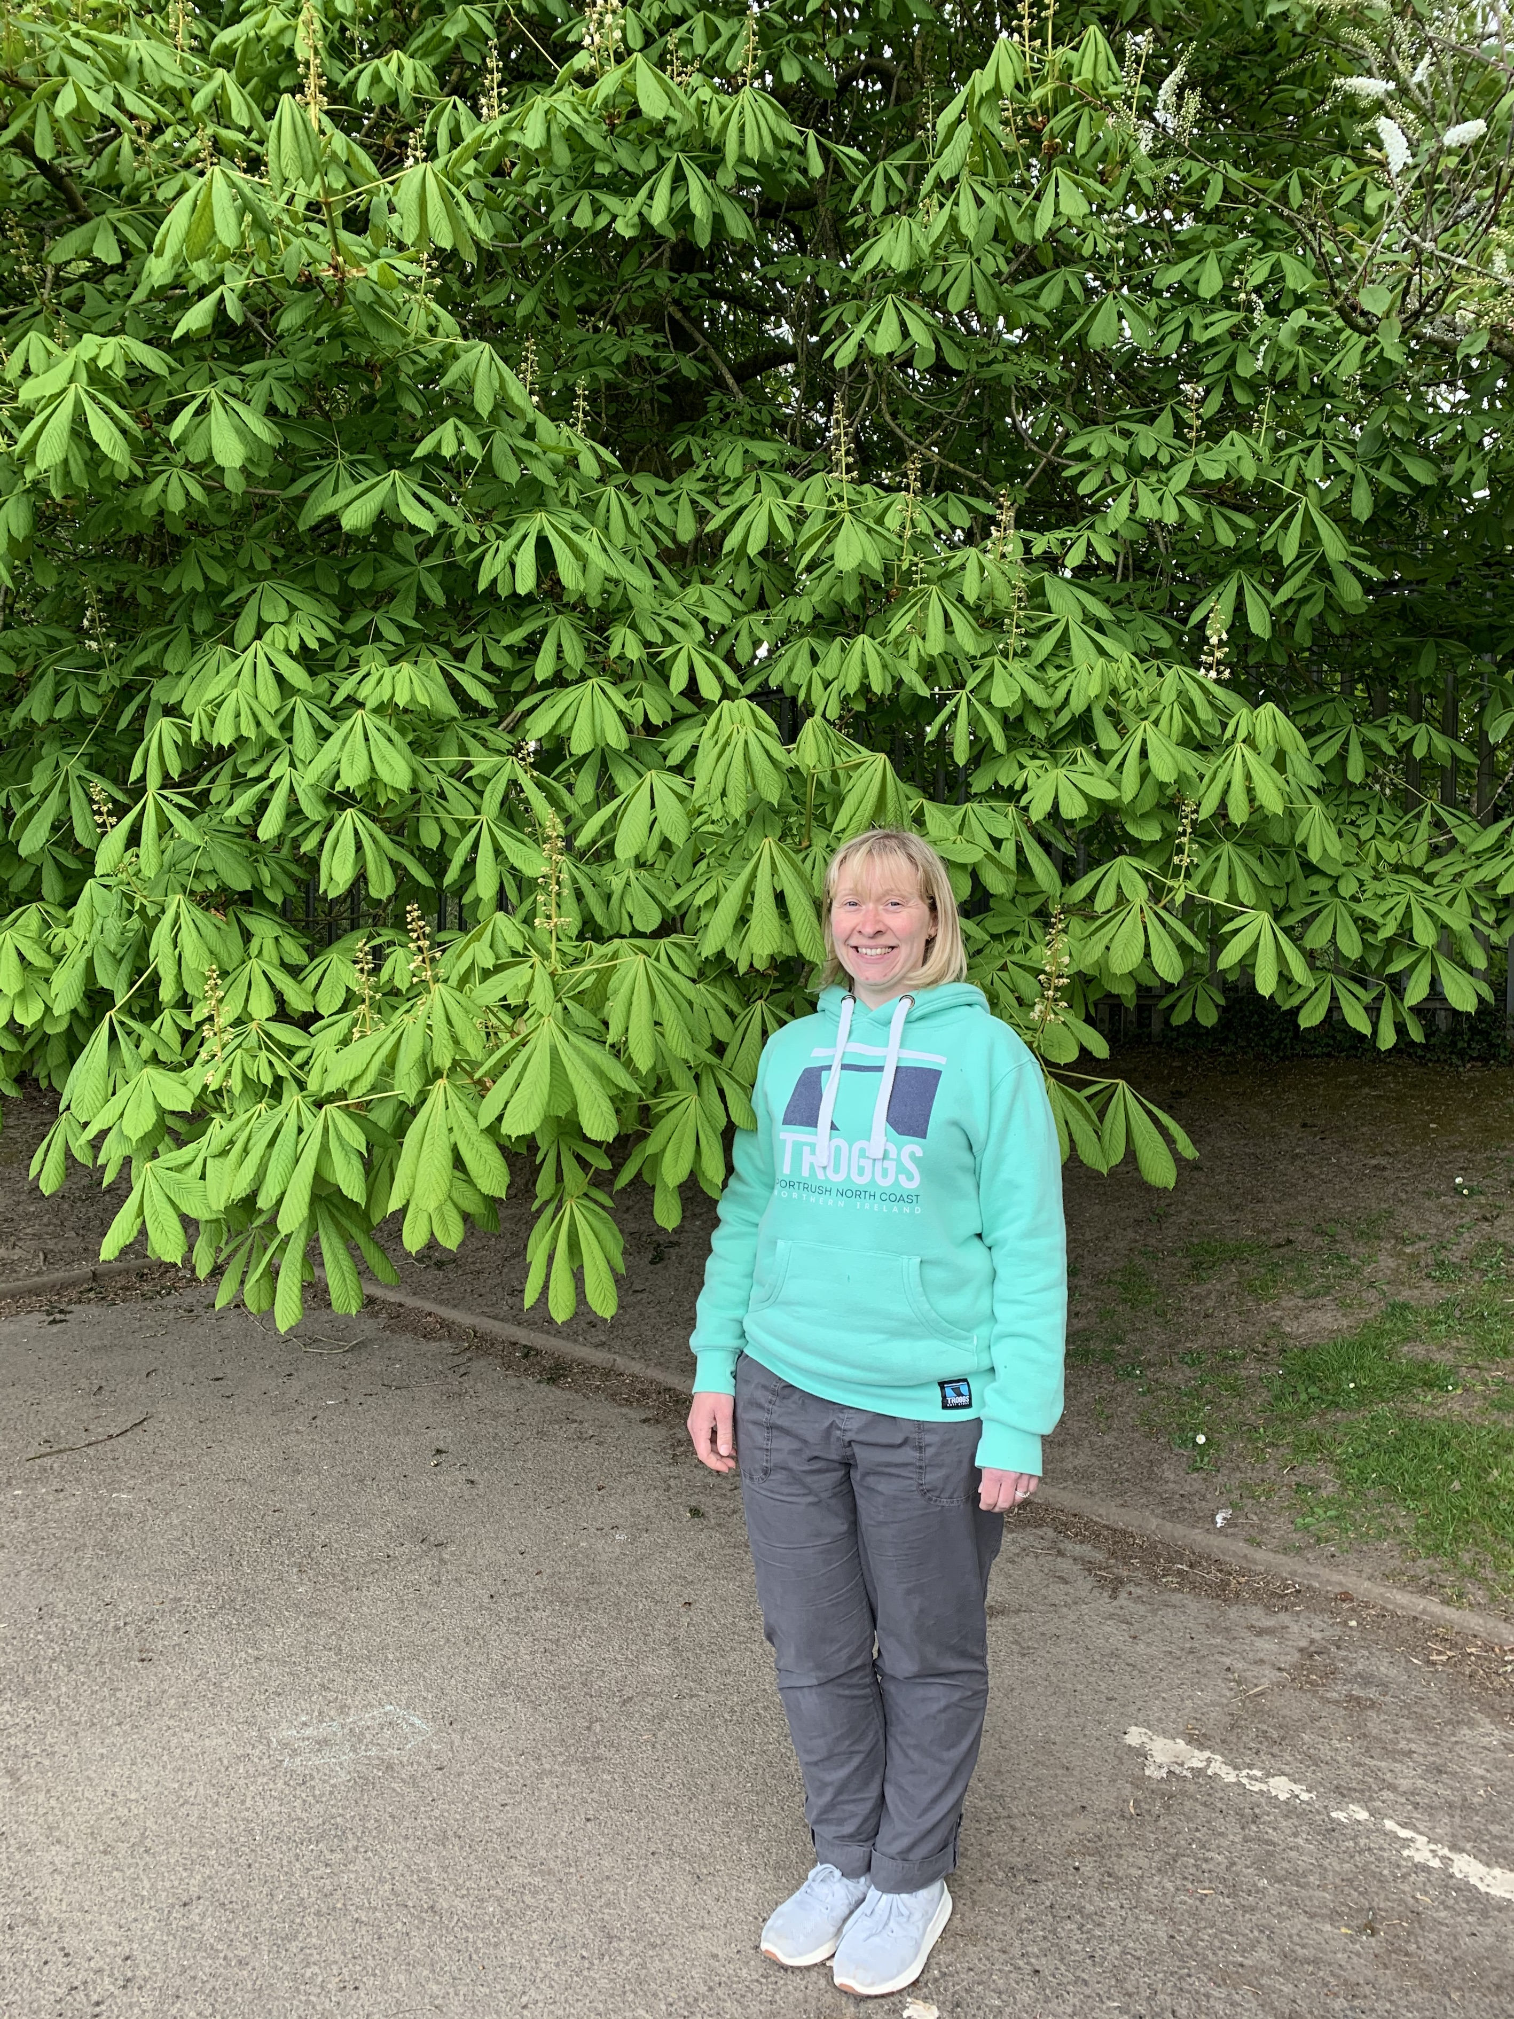
Horse Chestnut Tree
Hello P1!
Do you remember looking at the sticky buds on the Horse Chestnut tree in the playground? The sticky buds have grown and now look like this!

Slide 3
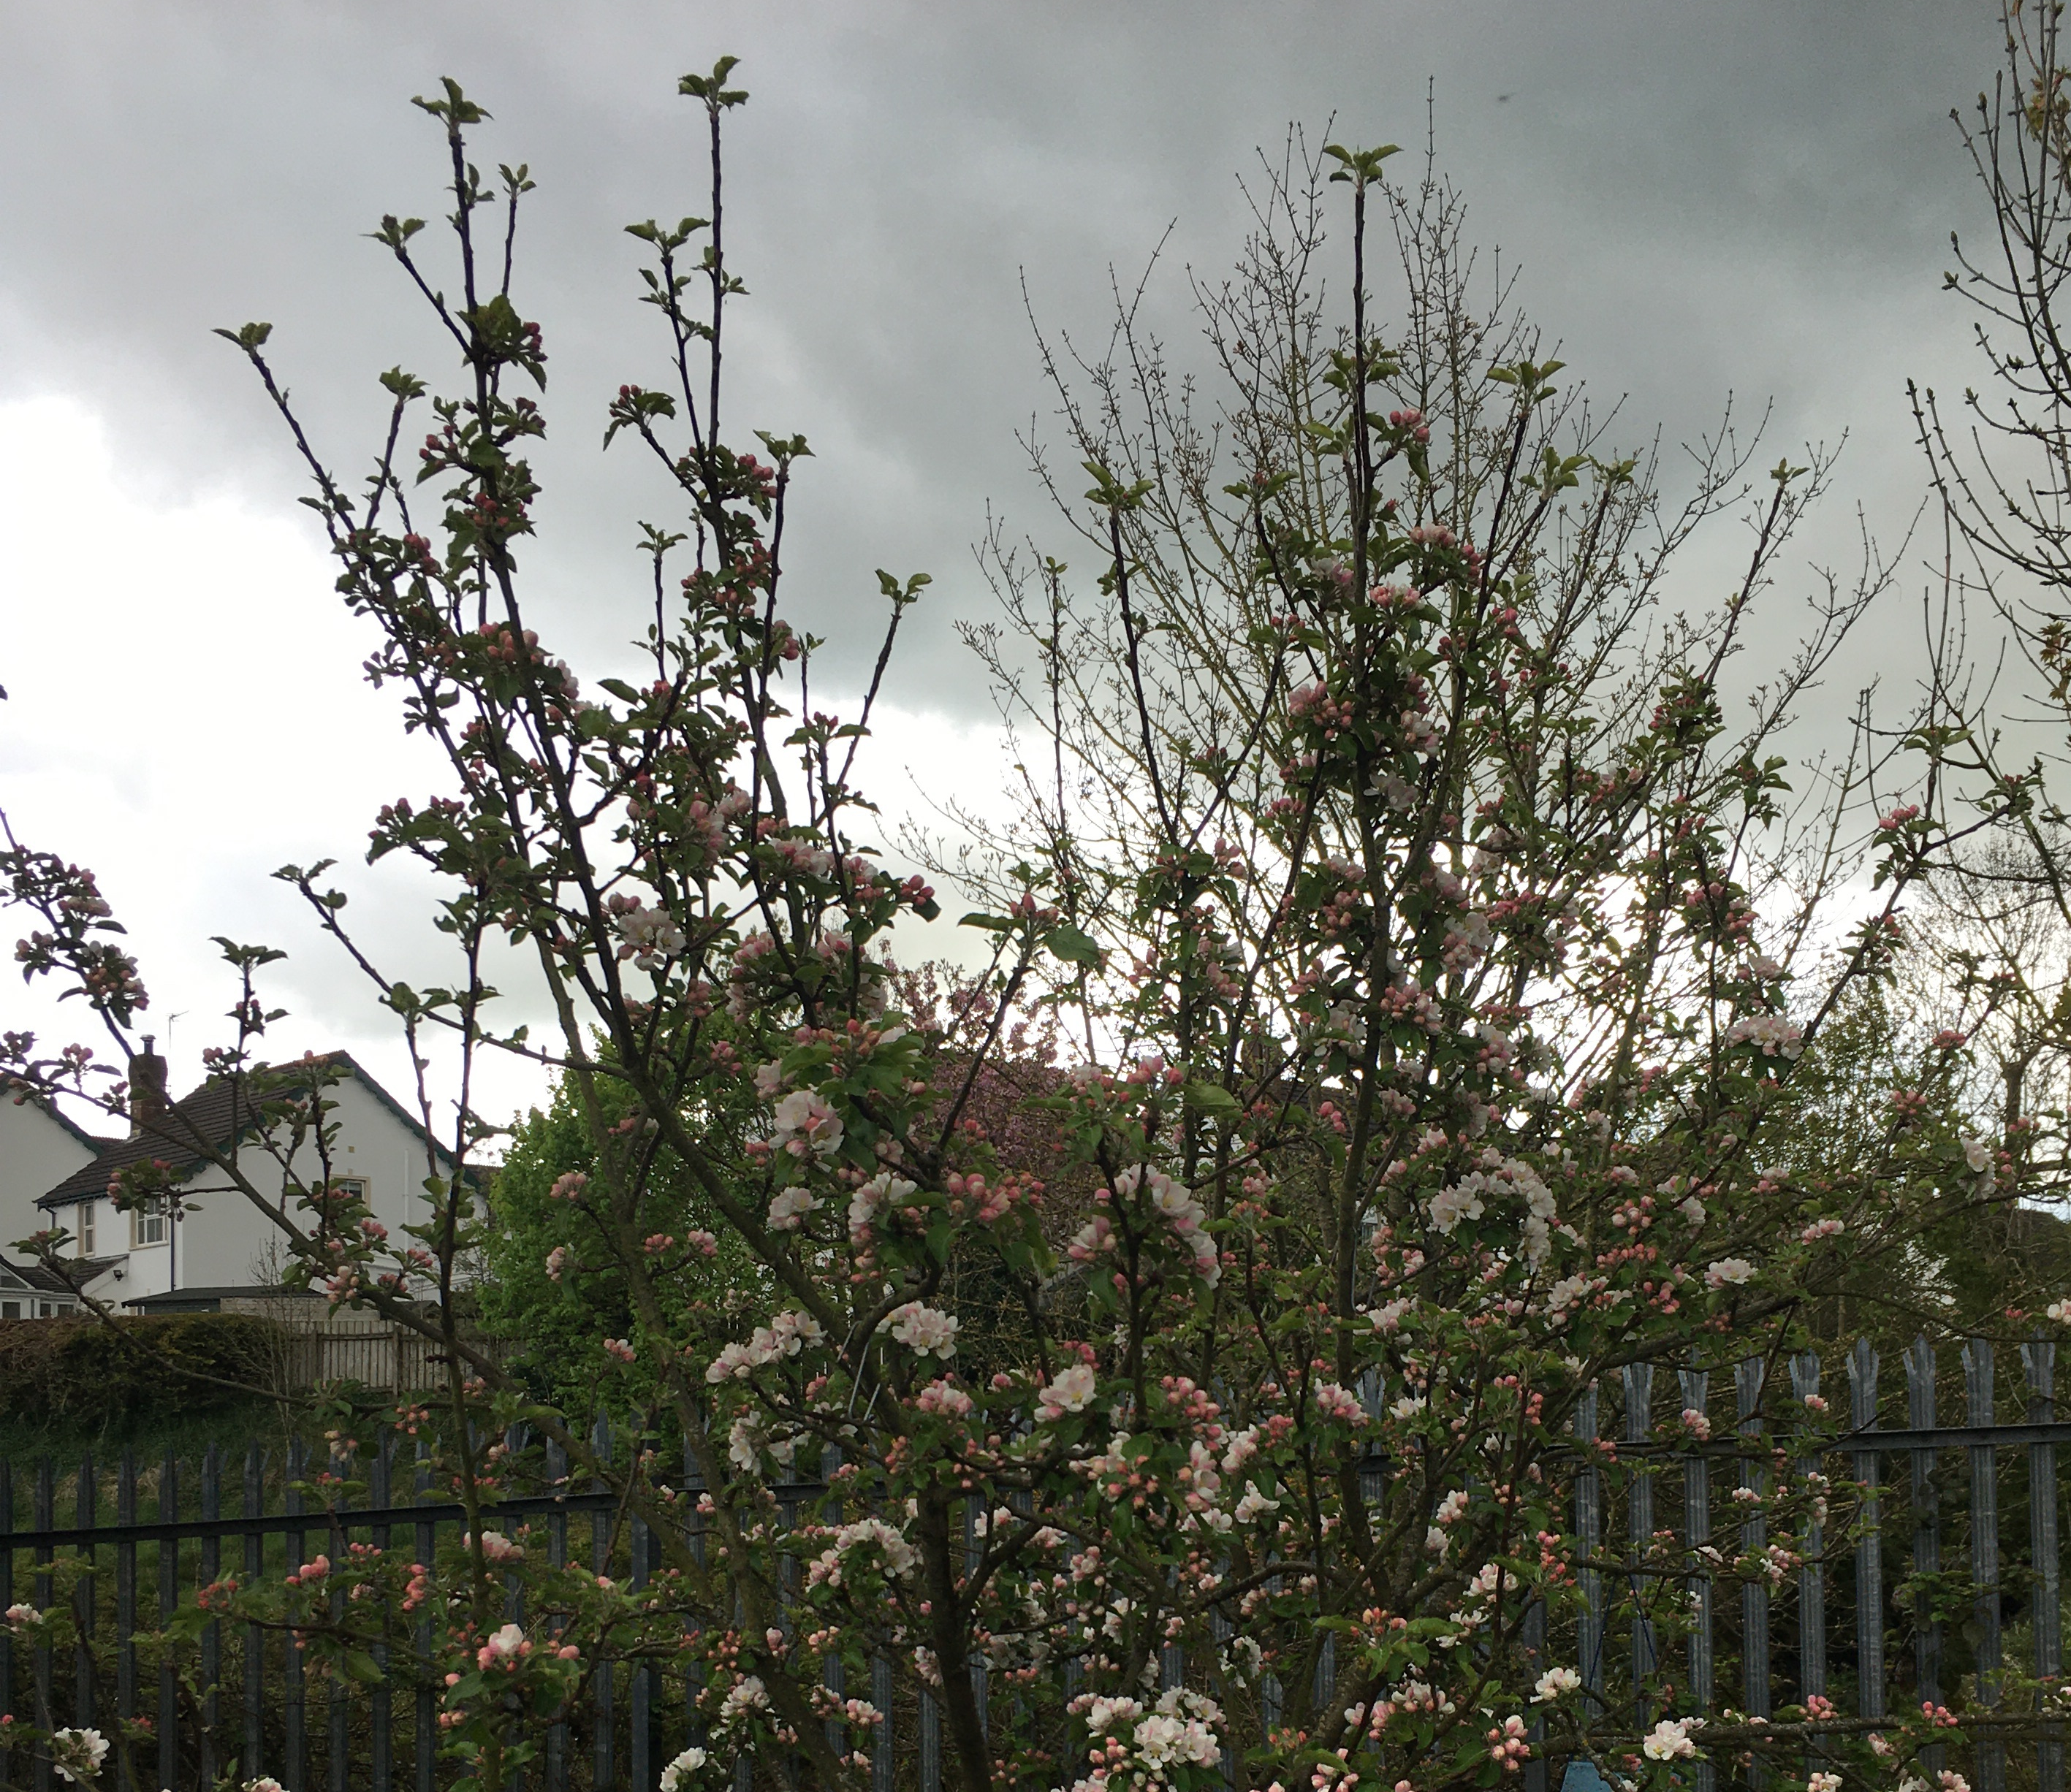
Apple blossom
Our apple tree in the playground is full of blossom. It is very pretty. I wonder how many apples will be on it this year?

Slide 4
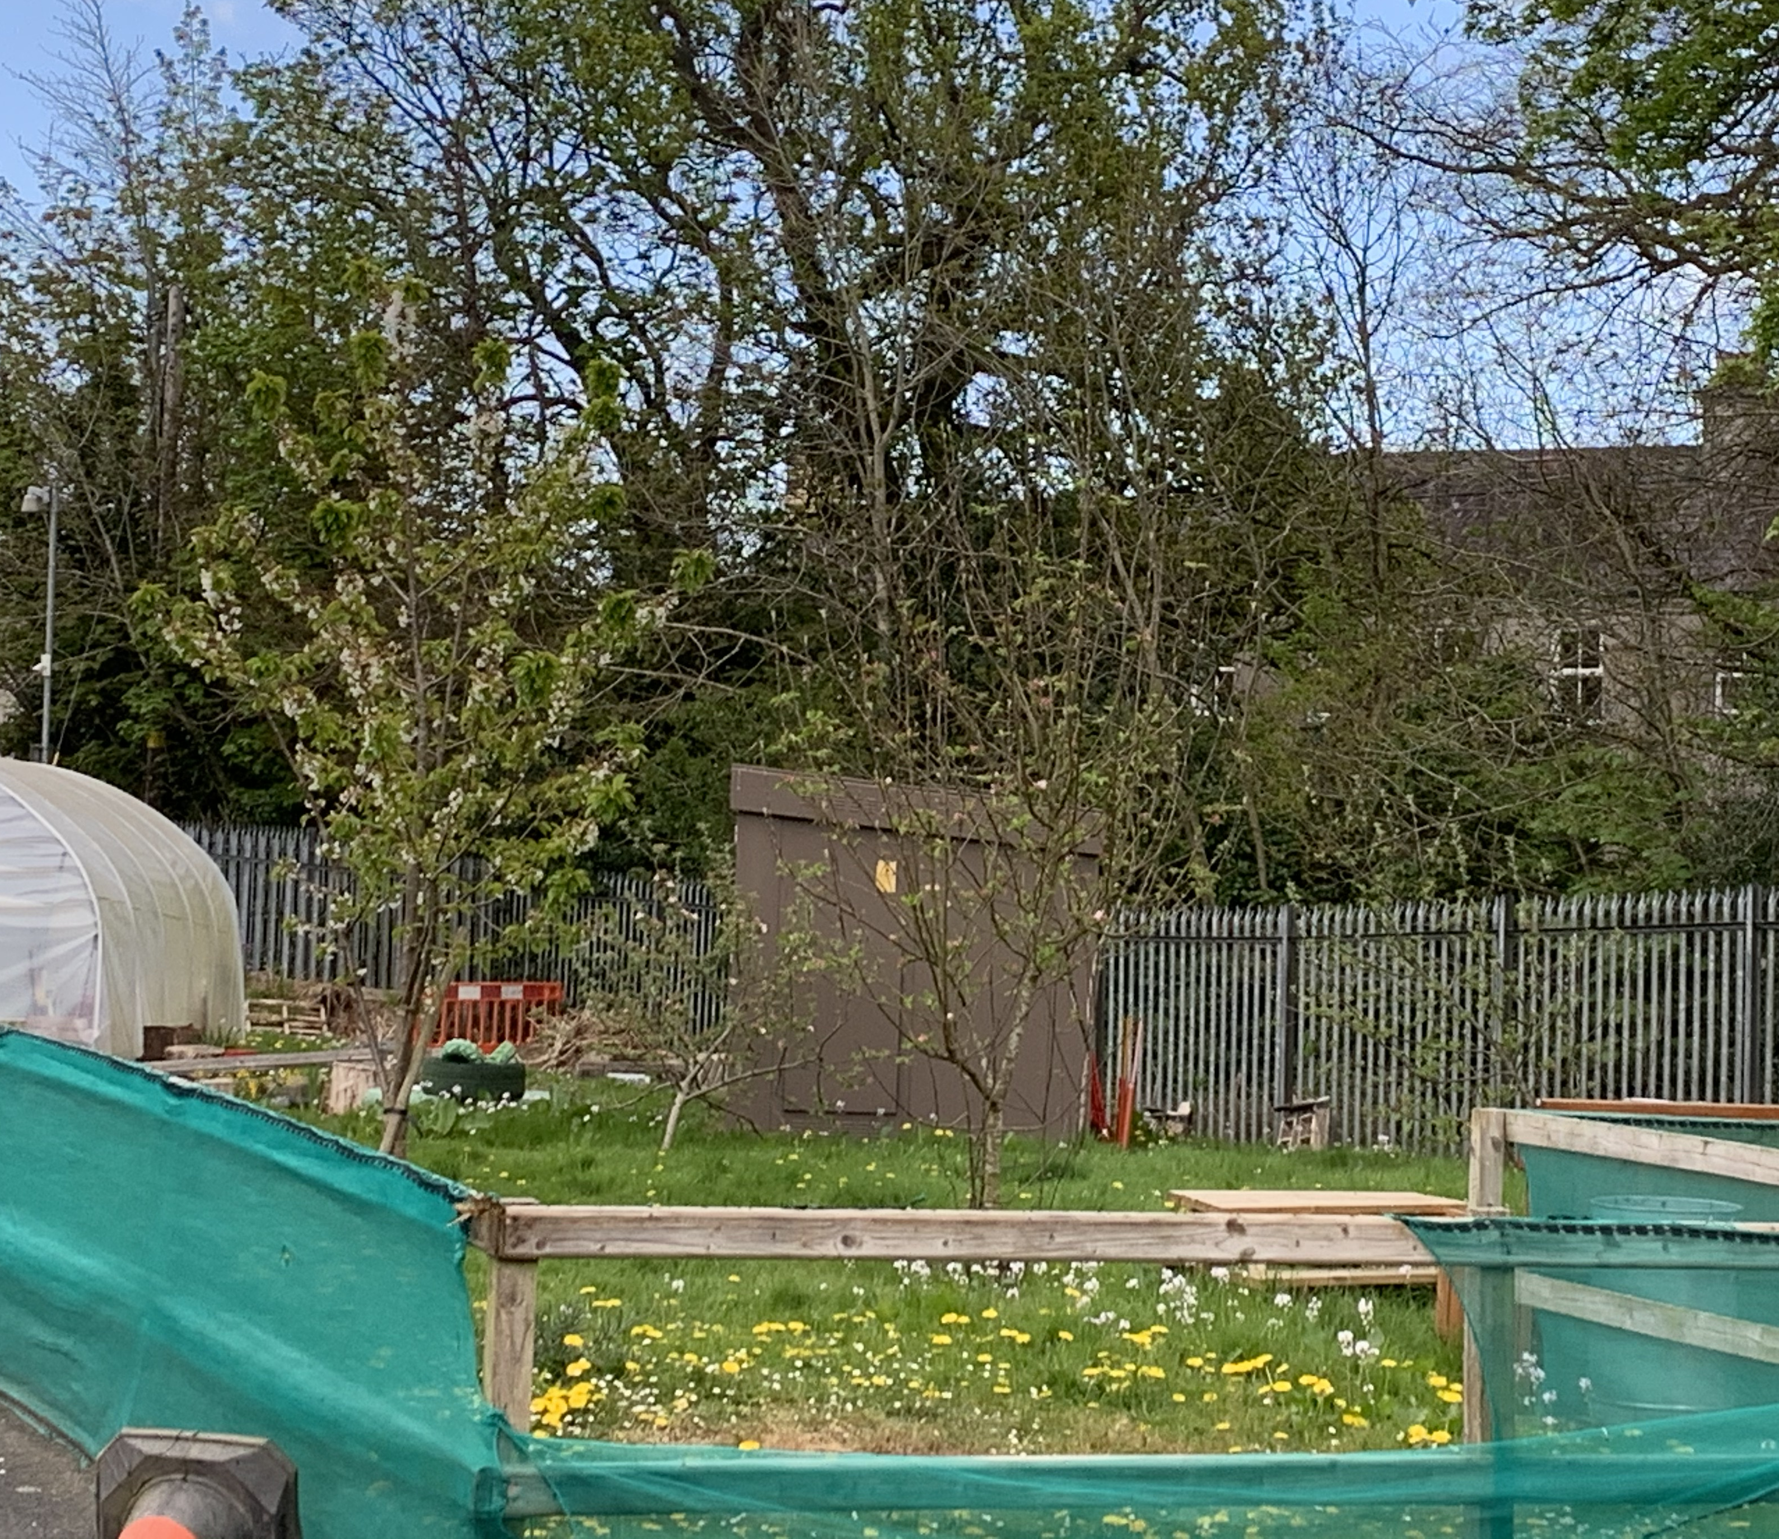
Look at the blossom on the apple trees in our orchard.
Do you remember collecting the apples just after you started P1?

Slide 5
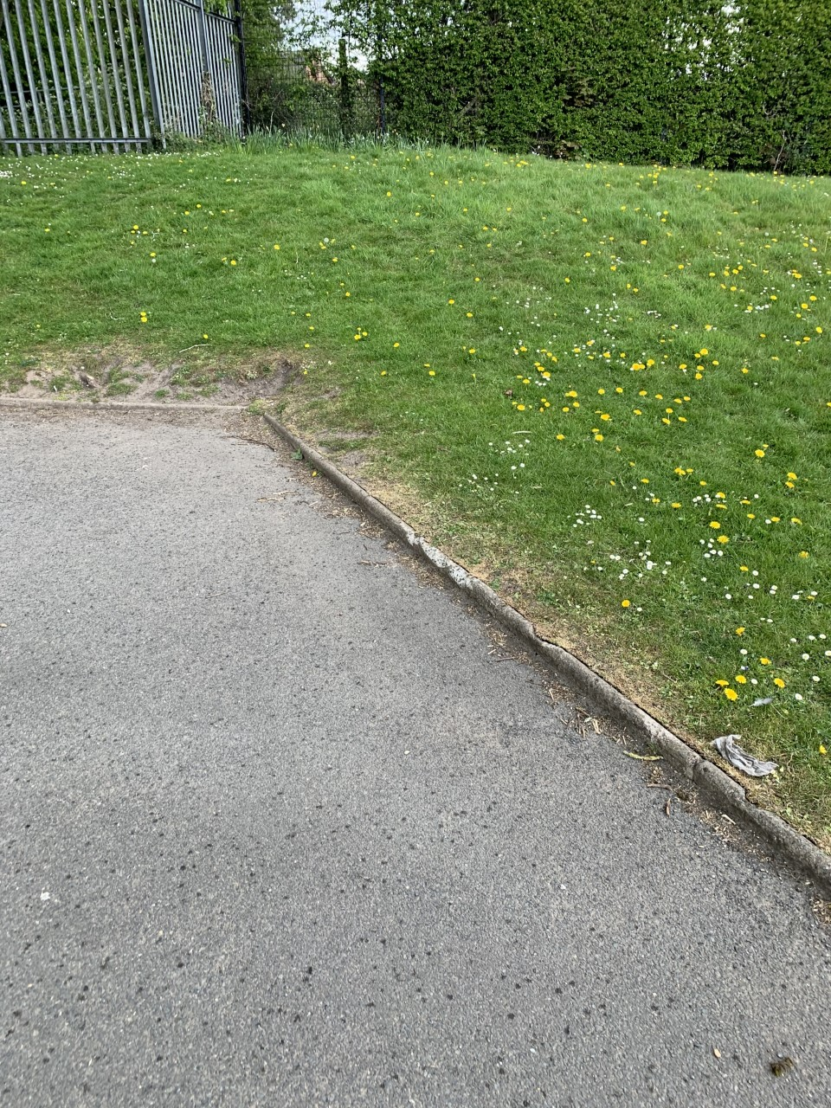
Dandelions

Slide 6
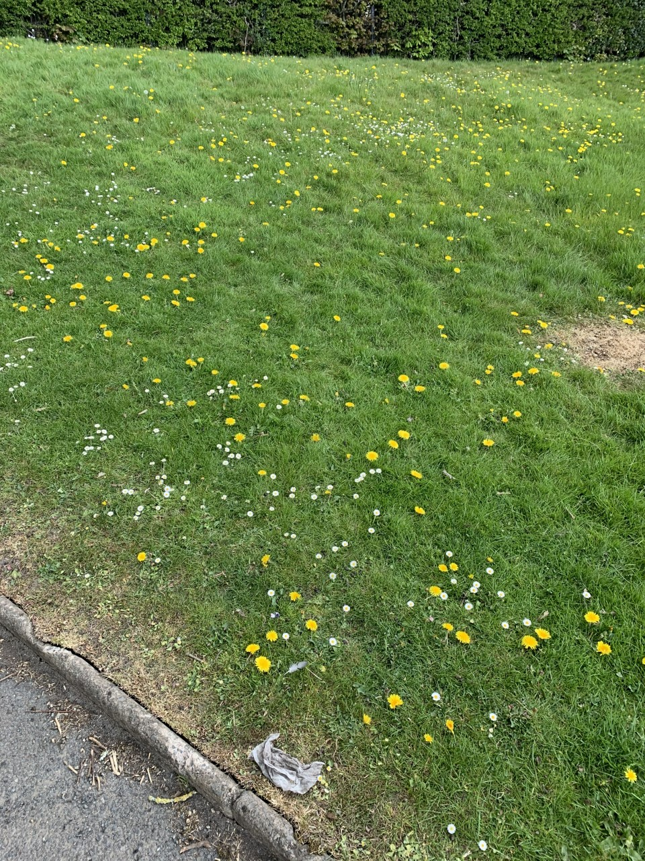
Can you find out some facts about dandelions?
(e.g: Dandelions are weeds not flowers.)
There are lots of dandelions growing in our playground.
A fun way of learning about seed dispersal is to go out looking for dandelions. You may even have some growing in your garden.

Slide 7
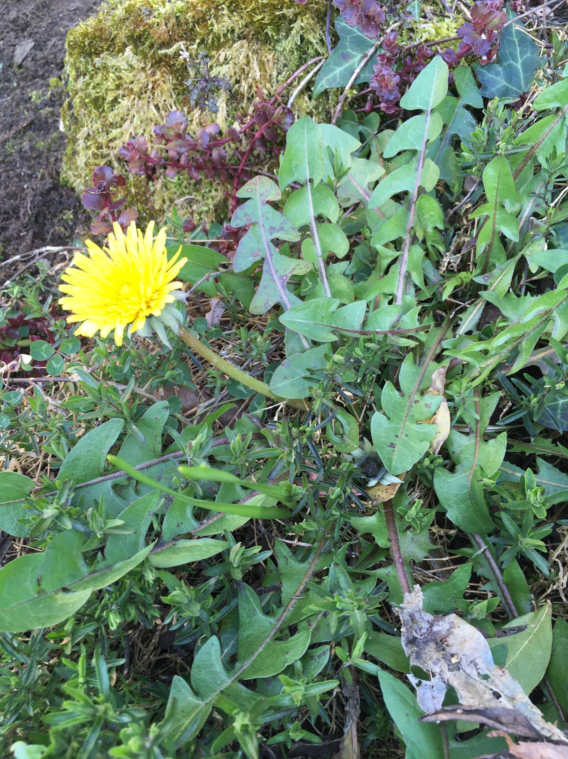
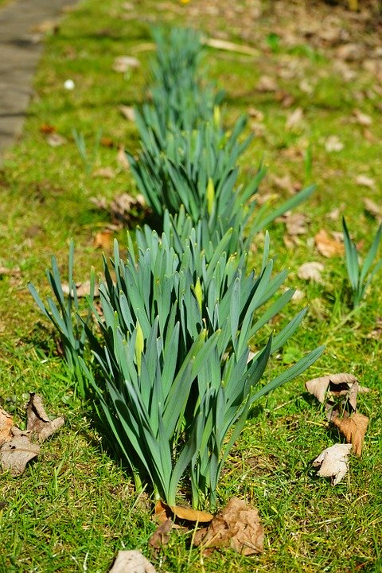
Pick one from the base of the stem. Look at it carefully. There are so many yellow petals. Can you try to guess how many you can see?
Is the stem long or short?
What shape are the leaves?
How are they different from daffodil leaves?
Can you draw or paint the dandelion? How about drawing it with chalk on the ground?

Slide 8
Collect a few dandelions.
Look at the length of their stems.
Can you put them in order from shortest to longest?
Can you take a photograph and send it to us?
Put your dandelions into a pot of water and observe them for a few days.
What happens to them?

Slide 9
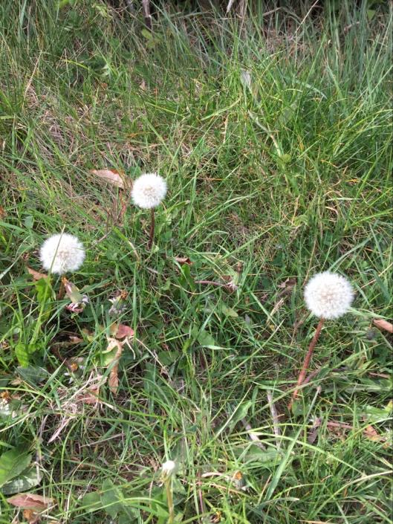
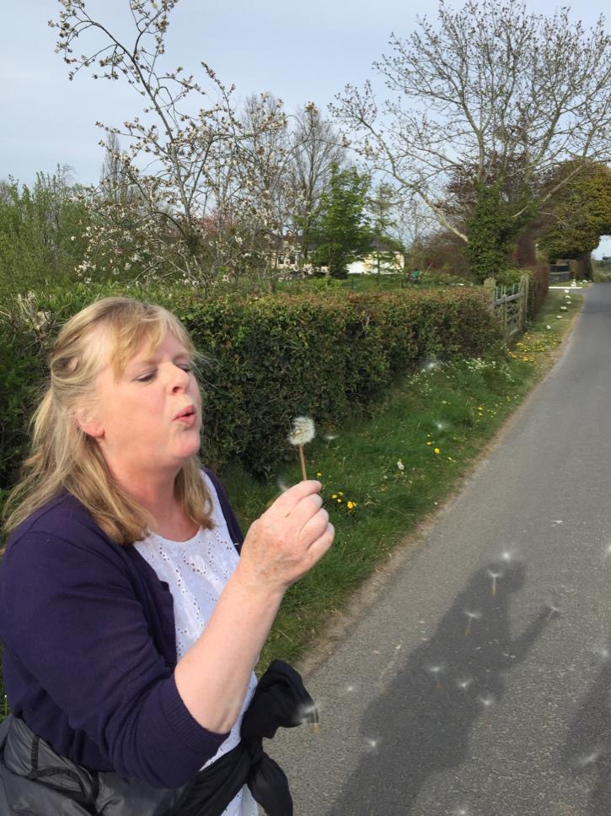
Have any seeds appeared? They are like little parachutes which float through the air, carried by the wind to settle on the ground somewhere else.
This is called seed dispersal
Why don’t you take your seeds and blow them in the air and watch them be carried away by the wind.

Slide 10
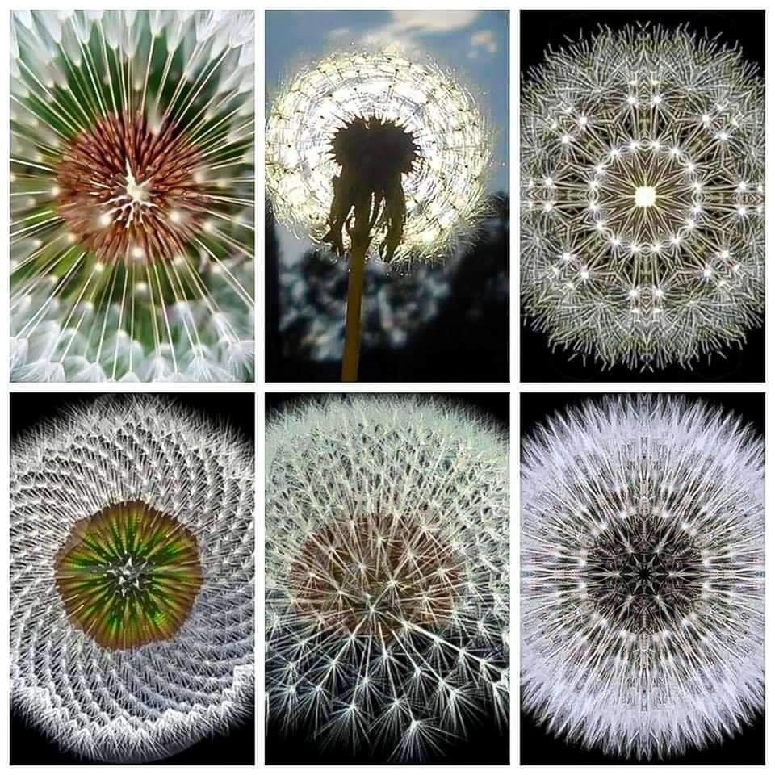
Look at the beautiful patterns of the dandelions clocks.
Can you draw a pattern like one of these?

Slide 11
Here’s another exciting fact about dandelions.

Slide 12
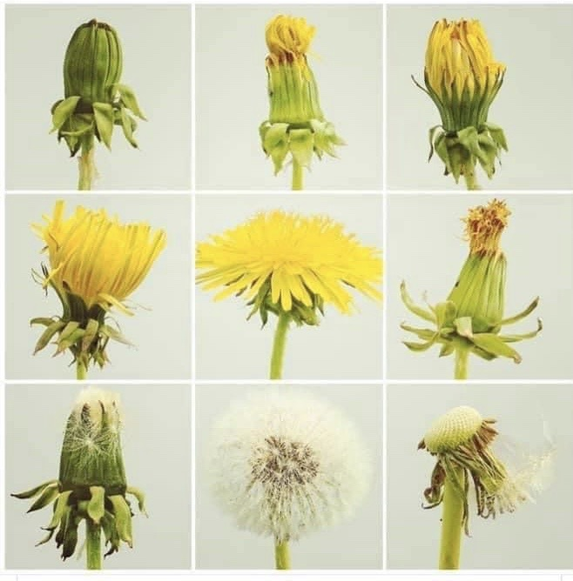
Does this start to happen?

Slide 13
Now you can watch Come Outside on Dandelions.
Auntie Mabel will tell you all about them!
https://www.youtube.com/watch?v=z6DdFup_3s4
Enjoy your learning!

Slide 14
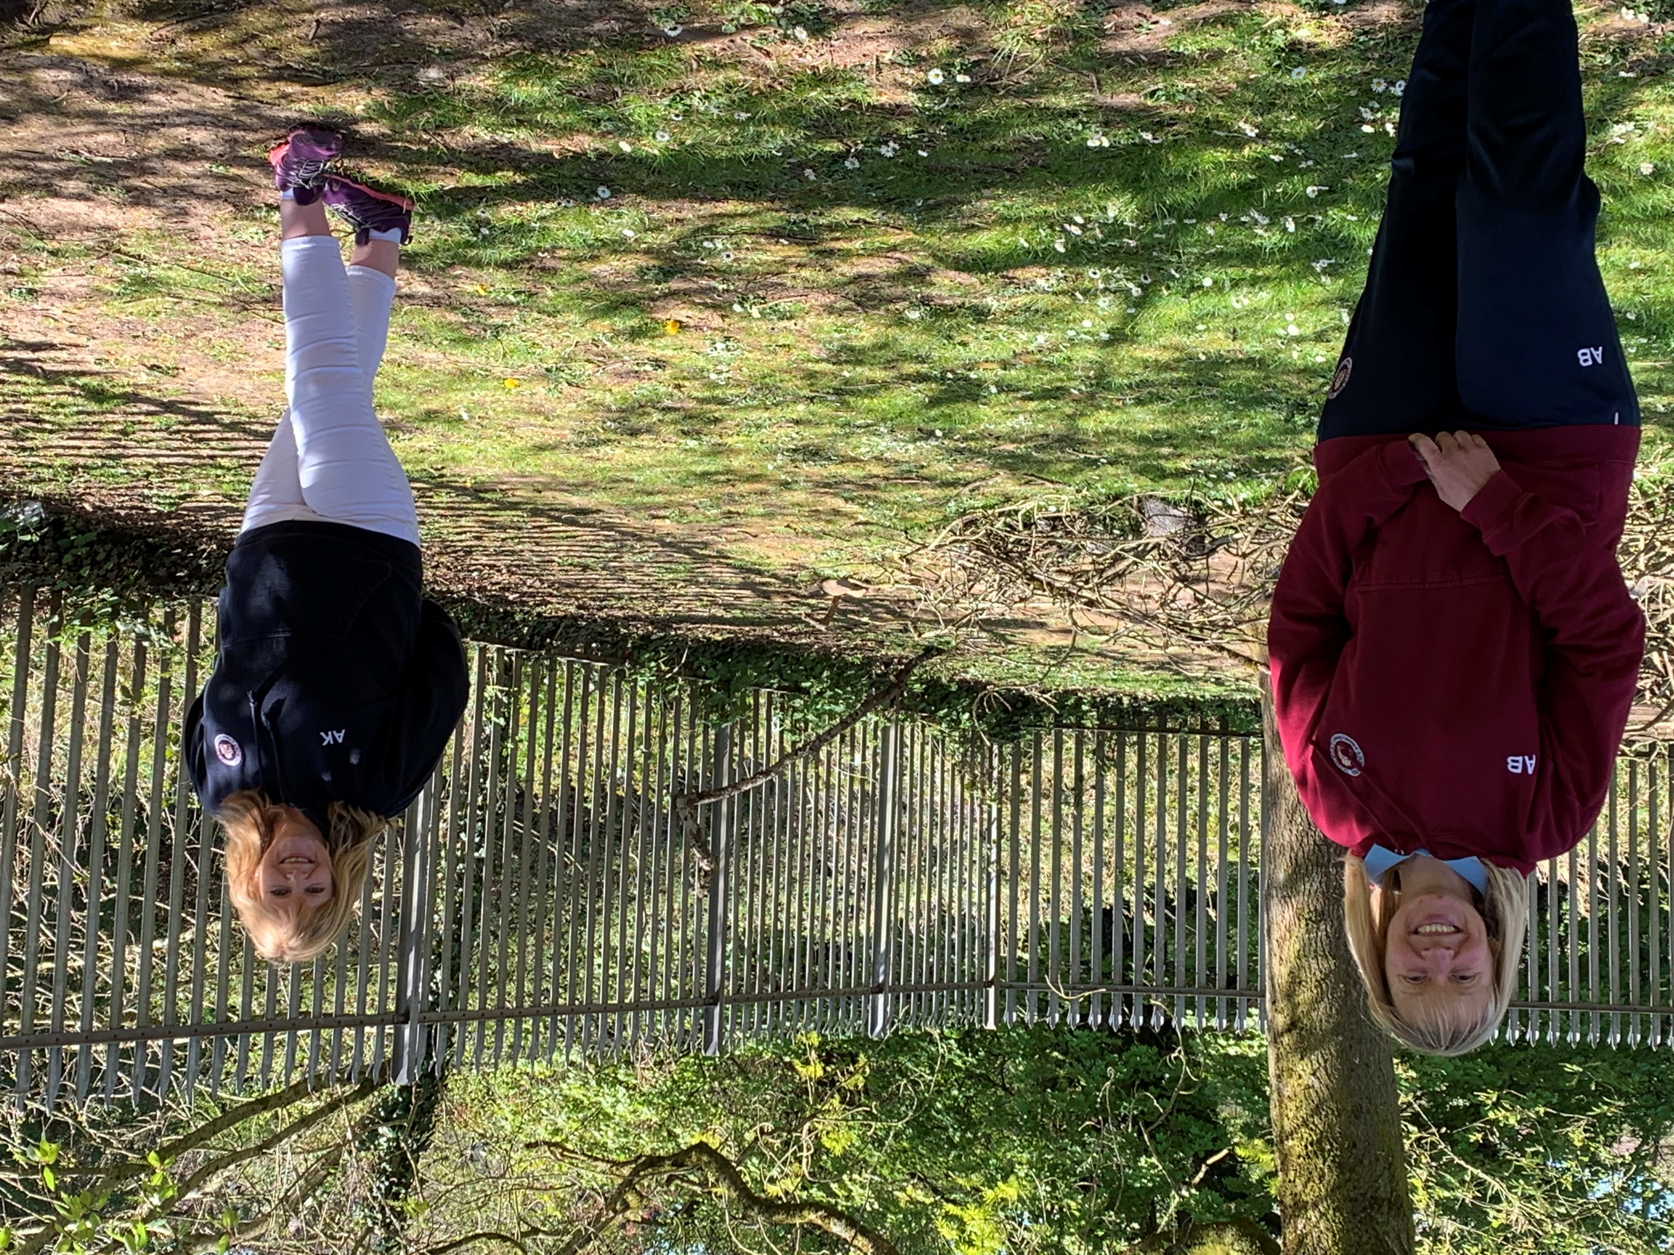
Please use this email address to send us some pictures of your work. Please put your child’s name in the subject field when sending the email.
p1@andrewsmps.com
We can’t wait to see what you have been up to!

