Slide 1
Knock! Knock!!!
Intro: Who lives behind a door like this?????

Slide 2
Door Number One

Slide 3
Door Number Two

Slide 4
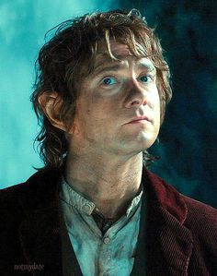
Door Number Three

Slide 5
Door Number Four

Slide 6
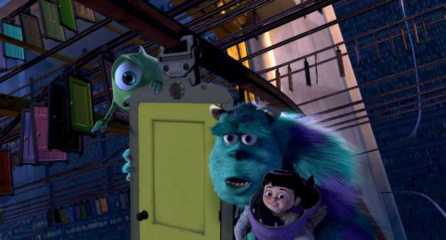
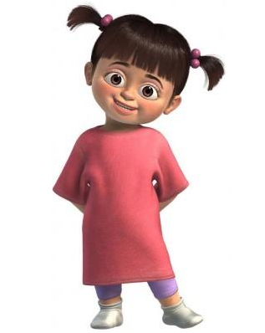
Door Number Five

Slide 7
Door Number Six

Slide 8
Door Number Seven

Slide 9
Beyond the Door…
Imagine it’s a normal day at Andrews Memorial, and you see this door on the balcony of the Andrews Hall. Something makes you go through it. What lies Beyond the Door? That’s the fantasy story we are going to tell!

Slide 10
Our Task:
To produce a piece of fantasy writing entitled…
Beyond The Door

Slide 11
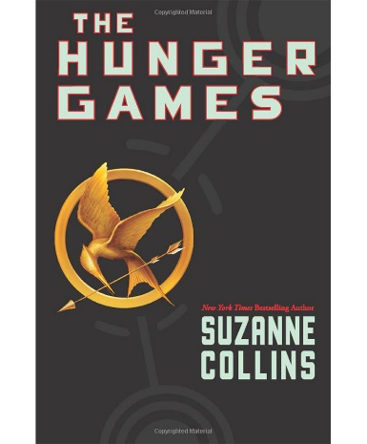
Step One:
WALT: Appreciate texts from the fantasy genre

Slide 12
Step One:
WALT: Appreciate texts from the fantasy genre
Definition of Fantasy Genre: “…any book that contains unrealistic settings, or magic, often set in a medieval universe, or possibly involving mythical beings or supernatural forms as a primary element of the plot, theme, or setting.”

Slide 13
Step Two:
WALT: Use our imagination to gather and organise our ideas, selecting the ones we may use

Slide 14
Use the mind map to gather lots of ideas. You will only use one idea for your final story, but see how many you can come up with!

Slide 15
Deep in Space
Beyond the Door
The undersea kingdom

Slide 16
The mind map on the previous slide has been started for you
At the end of each wiggly line, add a possible setting / location for what lies behind the door in your story
Then use smaller arrows to come up with characters and plot ideas
Finally, decide which idea you will base your story on

Slide 17
Step Three:
WALT: Organise our thoughts and ideas to create a structured plan for our written piece

Slide 18
Setting: Where or when is your story set once you go through the door?
Characters: Who do you meet when you go Beyond the Door?
Problem: What goes wrong or what must the characters overcome?
Intro: Set in today’s times, how and why are you going through the door? Once you go through, do you fall into a new world? Do you land with a bump?
Ending: How is the problem solved and how do you get back to the door?

Slide 19
Step Four:
WALT: Create an imaginative piece of writing in the fantasy genre

Slide 20
WILF:
Can you jot down on a post-it some more interesting words than the ones below? Try to use these in your writing instead!
Adverbs to strengthen verbs
Interesting adjectives
Careful spelling
Unique ideas
Can you use a thesaurus to avoid “boring” words?
Looked
Walked
Said
Curious
Scared
Excited

Slide 21
Follow the steps…
Conclusion
About 5 lines
Remember your story should start and end in the Andrews Hall
Paragraph 5
About 8 lines
Paragraph 4
About 8 lines
Only group 1 need a 4th and 5th paragraph
Paragraph 3
About 8 lines
Paragraph 2
About 8 lines
Introduction
Synonyms
Adverbs
Spelling!!!
About 5 lines

Slide 22
Self Assessment:
Something I did really well
Something else I did really
well
Something I could improve
on before writing their fantasy story
Even Better If…

Slide 23
Why not upload to NewsDesk?
Google “My School” and login using your usual login and password.
Click on “My Links”, then in “My Apps” click on NewsDesk.
Click on “Reporter” where there is a microphone icon.
Scroll down and click on “Create a Headline Story”.
Type your story on a Word document (or Pages on iPad), then copy and paste the writing into the box on NewsDesk (You don’t need a title or any colours or fonts).
Type your title “Beyond the Door” into the “Headline” box.
Add your age and the password you would usually use to log in.
Why not search “Beyond the Door” to like and comment on your classmates’ stories?
Note: It can take a few hours for stories and comments to be approved by the staff at NewsDesk, so they won’t appear immediately!

Slide 24
ICT Extension Tasks…
Why not bring your Beyond the Door story to life?
You could use BookCreator to tell your story with added animations!
You could use iMovie to transform your story into a movie with animations drawn and photographed, by acting, or by using lego figures or toys!
You could create a comic-book version of your story by using the ComicLife app!

