Slide 1
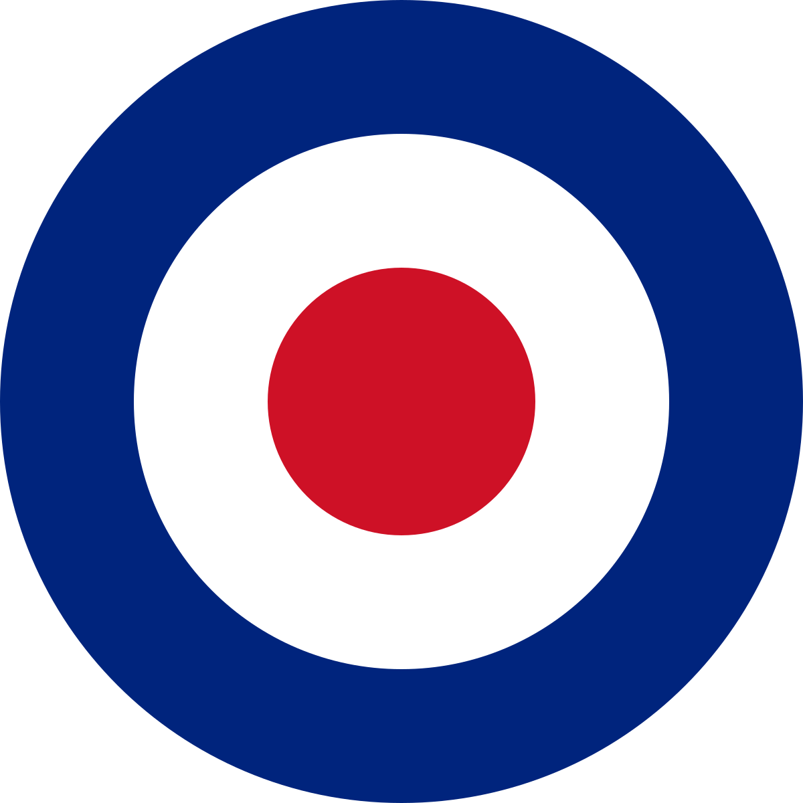
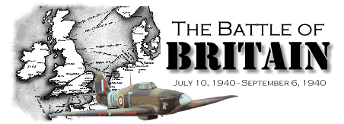

Slide 2
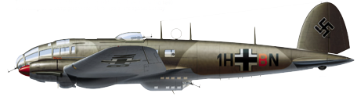
The British army had narrowly escaped complete defeat at Dunkirk
Now Hitler’s army was only 21 miles across the English Channel
But before they invaded, the Germans needed to control what?
The air!

Slide 3
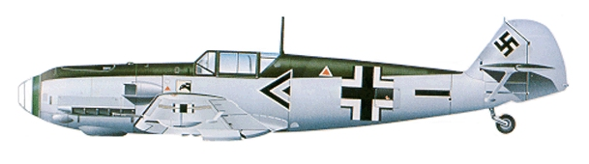

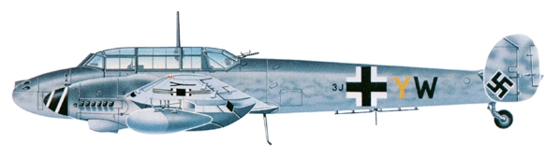
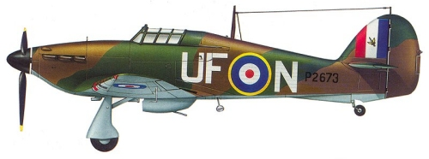
Why was control of the air so important?

Slide 4
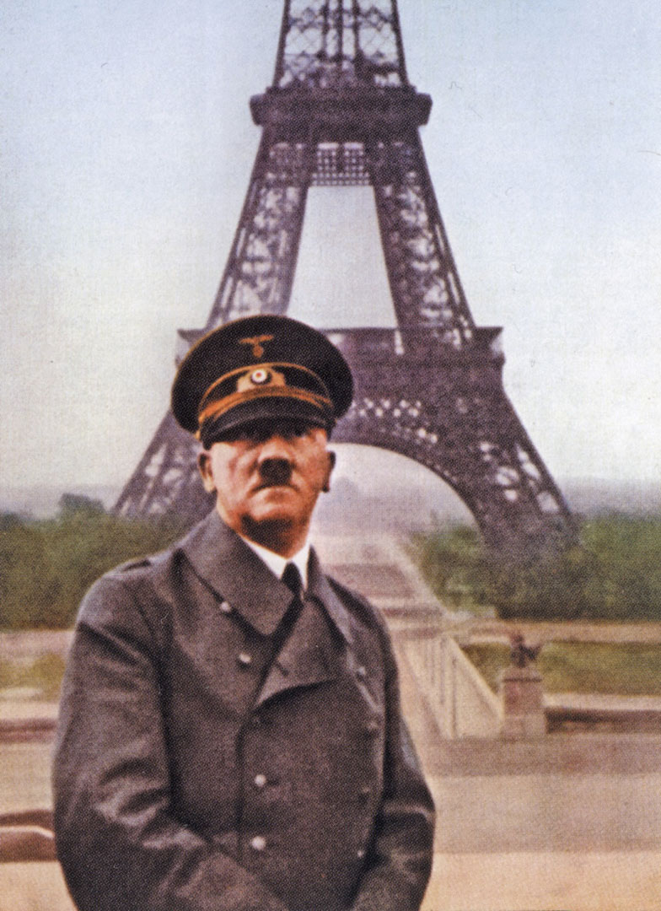
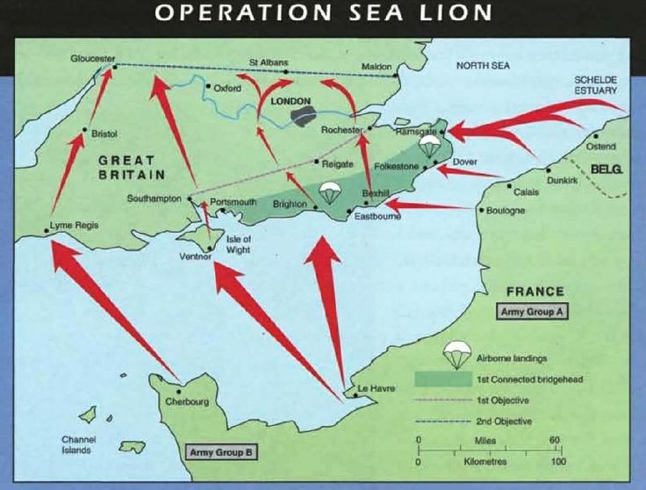
Hitler’s plan to invade England was called:
‘Operation Sealion’

Slide 5
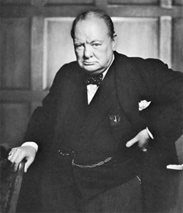
Winston Churchill, the Prime Minister, knew how important the next battle would be.
Winston Churchill
June 18, 1940

Slide 6
"What General Weygand called the Battle of France is over. The Battle of Britain is about to begin."
Winston Churchill
June 18, 1940

Slide 7
What was Churchill trying to achieve by making this speech?

Slide 8
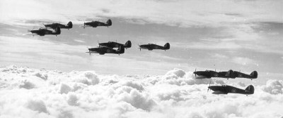
The Royal Air Force was greatly out-numbered
RAF
Luftwaffe
Single-seat fighters
Twin-seat fighter
Bombers
Maritime patrol
754
159
560
500
1,107
357
1,300 / 428*
233
* Dive-bombers
Source

Slide 9
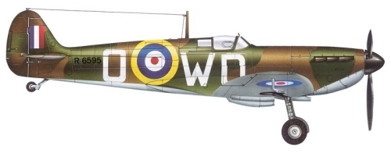
But the RAF had two excellent fighter planes!
Supermarine Spitfire
Hawker Hurricane

Slide 10


Spitfire vs. Bf 109
Generally felt to be evenly matched
More rugged
Higher maximum dive speed
Better handling characteristics
Heavy on controls at high speed
Better visibility
Heavier armament (cannon)
Source

Slide 11
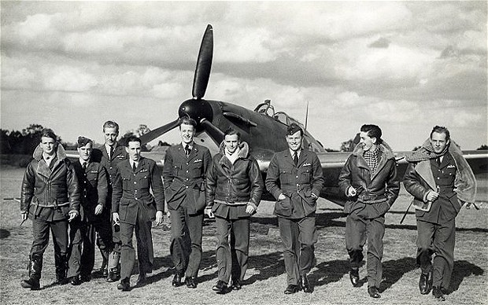
They also had some very brave, very young pilots…
Source

Slide 12
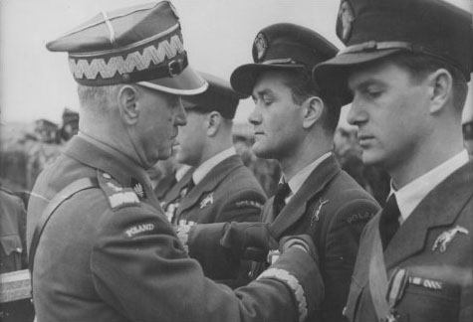
And the help of some very brave and experienced pilots from Poland and Czechoslovakia

Slide 13
Q.What did Poland and Czechoslovakia have in common?
A.Their countries had both been invaded by Hitler’s army

Slide 14
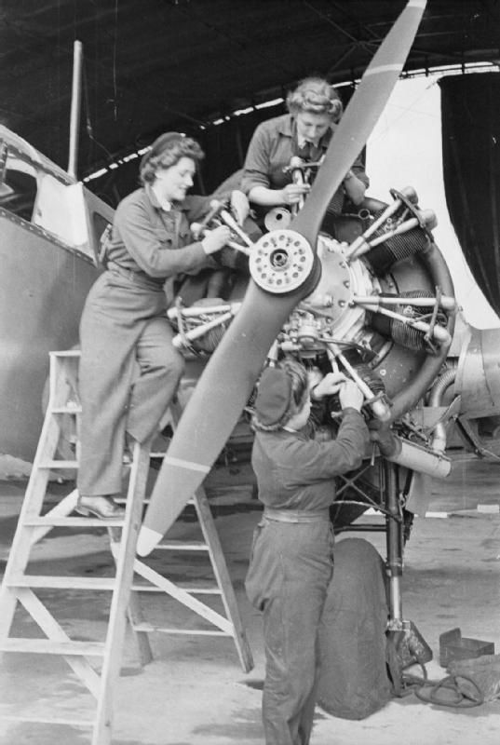
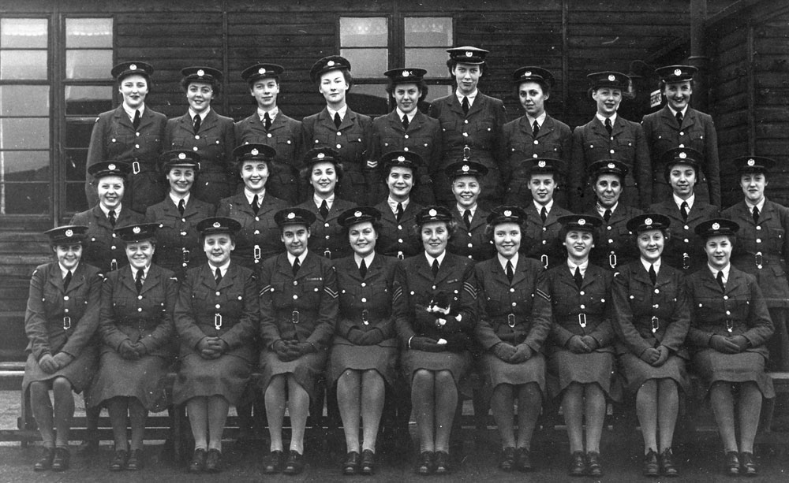
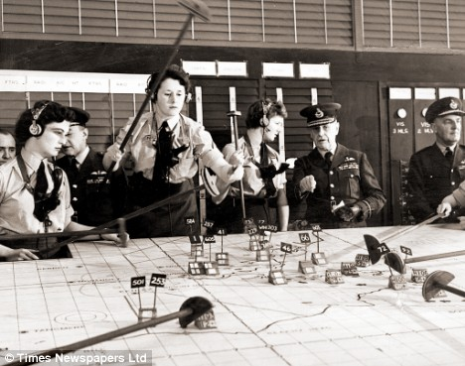
Women also played their part!

Slide 15
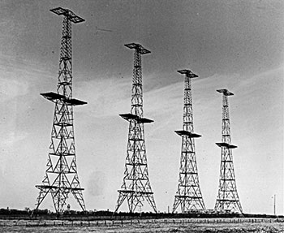
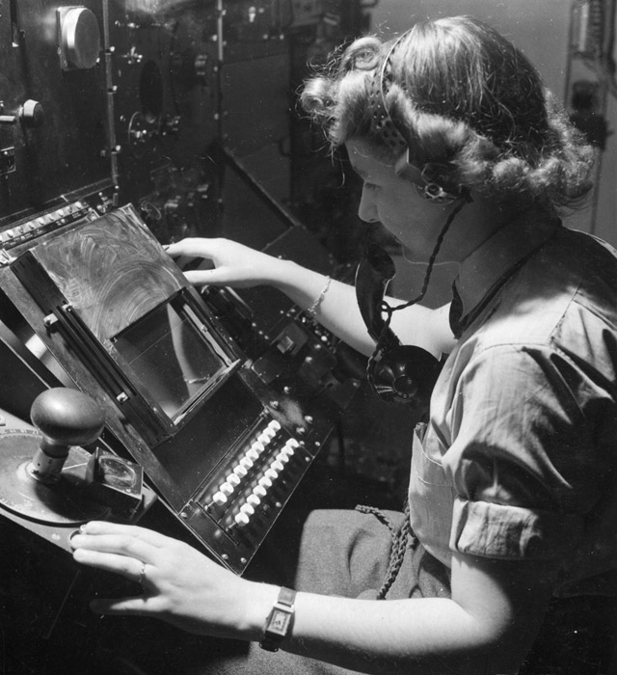
And one very special invention. Can you guess what it was?

Slide 16
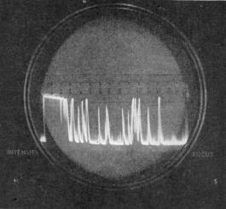
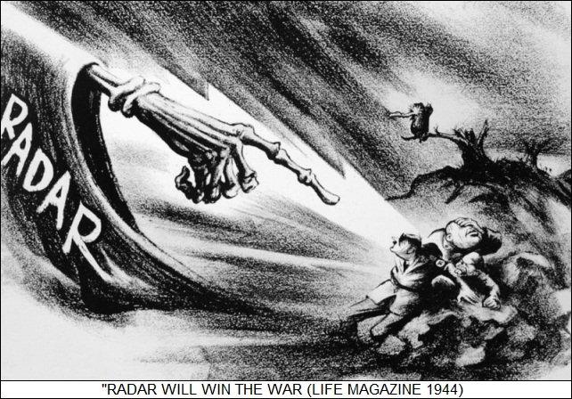

Slide 17
By 31st October 1940, Germany had lost so many planes and pilots that Operation Sealion was cancelled.
Britain was still losing the war, but for now the threat of invasion was over.

Slide 18
Losses
RAF
Luftwaffe
Single-seat fighters
Twin-seat fighter
Bombers
Maritime patrol
}
1,023
376
148
520
1,107
357
1,014
2,600+
Pilots Lost
Source

Slide 19
In Parliament, Mr. Churchill praised ‘the few’. Who do you think ‘the few’ were?

