Slide 1
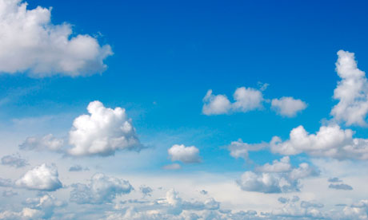
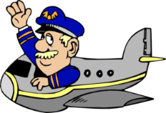
Captain Andrews’
Flight Experience…
…Lesson 2
PRESSURE

Slide 2
What does it mean to be…
?

Slide 3
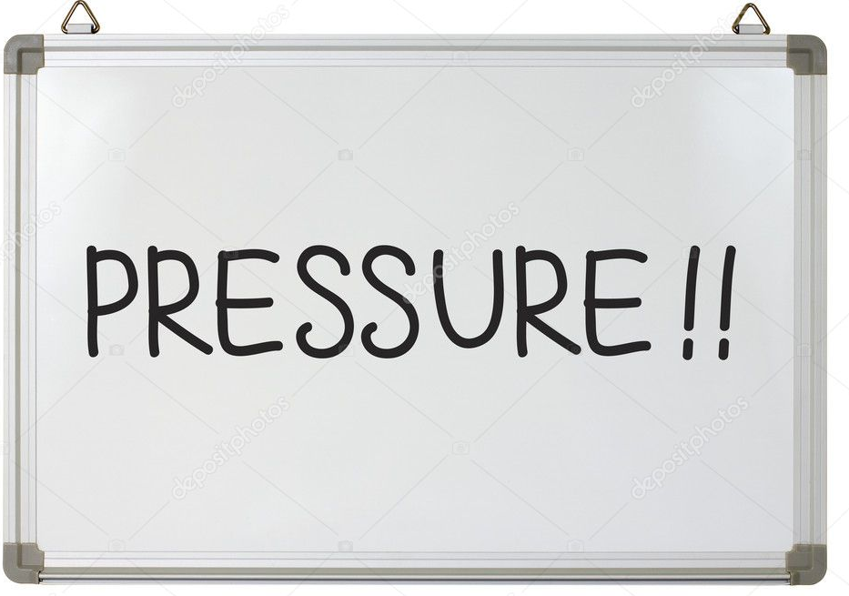
WALT
See that pressure is a force which pushes down on all objects

Slide 4
Unfortunately, some of
our experiments today
need to be demonstrated
as they can be a little
dangerous. Follow
these links to see them
https://www.youtube.com/watch?v=28TIyWdfxxc
https://www.youtube.com/watch?v=lT3PJ0RY4oY

Slide 5
But here’s one that’s
much safer that
you can do
https://www.youtube.com/watch?v=3xsOxff0Qf4

Slide 6
Follow these instructions
to help you complete today’s worksheet
Materials
Smooth table in a clear area
Safety goggles
A 30 cm ruler
Sheet of Newspaper
Procedure
First, set your ruler on the table. Allow about 12cm of the ruler to protrude over the edge of the table.
Place a piece of double-folded newspaper over part of the ruler that is on the table.
What do you think will happen when strike the stick with a karate chop?
Using the side of your palm, try to chop the ruler in two using a knifehand strike. Don’t use your other hand to brace the ruler!
Next, unfold the newspaper and cover the ruler with one or two sheets of newspaper. Smooth the paper over the ruler so that there are no air pockets. Again, make sure the appropriate length of the ruler extends over the edge of the table.
Predict what you think will happen this time when you strike the ruler.
Give the ruler your best strike (again, no bracing allowed!).

Slide 7
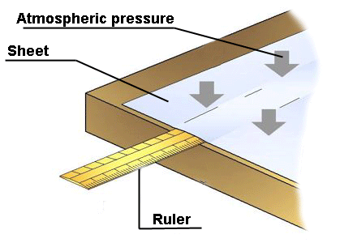
Results
During the first chop, the ruler probably flew off the table. During the second chop, the ruler should hardly have even moved! (If you didn’t get this result for the second chop, try again, making sure that your newspaper lies perfectly smooth and that you strike cleanly.)
Why?
When you spread out the newspaper on top of the ruler, you basically created a large suction cup because you’re preventing air from flowing underneath. When you strike the ruler, it tries to lift up against the newspaper, but because the air can’t flow very quickly into the space between the table and the newspaper, most of the column of air is above the paper pushes down on it. AIR PRESSURE IN ACTION

Slide 8
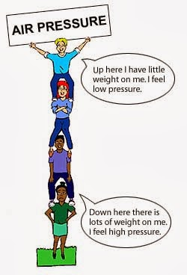
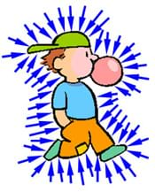
Air Pressure
is all around us all of the time ~
we don’t notice it because we’re
so used to it ~
it’s always pressing down on us.

Slide 9
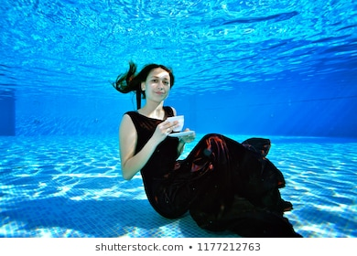
If you sit on the bottom of a swimming
pool it feels very different.
That’s because there’s a different pressure, pressing against you.
WATER PRESSURE

Slide 10
Captain Andrews’
Flight Experience…
…Lesson 2
PRESSURE

