Slide 1
Spring

Slide 2
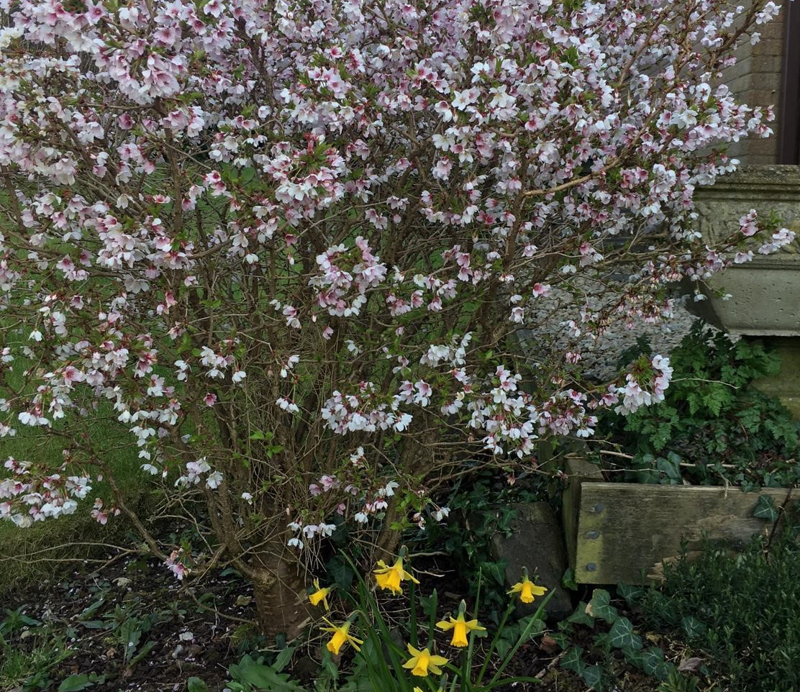
Spring challenge

Slide 3
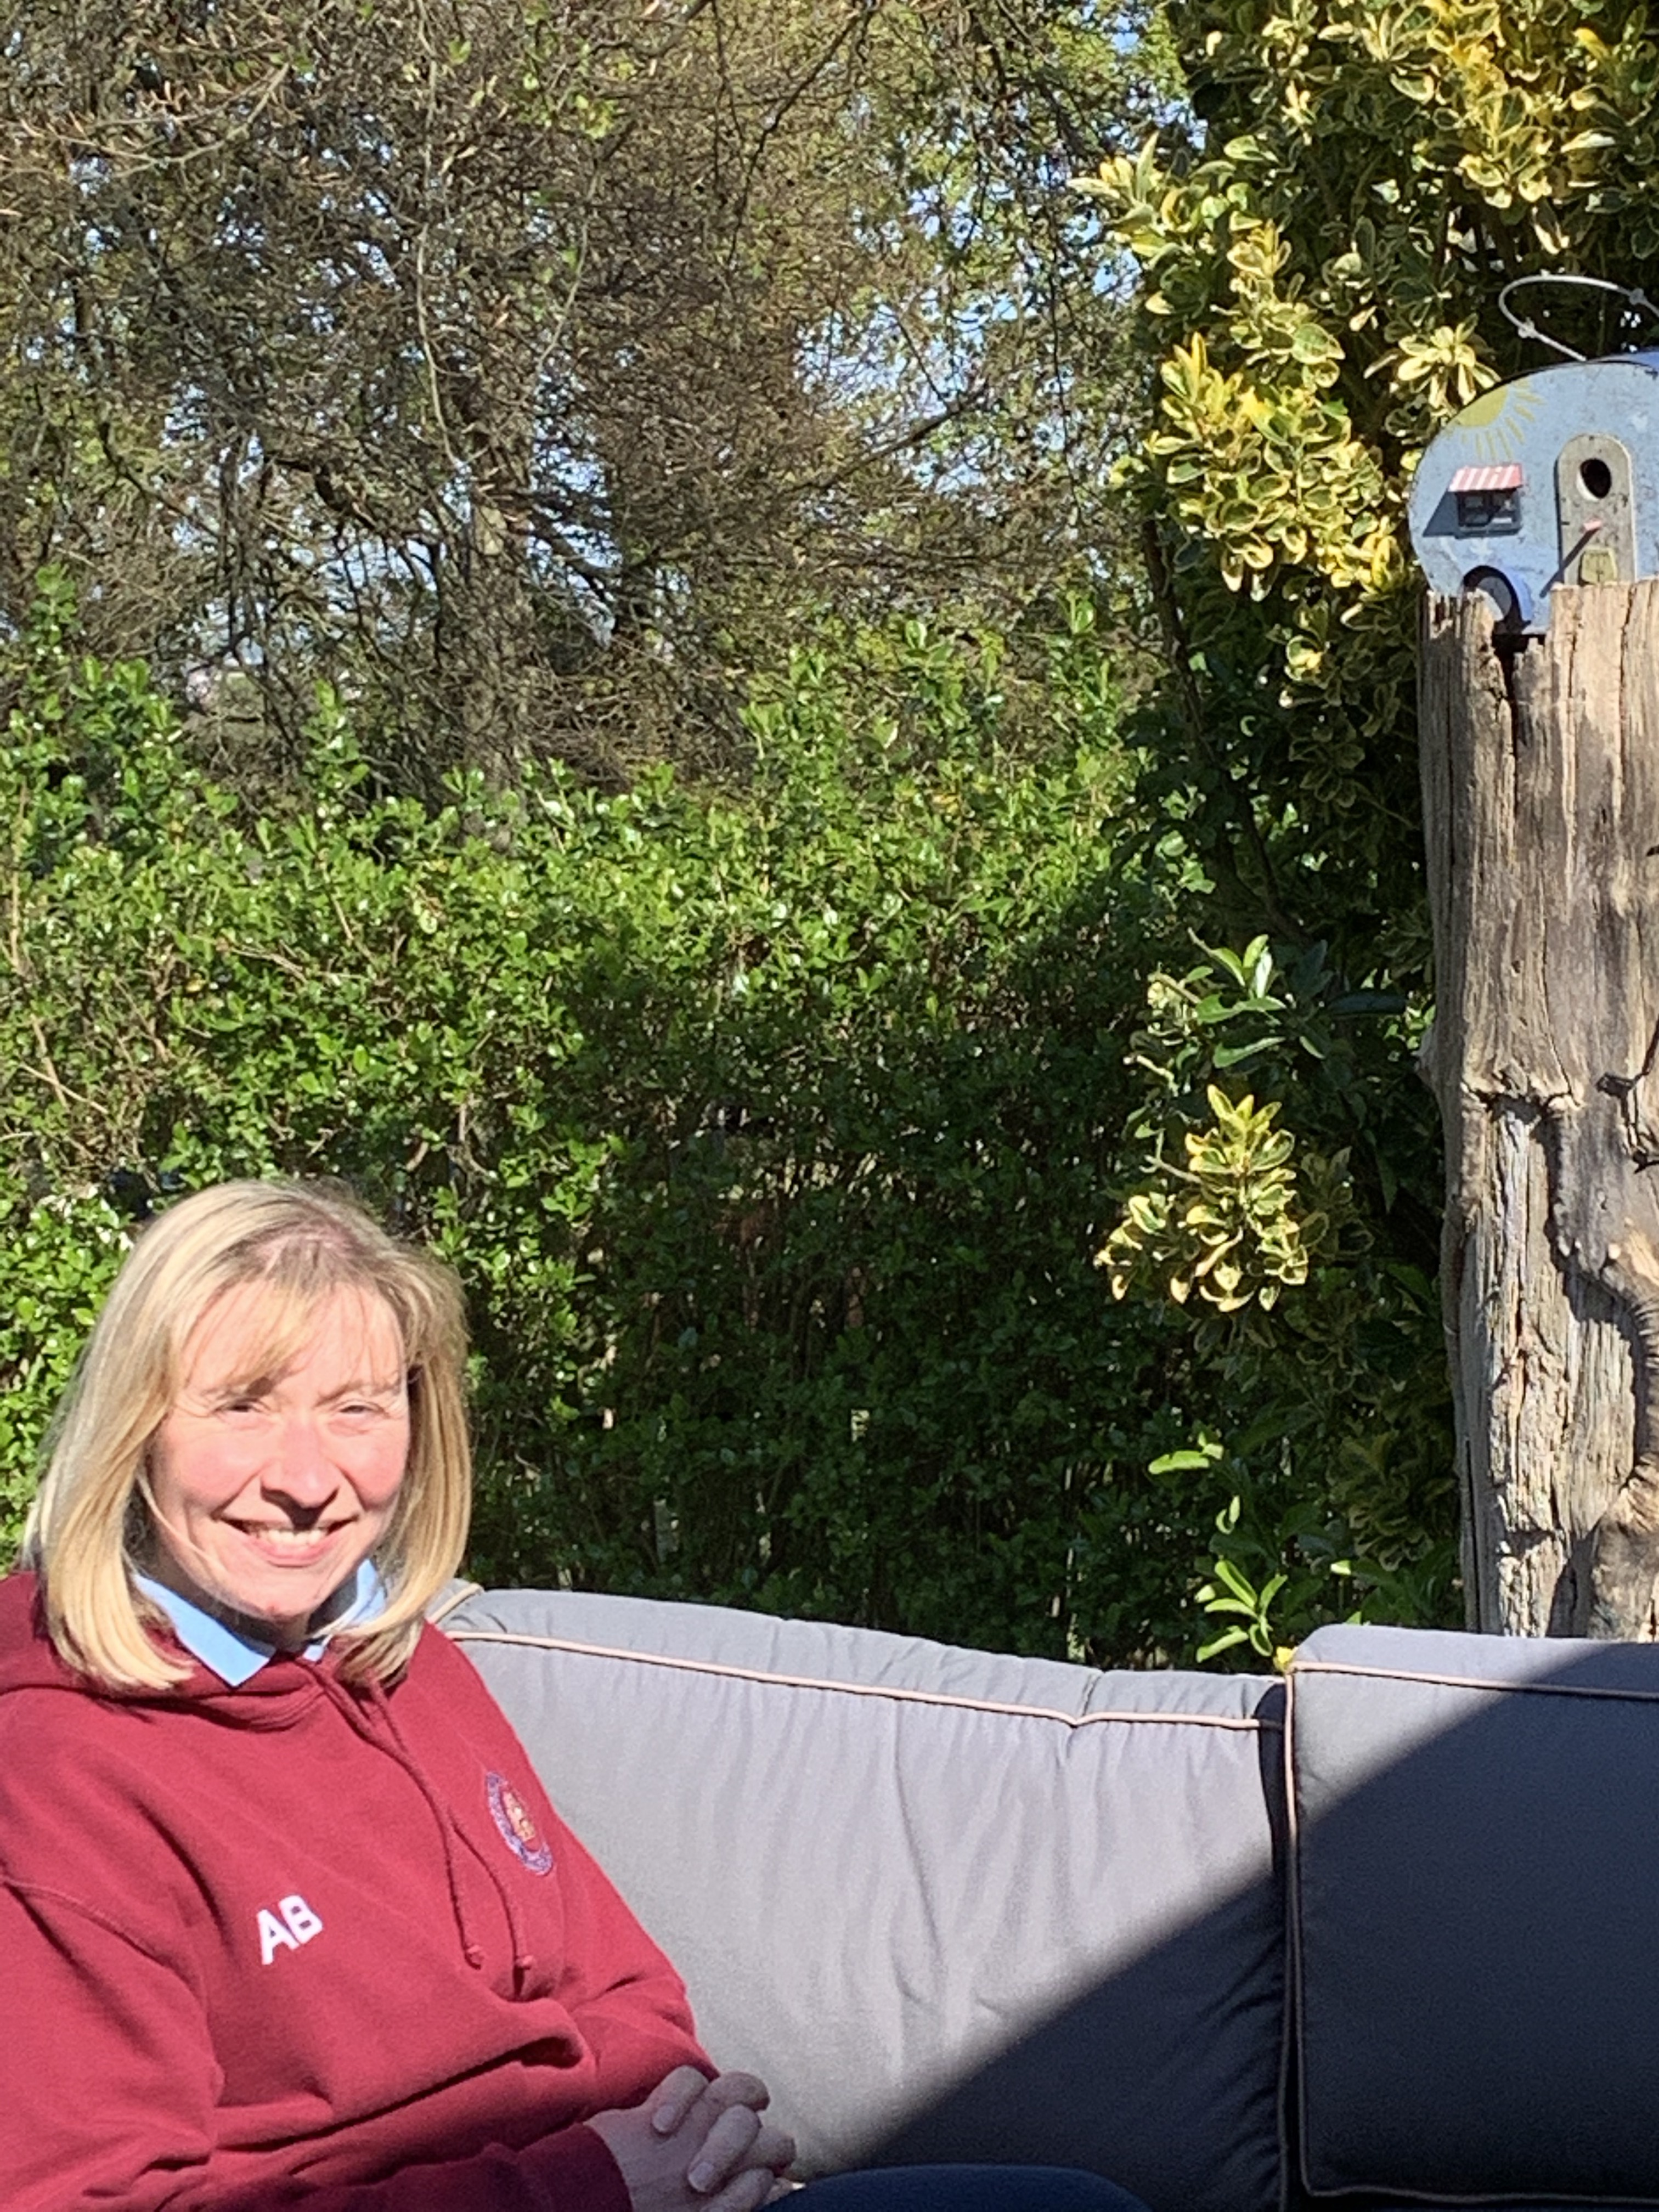
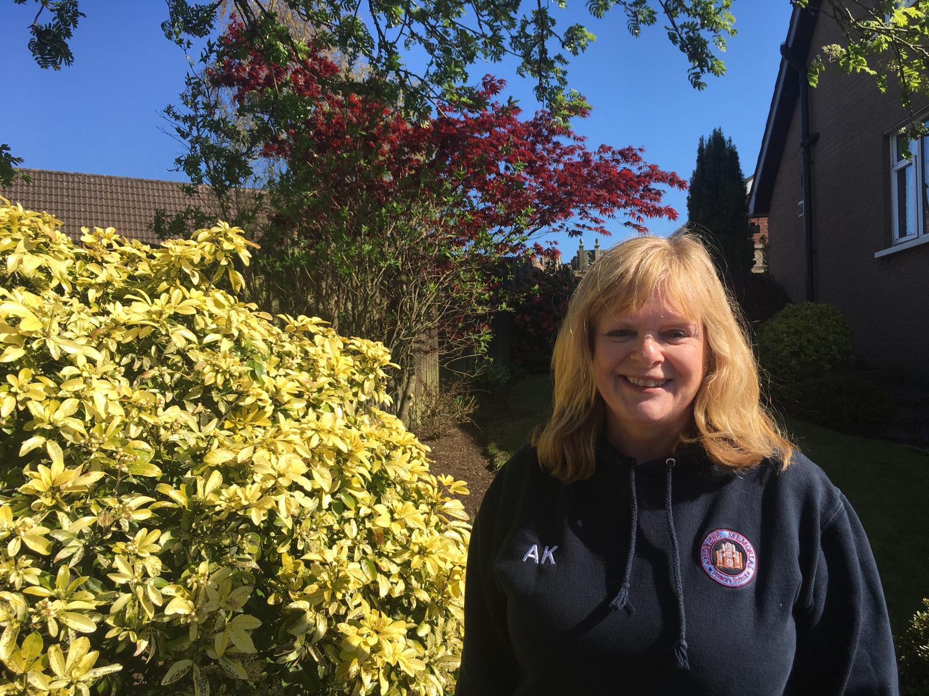
Spring challenge
Hello P1!
Mrs Knaggs and Mrs Bovill have been enjoying the good weather. We hope you have too.
We have spotted lots of signs of Spring in our gardens and on our walks. We have taken lots of photographs. Let’s have some fun with them.
We have set you this Spring Challenge. There are photos to look at and questions to answer.

Slide 4
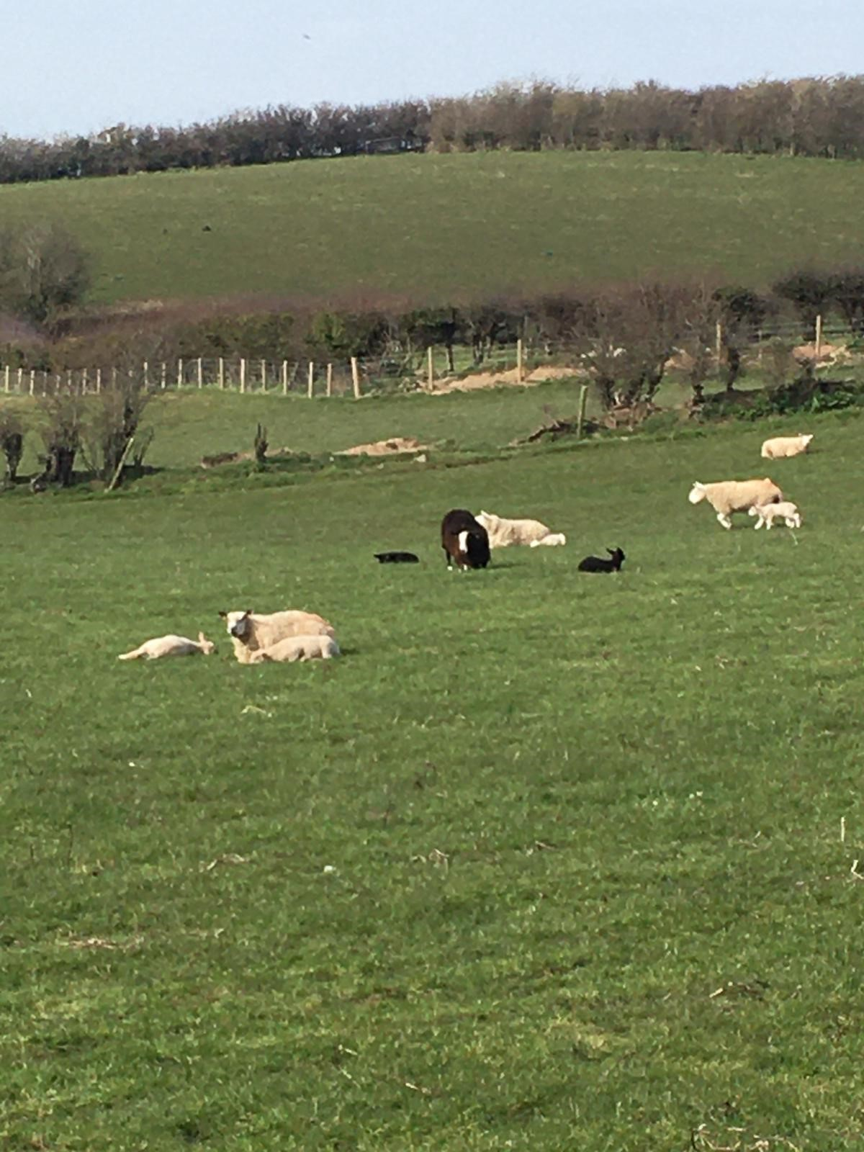
Sheep
How many sheep can you see in the picture?
Can you count how many black sheep there are?
How many white sheep are there?
How many lambs can you see?
🎵 Can you sing Baa Baa Black Sheep to your family? 🎶 🐑

Slide 5
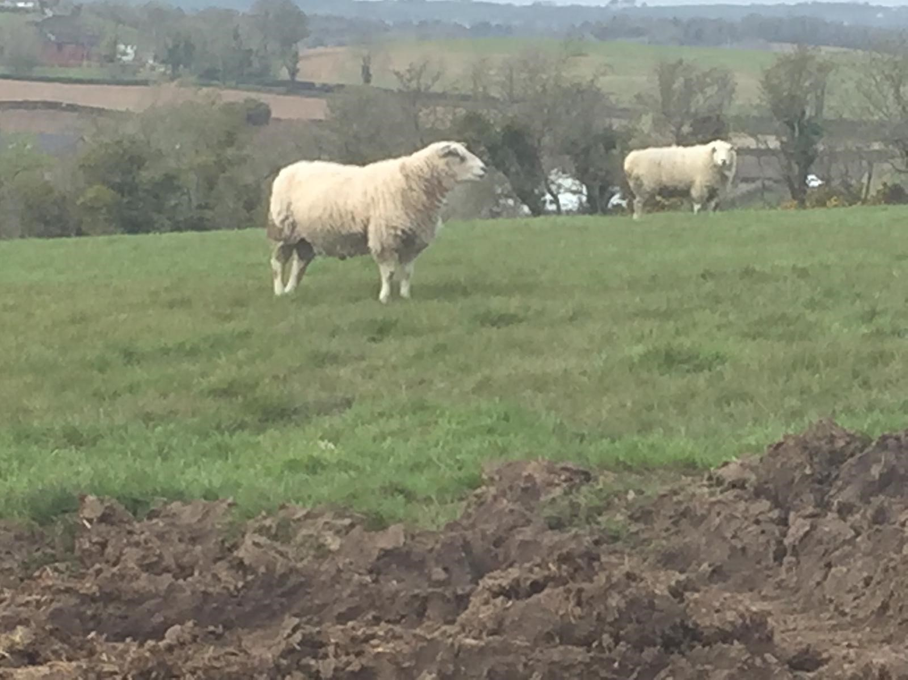
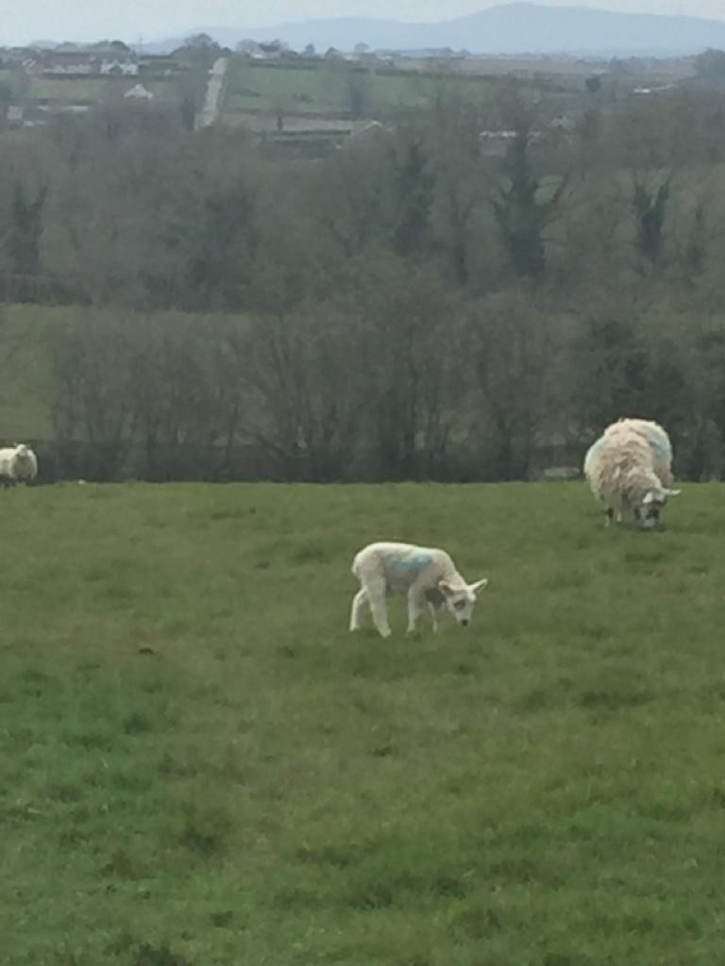
Can you find out three facts about sheep?
(e.g: Sheep have four legs.)
Now draw a picture or write some facts about a sheep.
Can you write: ‘I can see a sheep.’ under your drawing?
Check out the ‘How to draw a sheep sheet.’

Slide 6
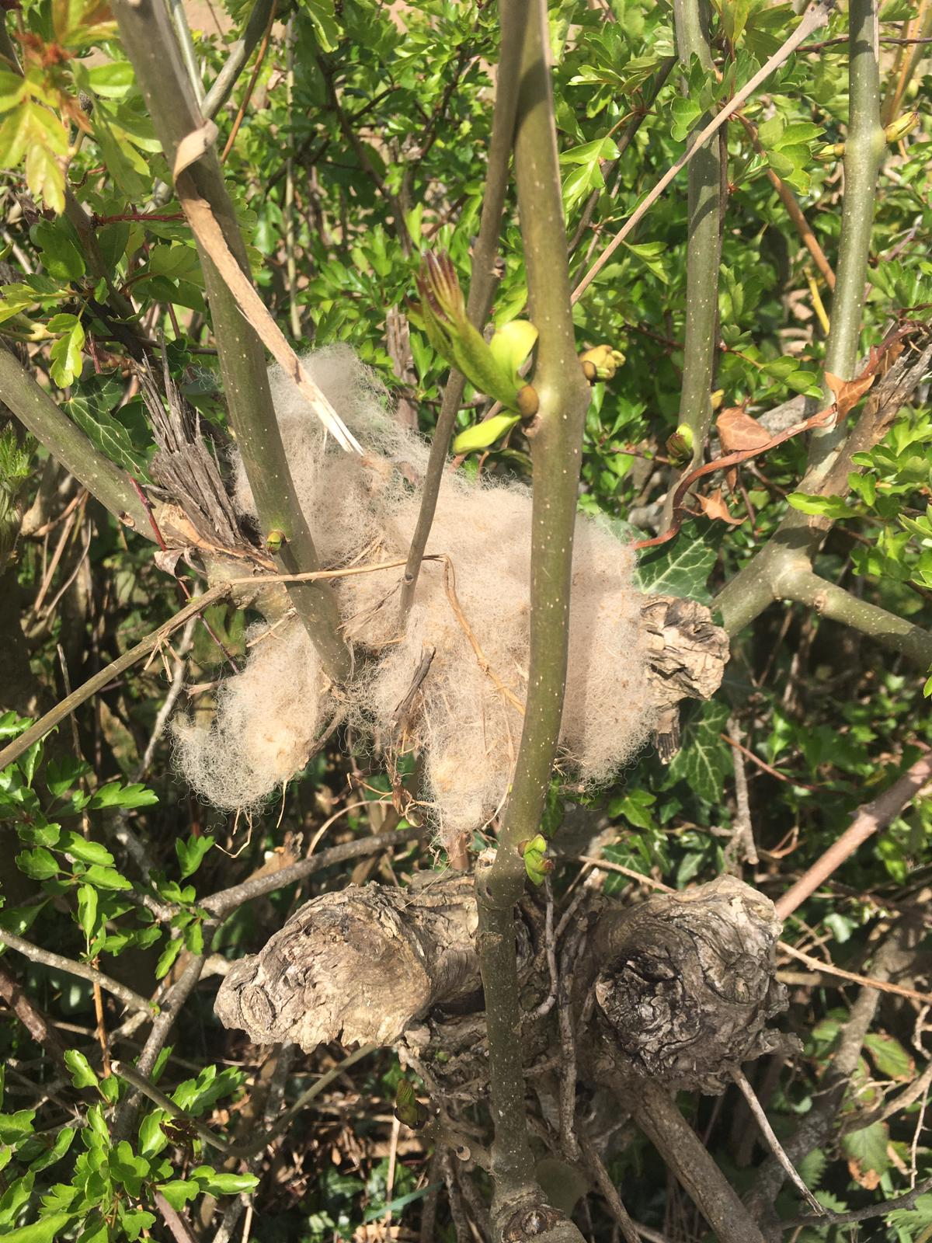
The fleece from a sheep is made into wool. To find out how this happens please watch ‘Come Outside’.
A woolly jumper:
https://youtu.be/41jx0Ljy23A
What do you get if you cross a sheep with a kangaroo?
A woolly jumper! 🤣
Mrs Knaggs found some sheep’s wool caught in the branches when she was on her walk.

Slide 7
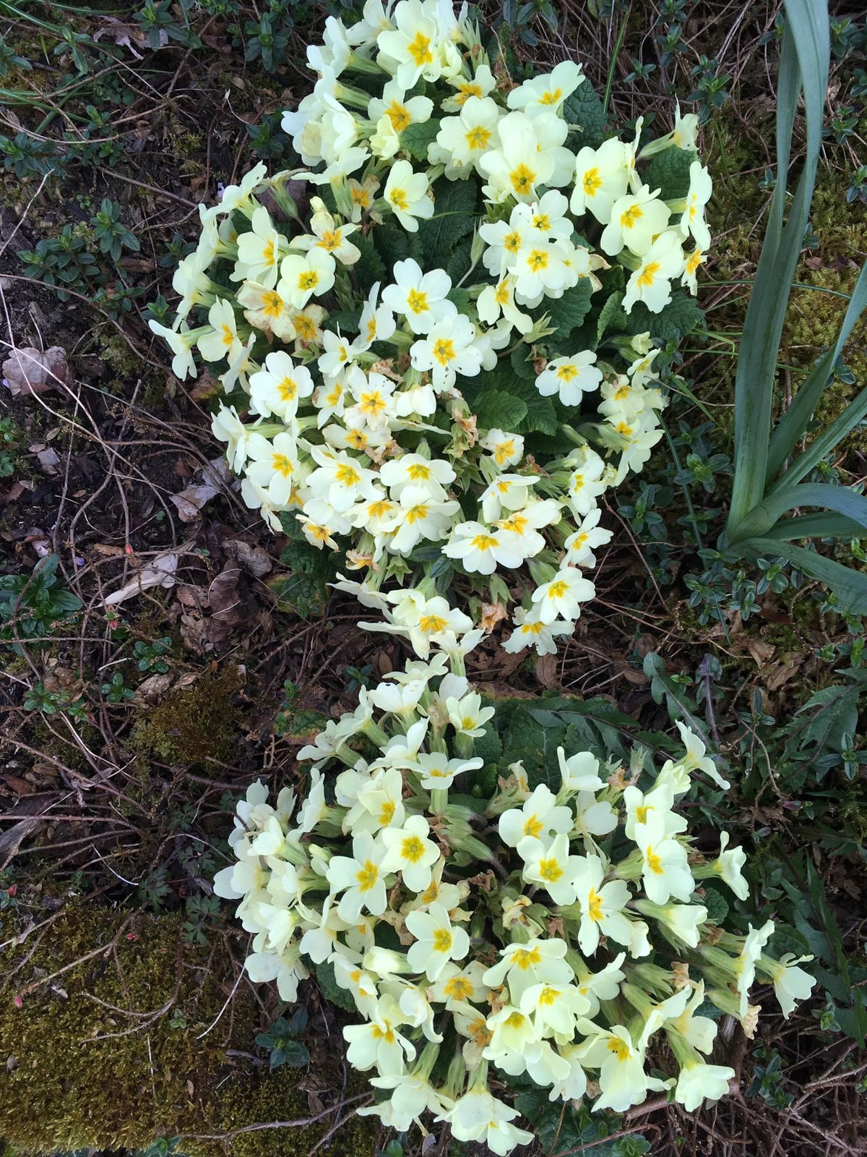
We think that this looks like a number.
Which number shape can you see?
Can you write this number yourself?

Slide 8
Did you guess the right number?
Now watch and enjoy Numbertime with your family.
https://youtu.be/c5vc1-ssBns
Can you draw 8 flowers?

Slide 9
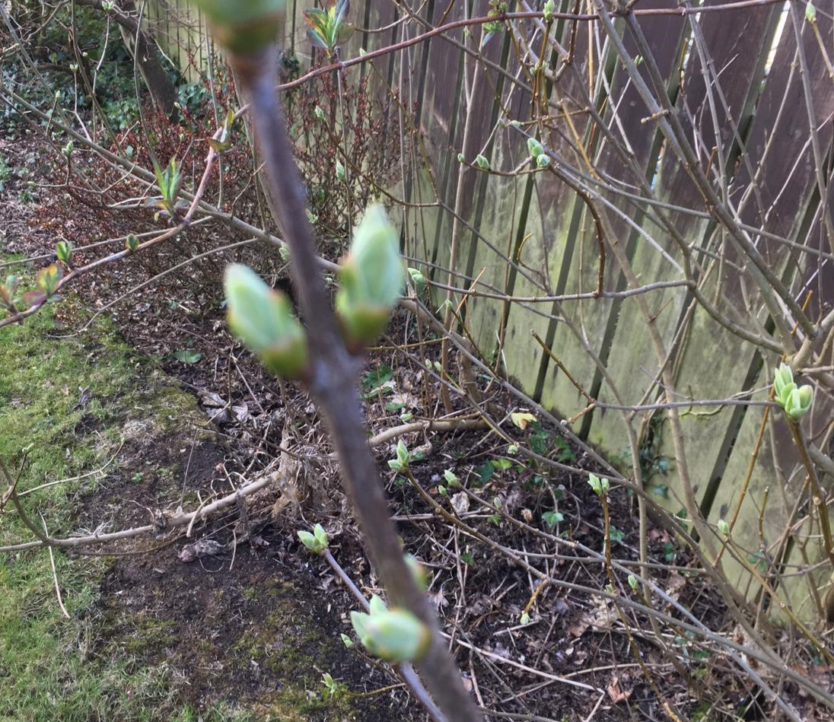
In Mrs Knaggs’ garden there are some new buds beginning to grow on the trees.
When you are in your garden or out on your walk can you find some new buds beginning to grow?

Slide 10
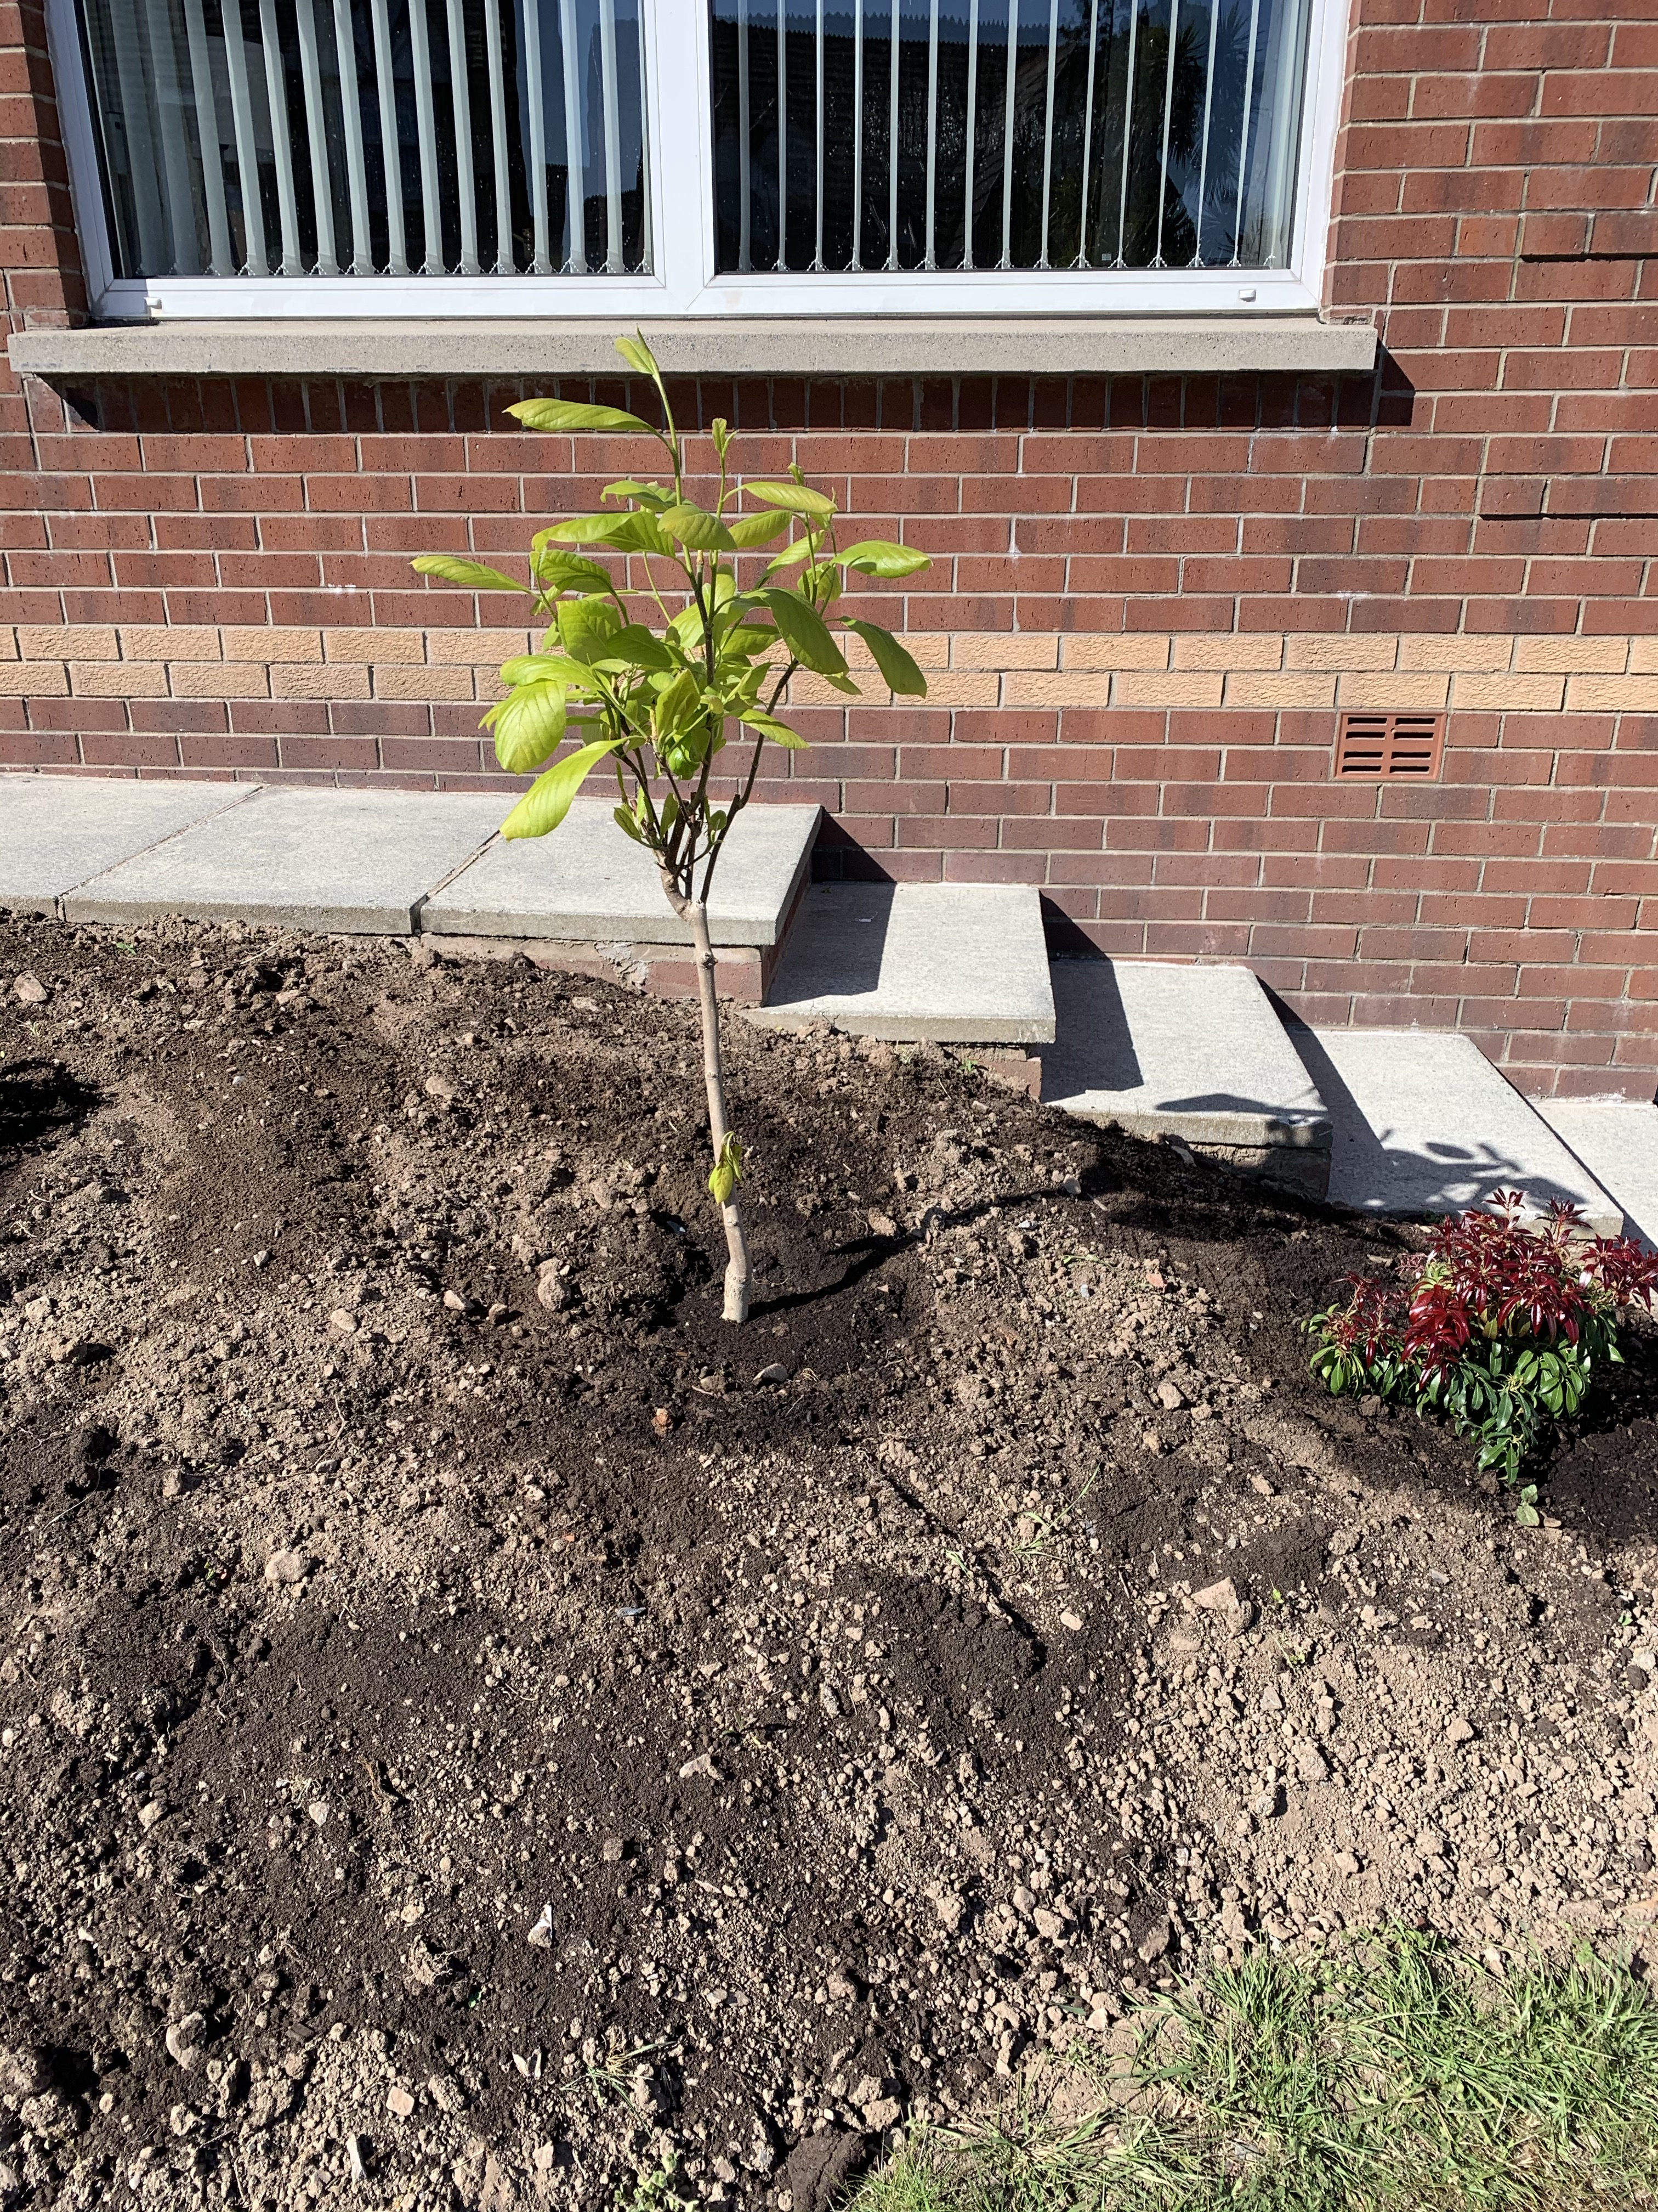
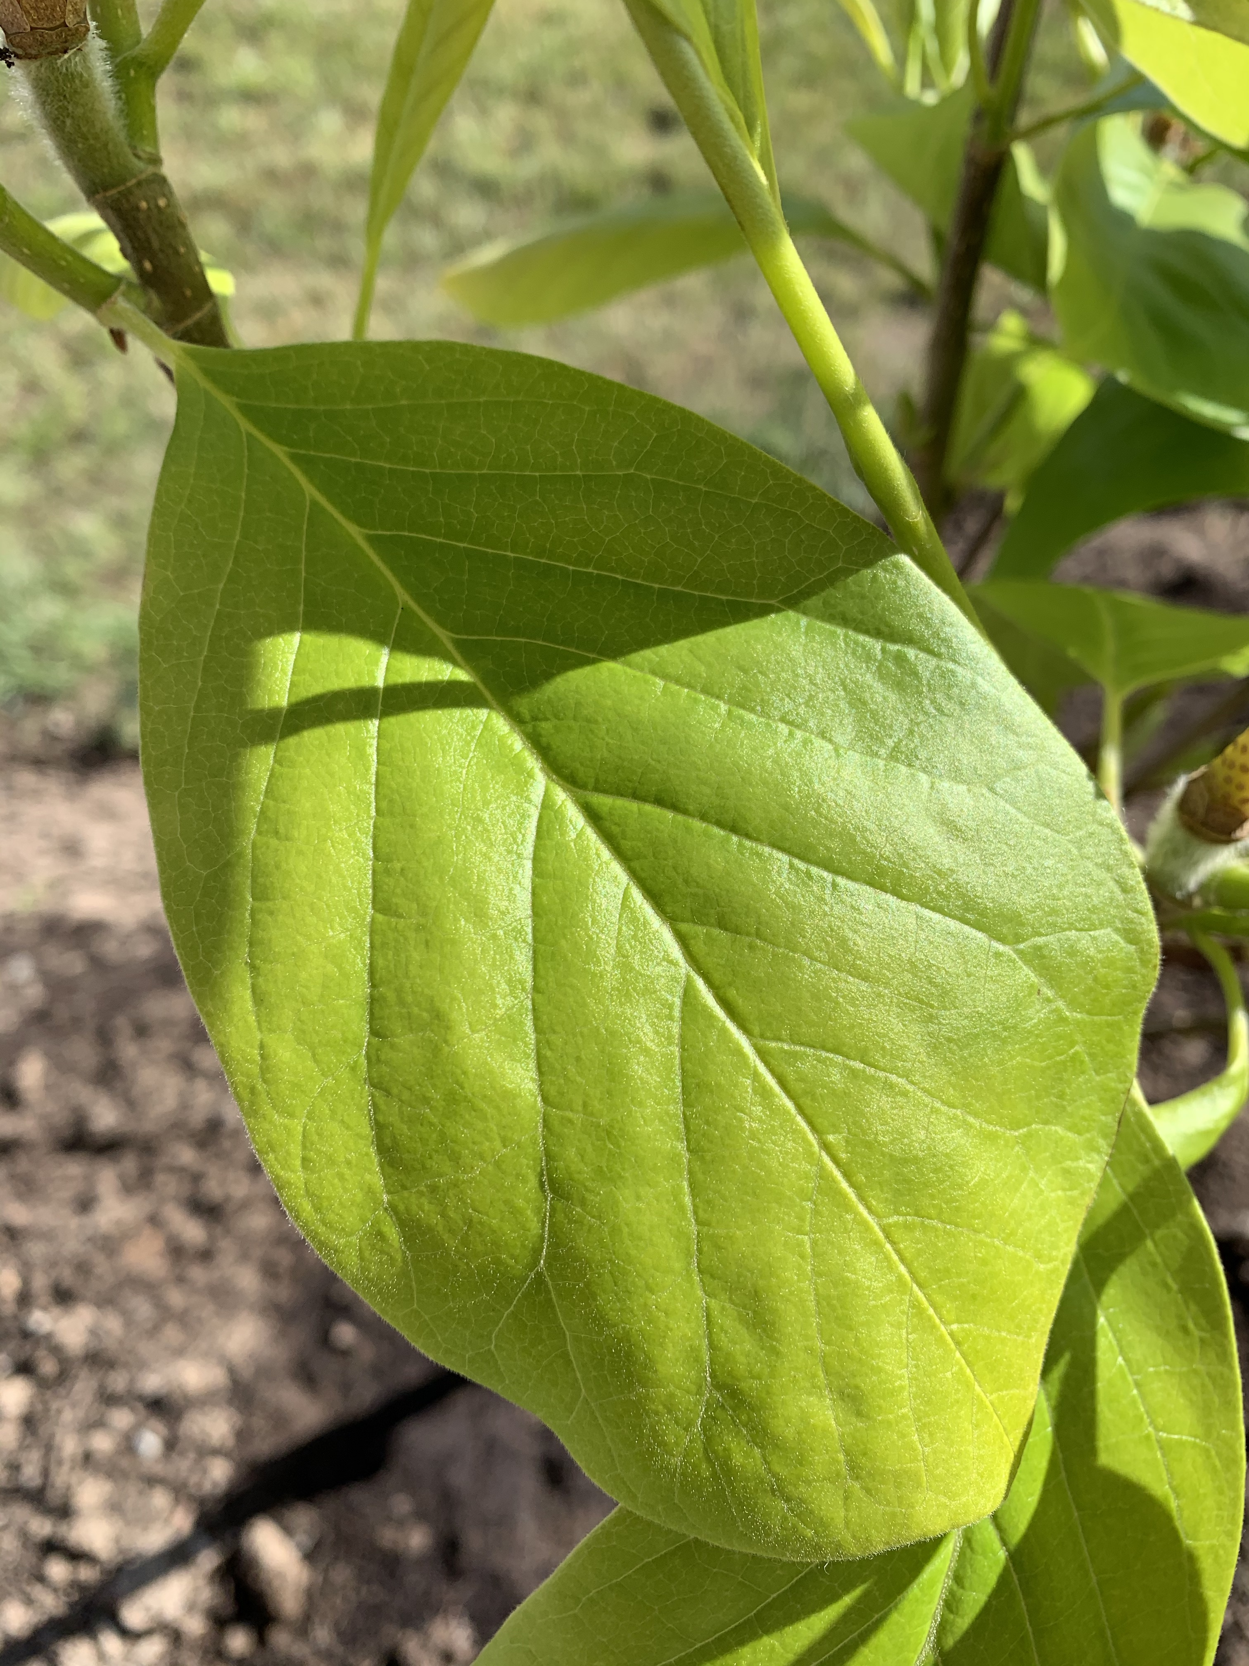
Mrs Bovill was very excited to get a new tree for her garden!
She has taken some pictures. Can you look at the photo very carefully and draw a picture of the leaf?

Slide 11
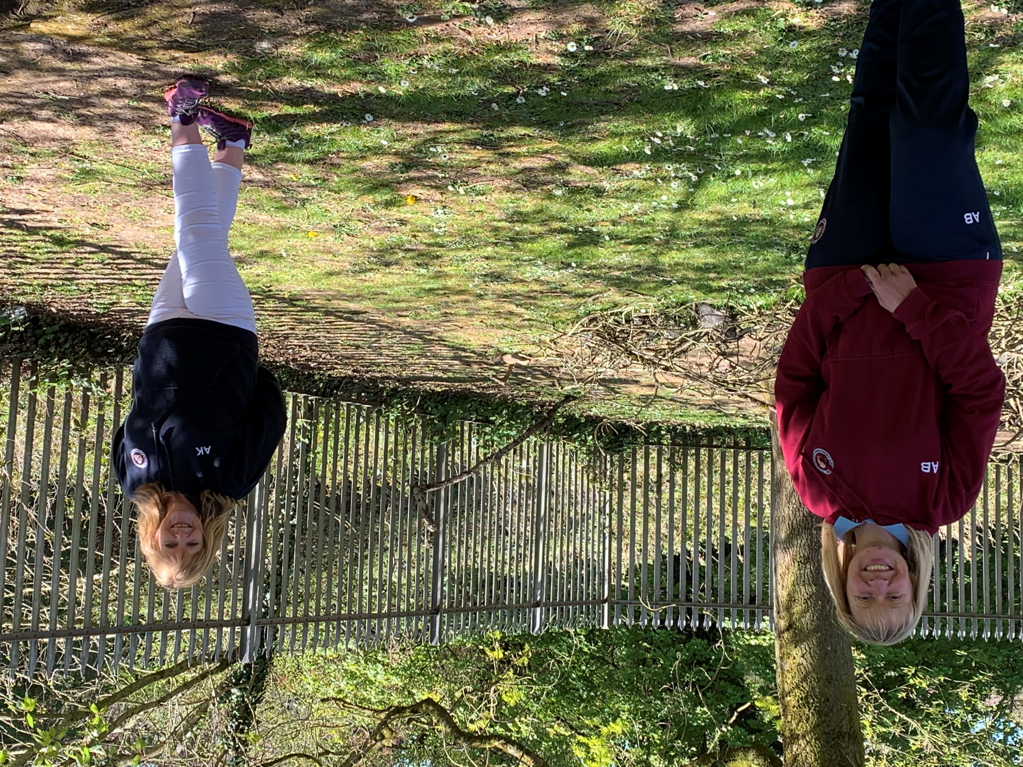
Please use this email address to send us some pictures of your work. Please put your child’s name in the subject field when sending the email.
p1@andrewsmps.com
We can’t wait to see what you have been up to!

